Slide 1
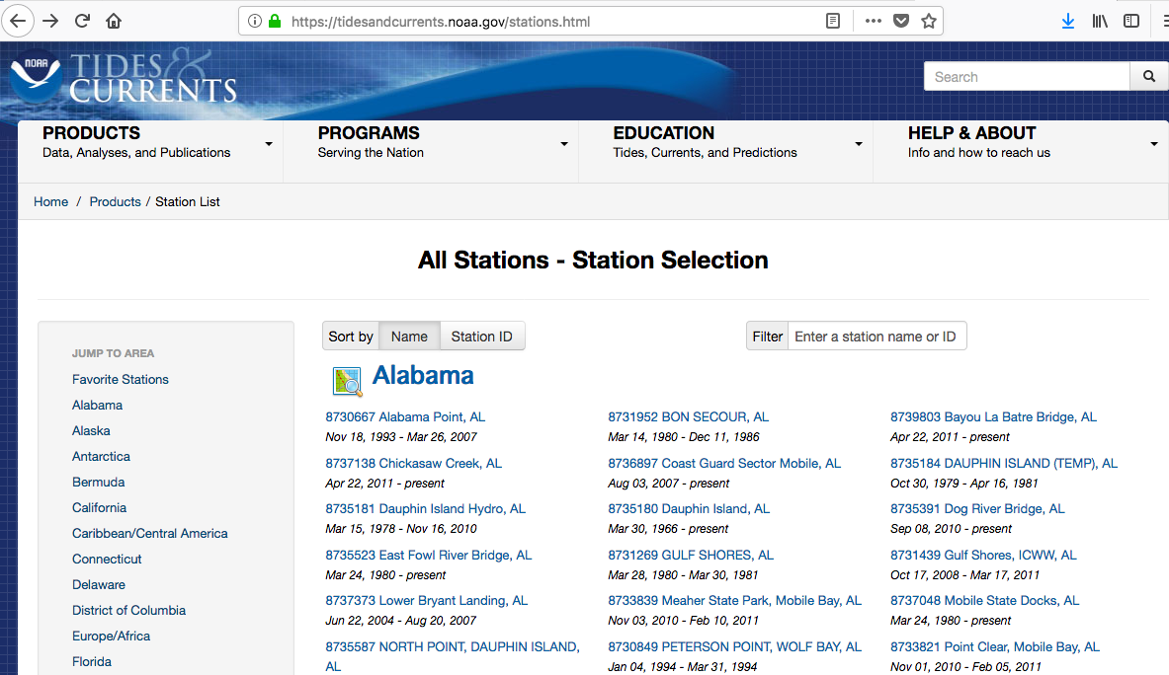
NOAA Water Level Data
https://tidesandcurrents.noaa.gov/stations.html
Select station of intereest

Slide 2
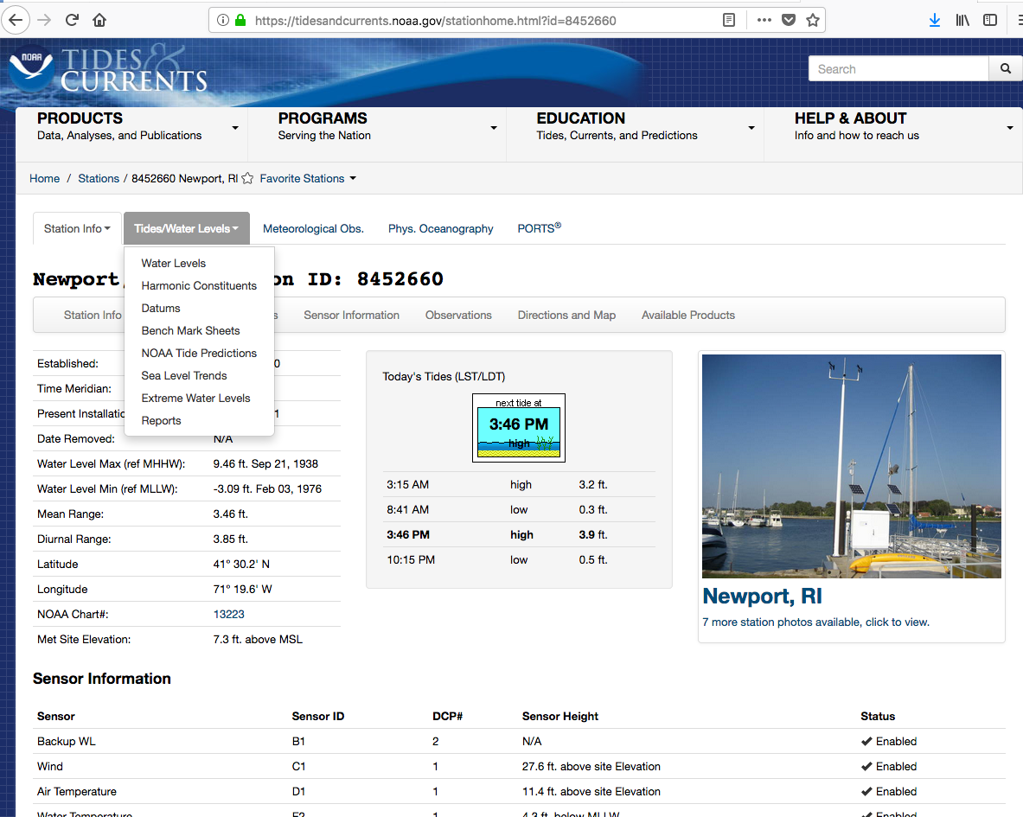
NOAA Water Level Data
Use Tides/Water Levels pulldown to select Water Levels

Slide 3
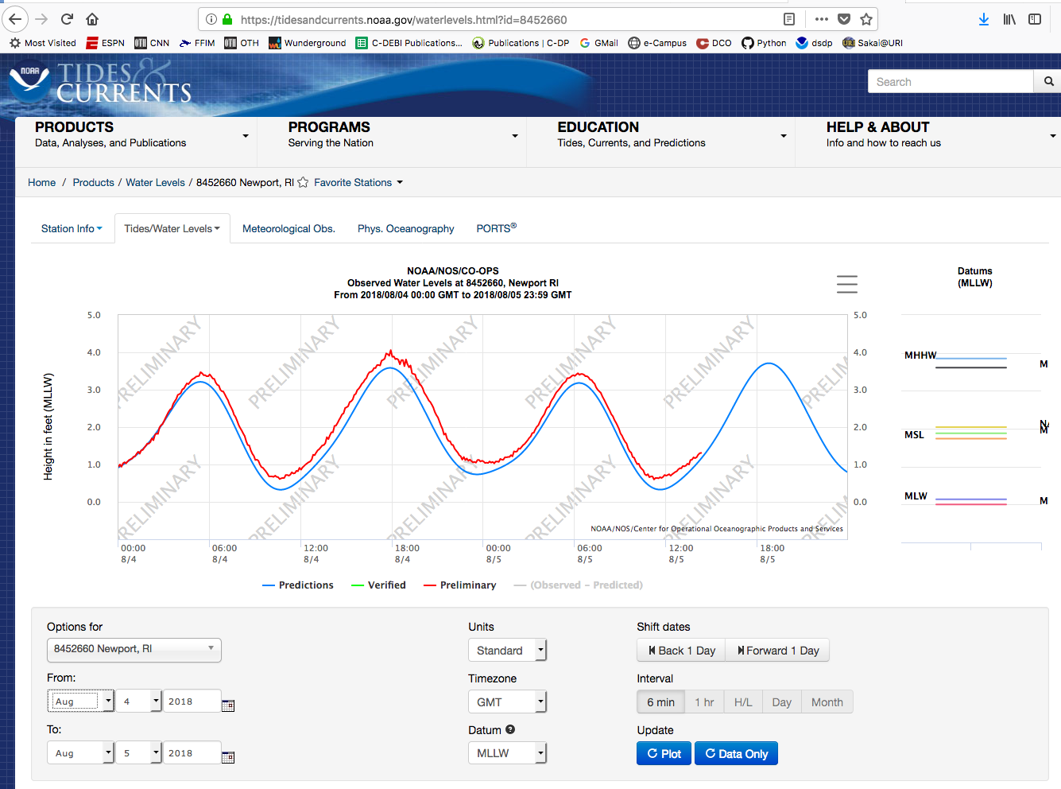
NOAA Water Level Data

Slide 4
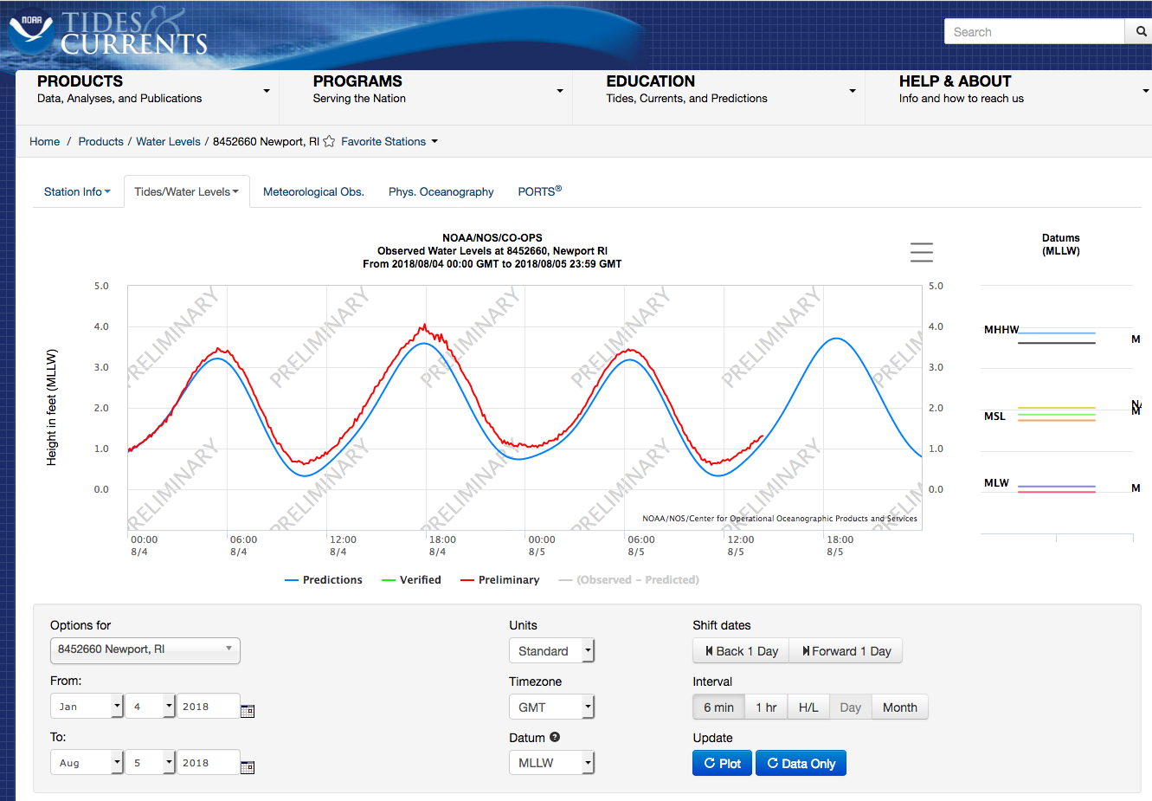
NOAA Water Level Data
Change Month to “Jan”
Click “Month”

Slide 5
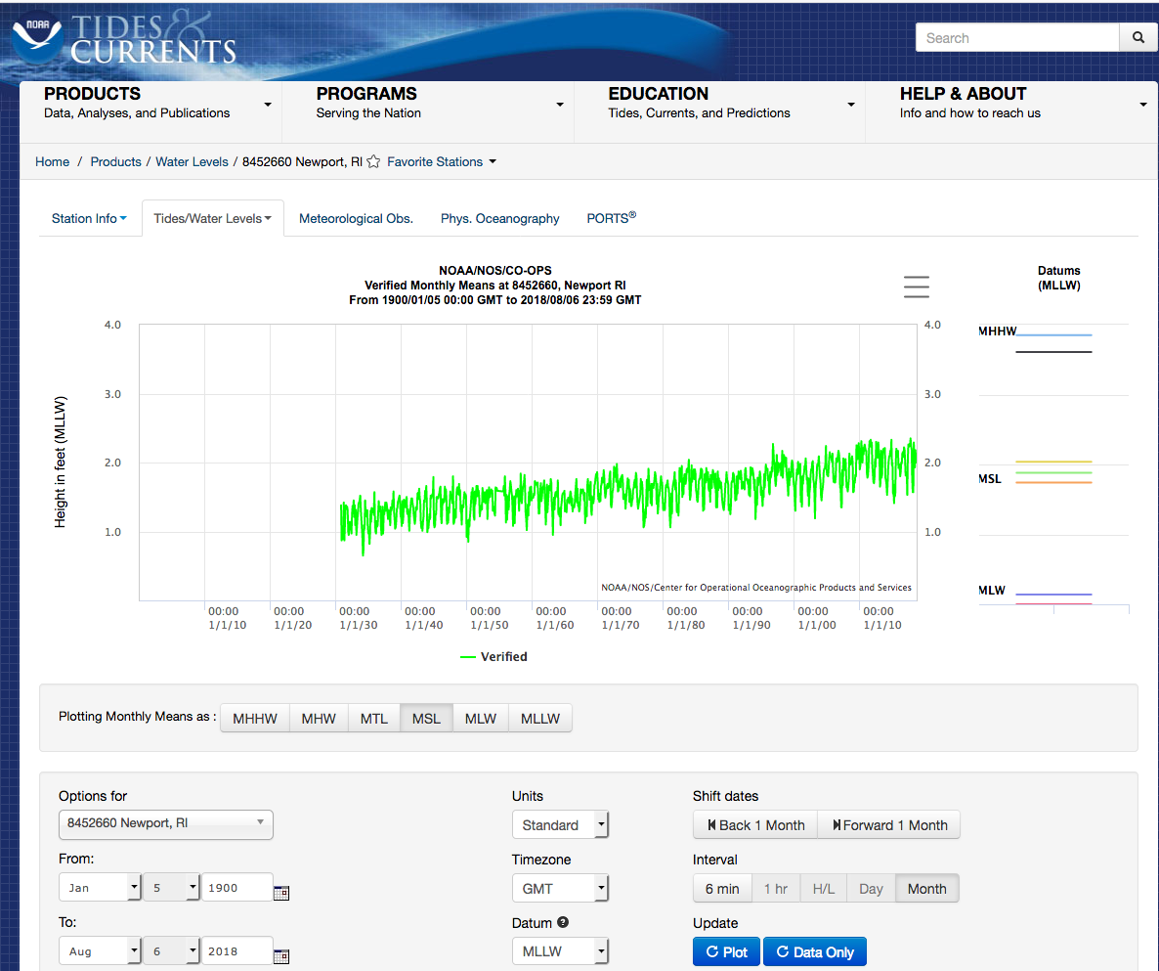
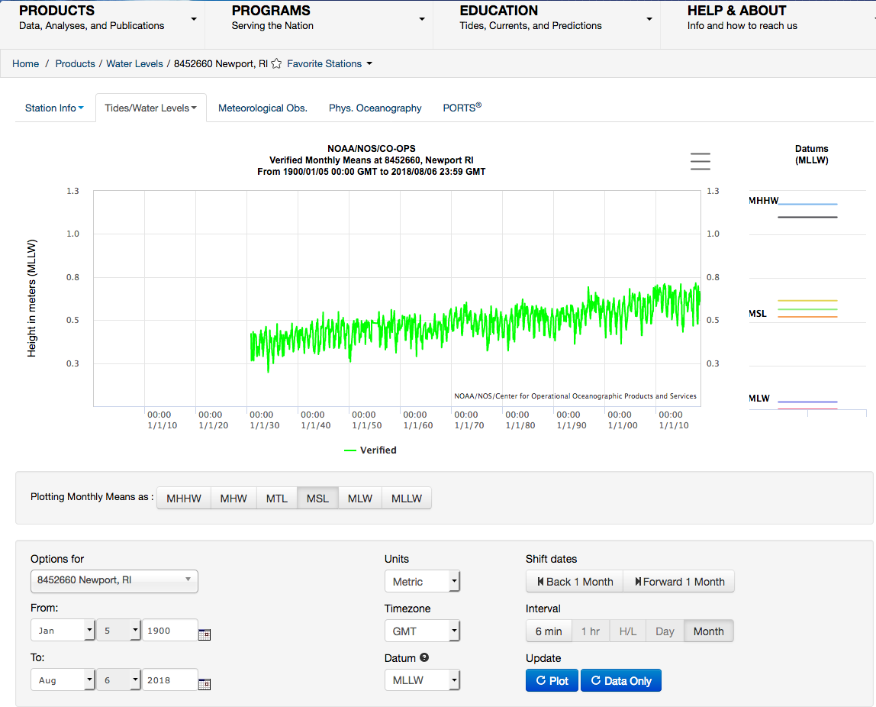
NOAA Water Level Data
Change to “1900”
Click “Plot”
Click “Data Only”

Slide 6
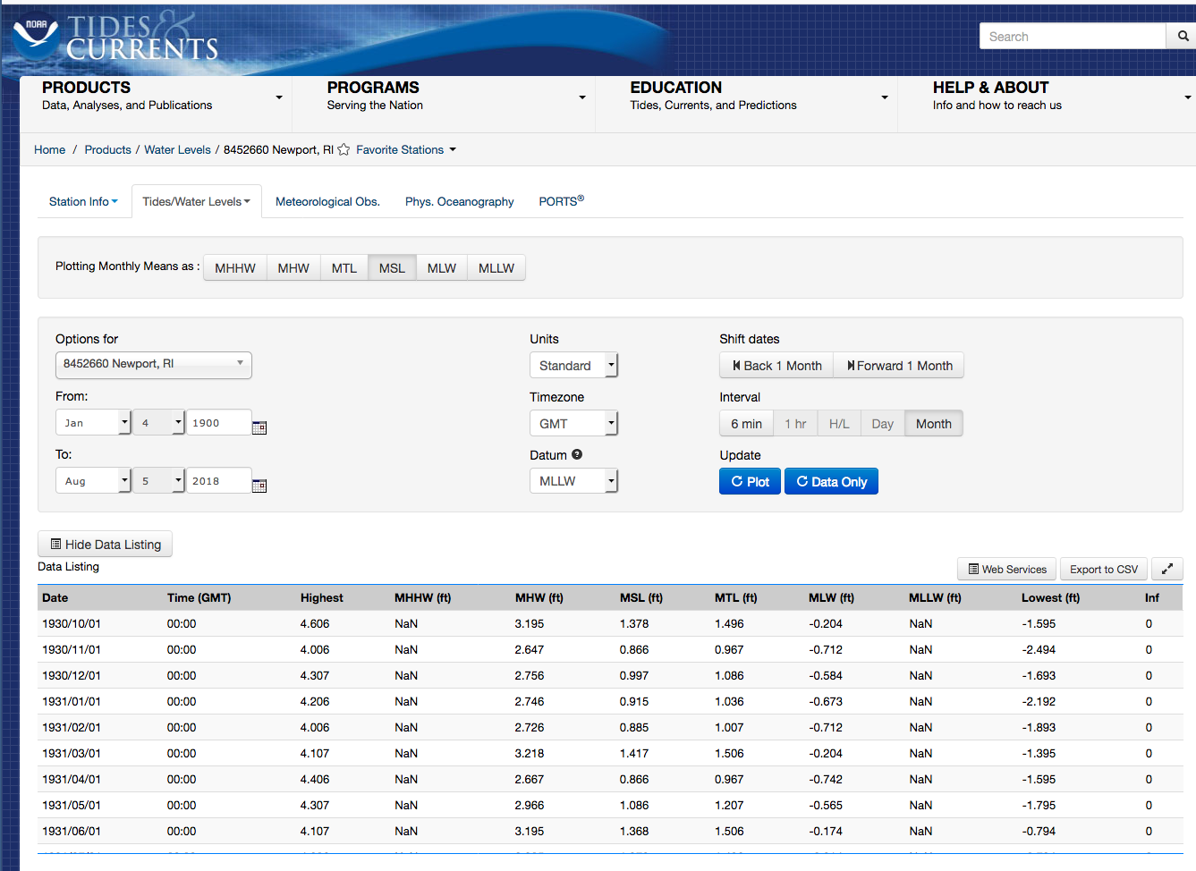
NOAA Water Level Data
Click “Export to CSV”

