Slide 1
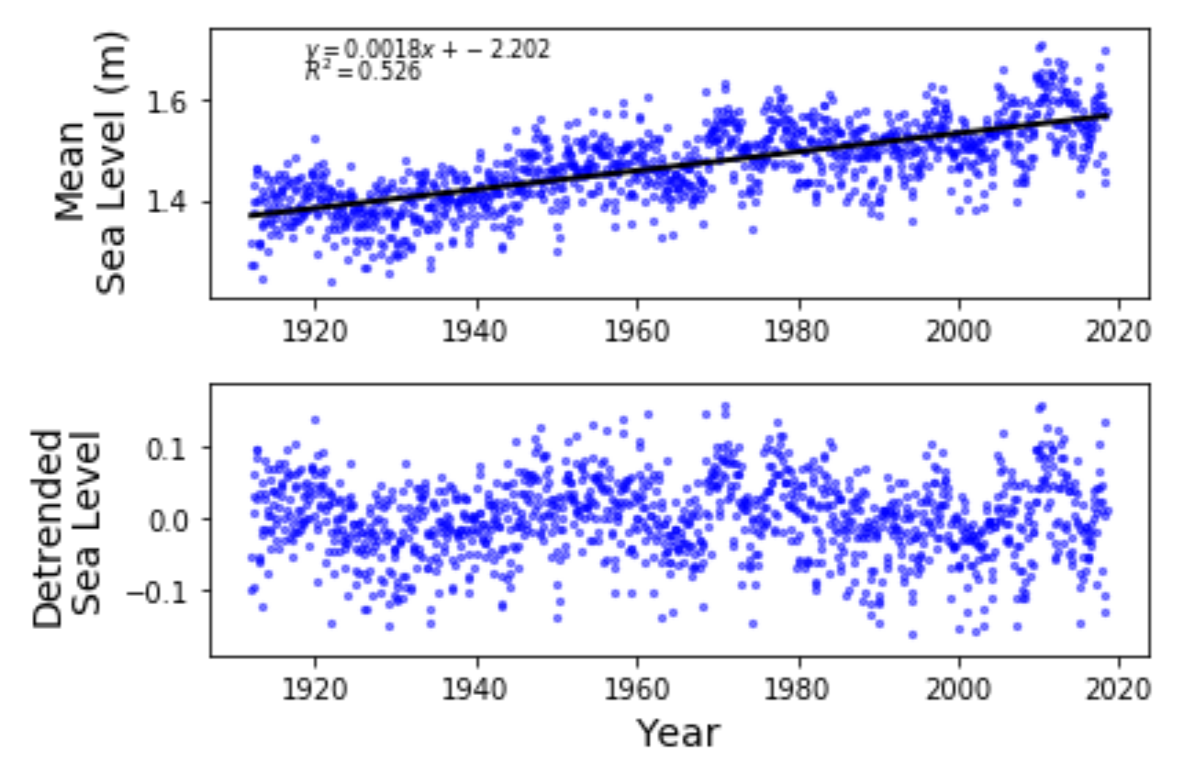
Introduction to Jupyter Notebooks and Python Programming
Jupyter Notebooks
- download, install & launch
Python Code
- download, decompress & run
Jupyter Notebook attributes
First basic script
More advanced scripts
Python tutorials
DCO Webinars
Portland, Maine
Rob Pockalny
Graduate School of Oceanography
University of Rhode Island

Slide 2
Rules/Philosophy of Workshop
2
Attributes of a Programmer
impatience
hubris
laziness
Patience with each other and assistants (ironic huh?)
Peer-to-peer assistance is very much welcomed
I am not an expert with Jupyter Notebooks or Python
Please seek assistance online or from each other
TIMTOWDI
- There Is More Than One Way To Do It

Slide 3
Jupyter Notebooks - download, install & launch
3
System requirements
32- or 64-bit computer
Minimum 3 GB disk space to download and install
Windows, macOS or Linux
Web browser (e.g., Safari, Firefox)
Download Jupyter Notebook installer
https://www.anaconda.com/download/

Slide 4
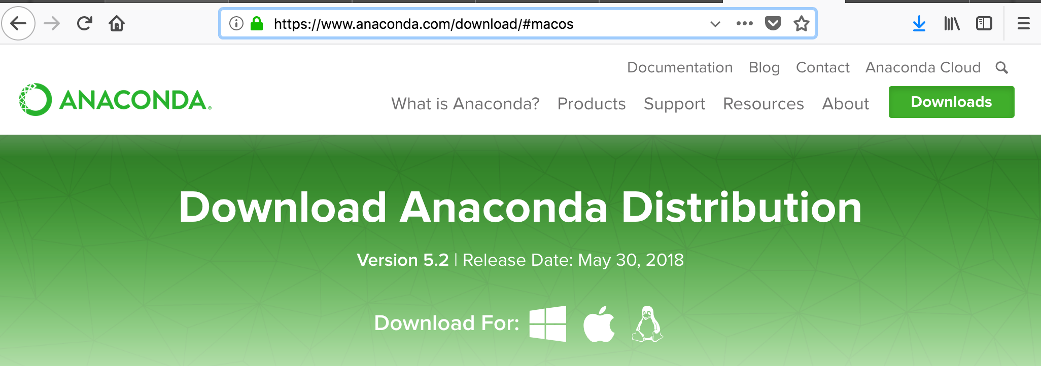
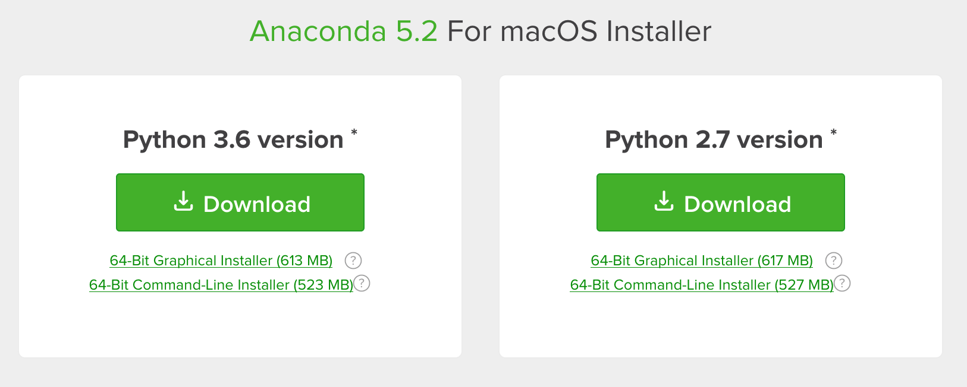
Jupyter Notebooks - download, install & launch
4
Select operating system
Select Python 3.6

Slide 5
Jupyter Notebooks - download, install & launch
5
Install package will download
Anaconda3-5.2.0-MacOSX-x86_64.pkg
Use installation wizard to install
- automatic or double-click
Make note of folder/directory location of install site
Go to application
for MacOS, in “Applications” folder
for PCs
Double-click “Anaconda-Navigator” application icon to open

Slide 6
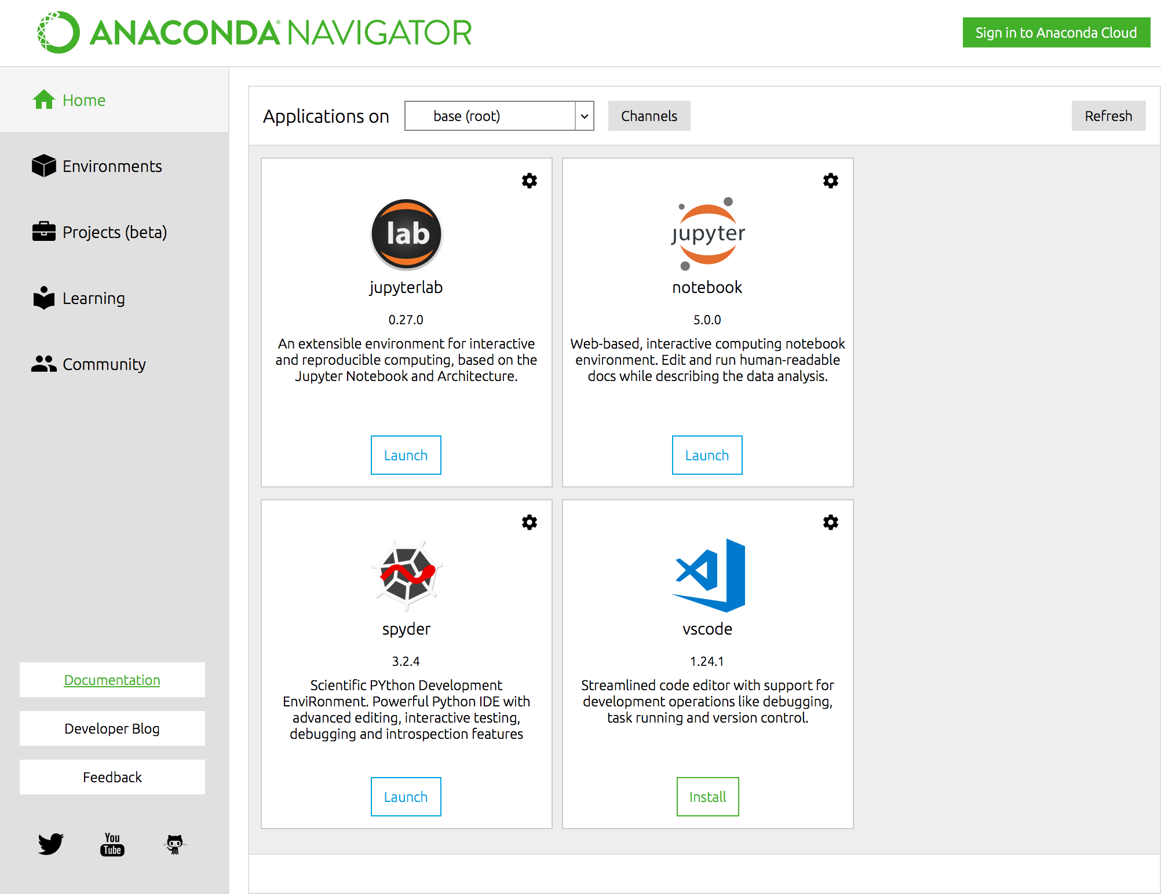
Jupyter Notebooks - download, install & launch
6
Click “Launch” to open

Slide 7
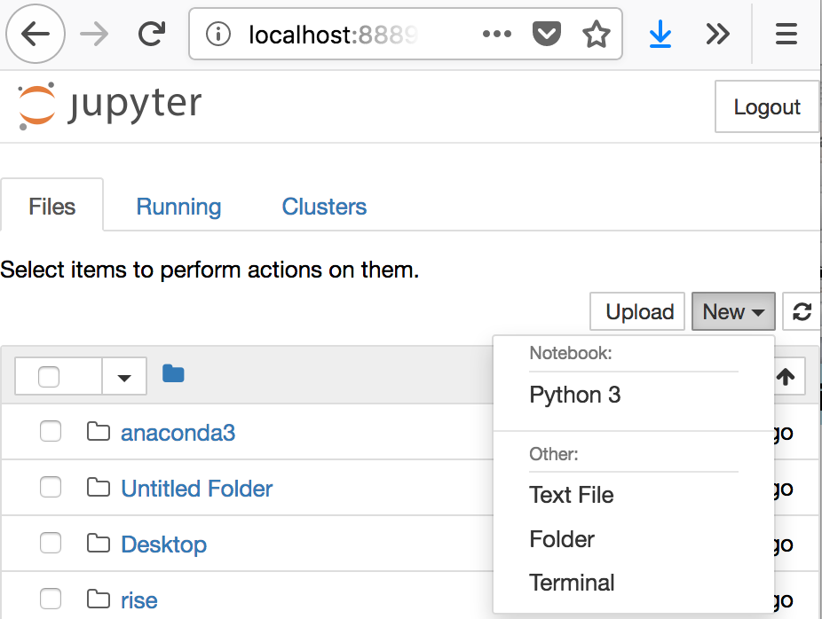
Jupyter Notebooks - download, install & launch
7
Create a Working Folder
Opens to home directory
1) Select “New”
2) Select Folder
3) New “Untitled Folder” is created
1
3
2

Slide 8
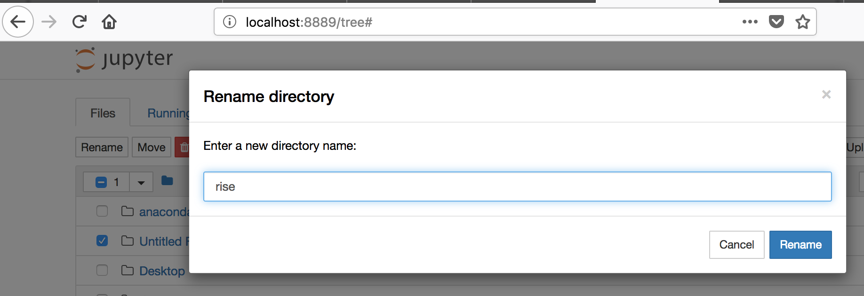
Jupyter Notebooks - download, install & launch
8
Rename Folder
1) Check box next to
“Untitled Folder”
2) Click “Rename”
3) Enter name of new folder “snakes” ….or whatever
2
3
snakes
1

Slide 9
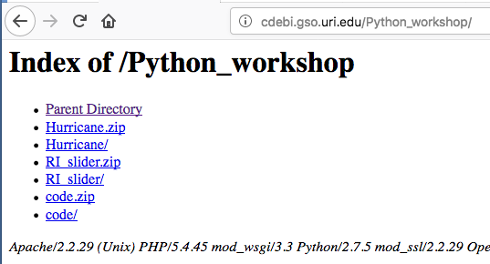
Python Code - download, decompress & run
9
Get Python Code file
Download “code.zip” file
cdebi.gso.uri.edu/Python_workshop/code.zip
Move code.zip file to your preferred location/directory
- if file auto-unpacks, move “code” folder to preferred location
Unzip/decompress file (double-click icon)

Slide 10
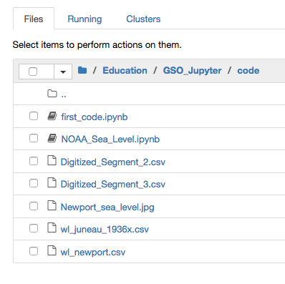
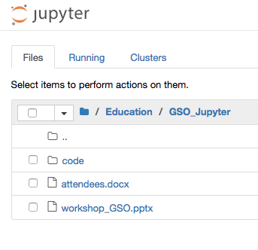
Python Code - download, decompress & run
10
Locate “code” folder
Go to Jupyter Notebooks
Click on “code” folder to open

Slide 11
Python Code - download, decompress & run
11
Open test code
Click on “first_code.ipynb” file
ipynb => iPython Notebook

Slide 12
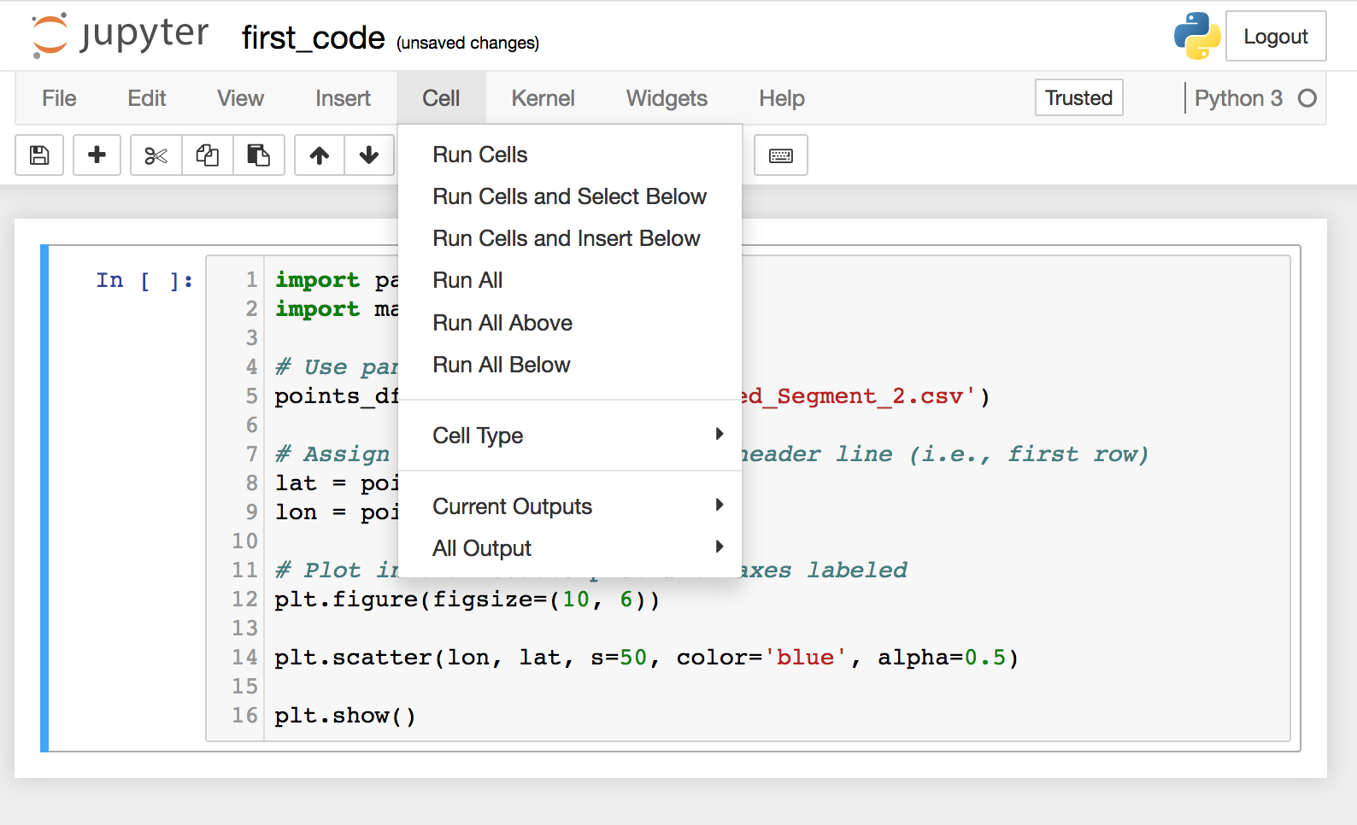
Python Code - download, decompress & run
12
Run test code
1) Click on “Cell” on menubar
2) Select “Run All” from drop-down menu
Cross fingers
1
2

Slide 13
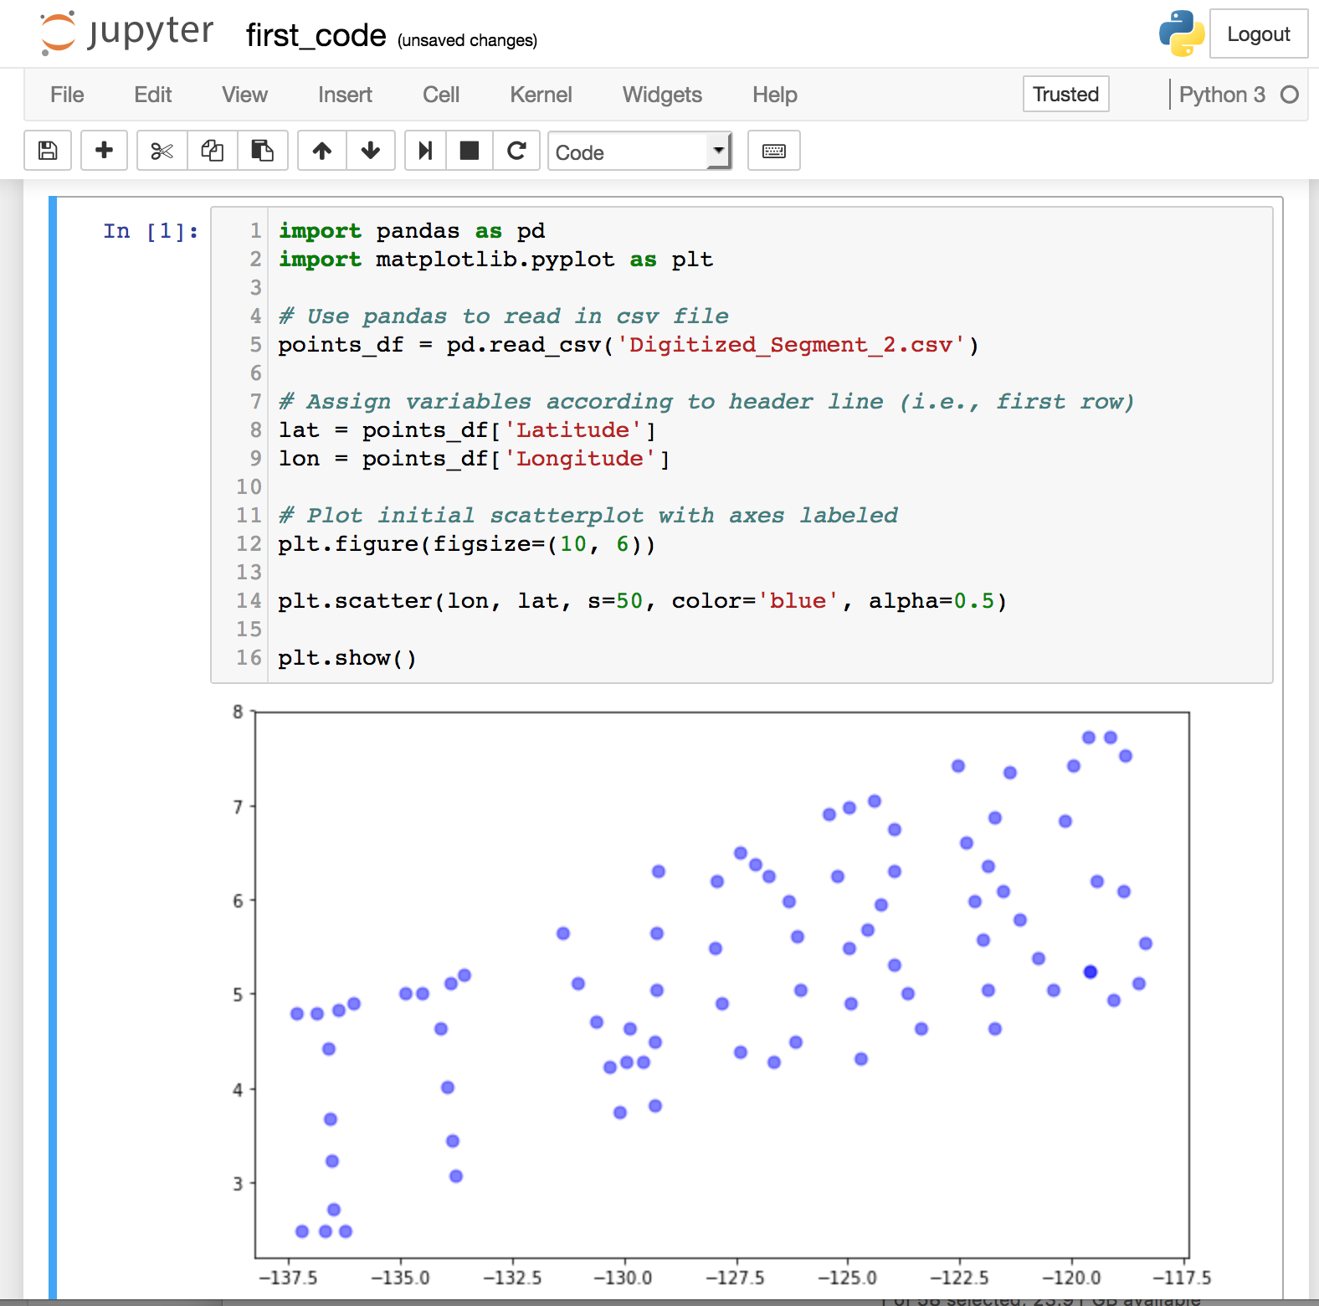
Python Code - download, decompress & run
13
Success?????

Slide 14
Python Code - download, decompress & run
14
Quick Dissection
Import Libraries
Read Datafile
Assign Variables
Create Plot
Instant
Gratification

Slide 15
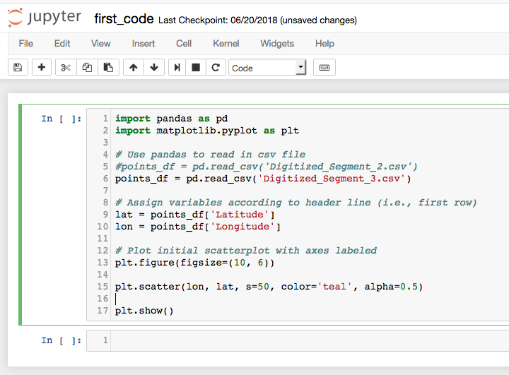
Python Code - download, decompress & run
15
Plot other CSV file
by removing #

Slide 16
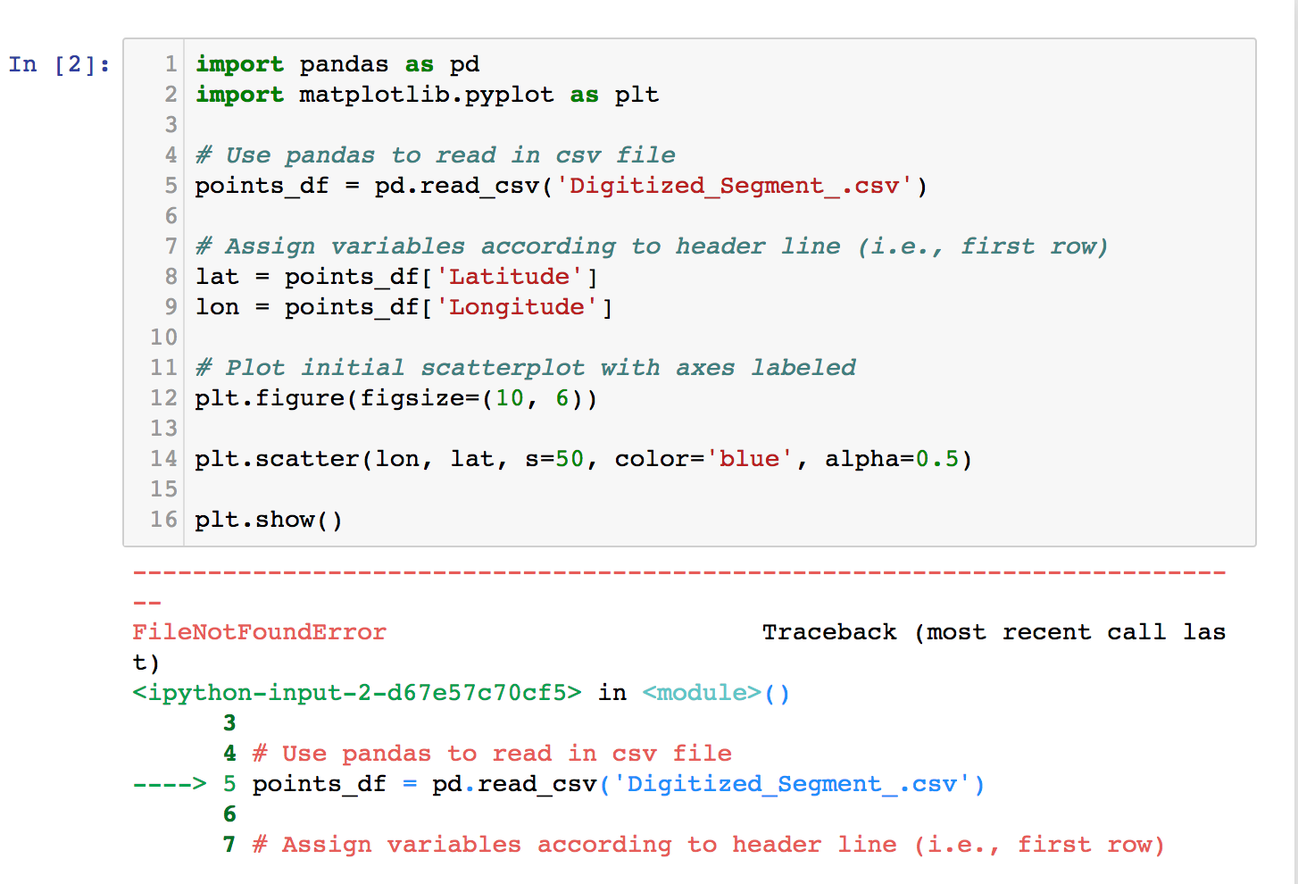
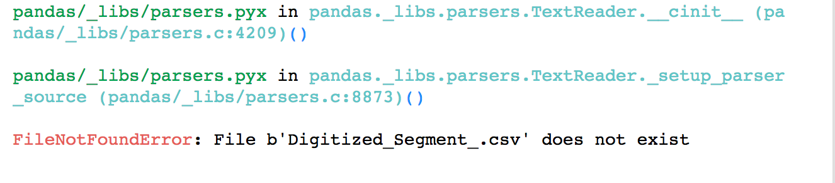
Python Code - download, decompress & run
16
Errors!!!
Misspelled filename
Cause of error
Location of error
Details of cause

Slide 17
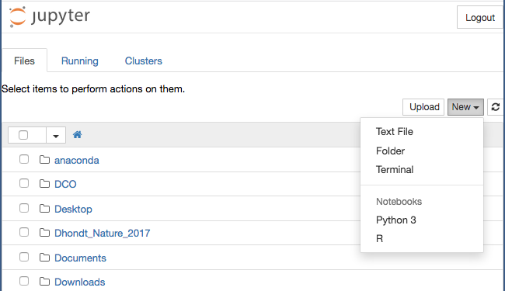
Jupyter Notebooks - attributes
17
Jupyter dashboard (home)
file “manager”
File Type
List by Type

Slide 18
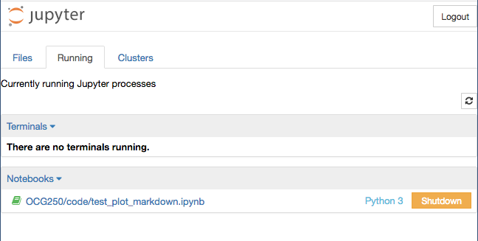
Jupyter Notebooks - attributes
18
Jupyter dashboard (home)
code “manager”

Slide 19
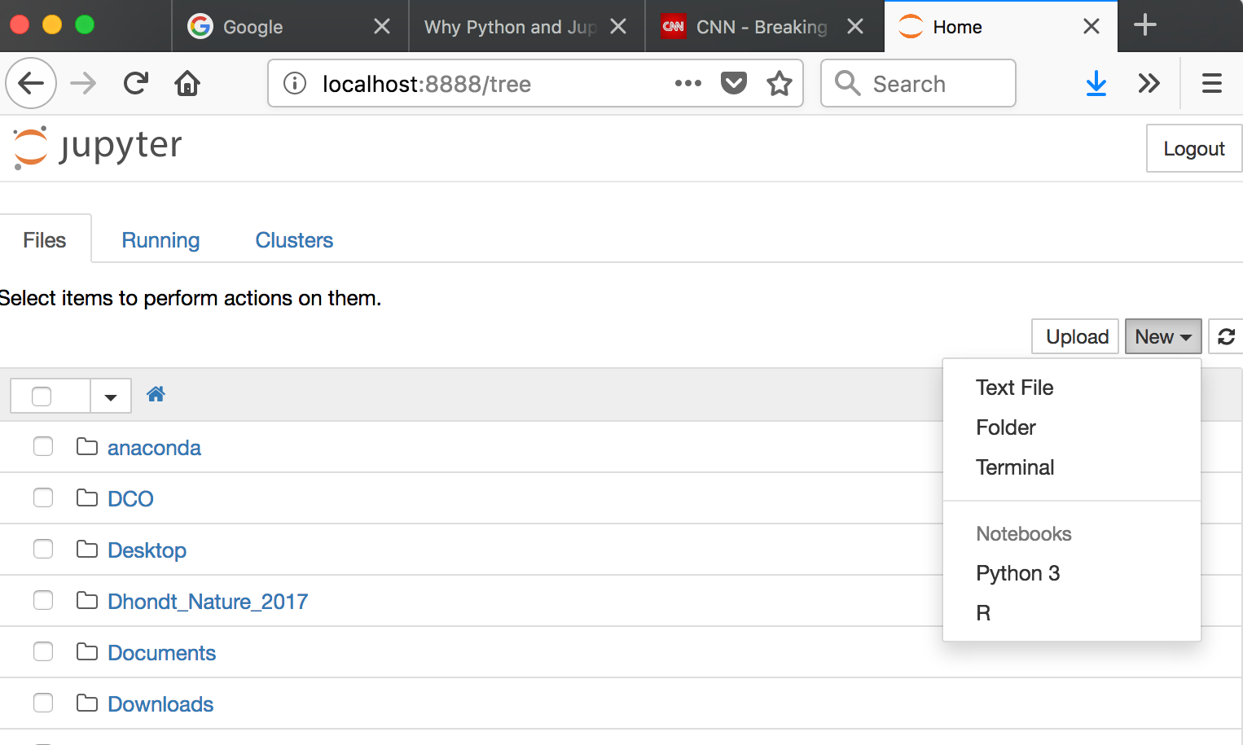
Jupyter Notebooks - attributes
19
file management

Slide 20
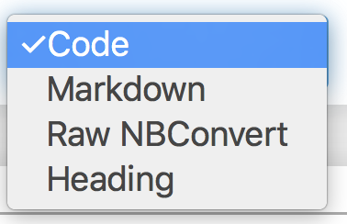
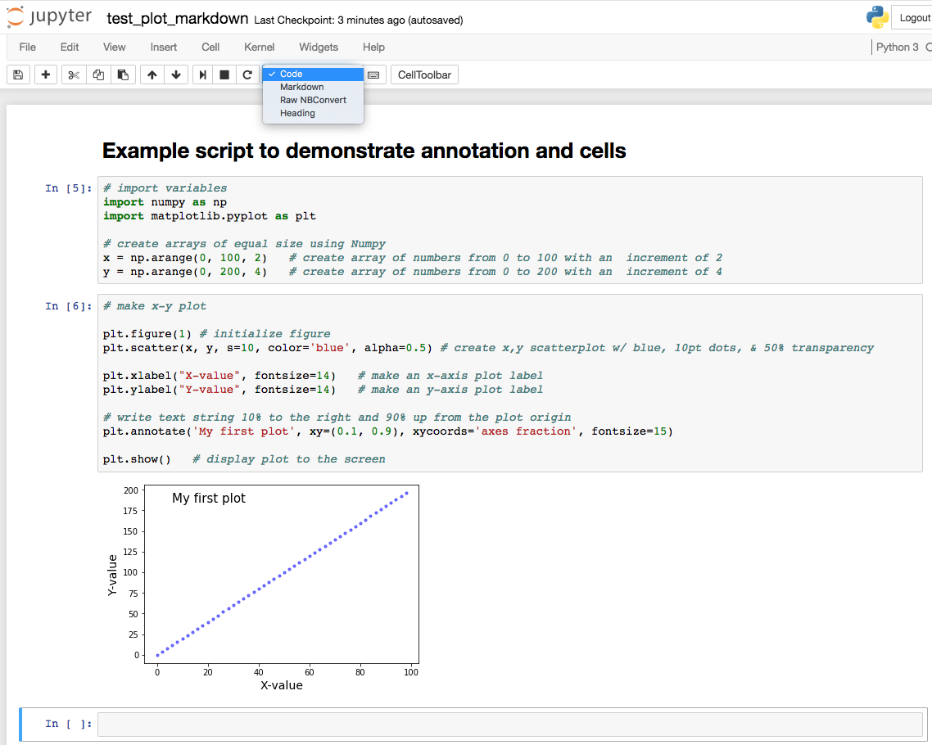
Jupyter Notebooks - attributes
20
example script
Markdown (annotation)
Code

Slide 21
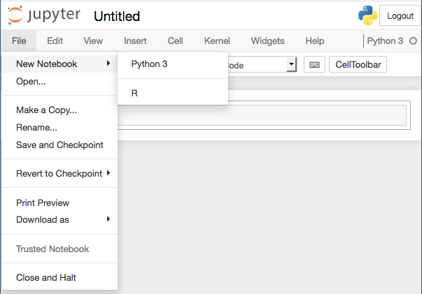
Jupyter Notebooks - attributes
21
menu items

Slide 22
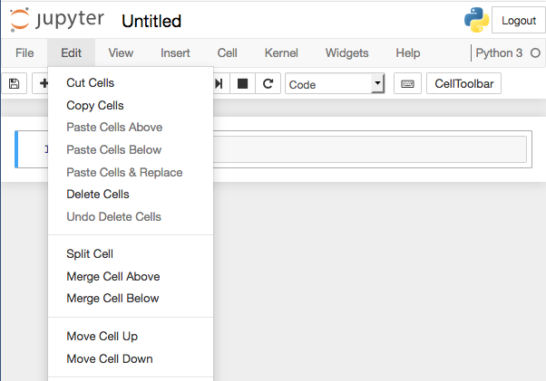
Jupyter Notebooks - attributes
22
menu items

Slide 23
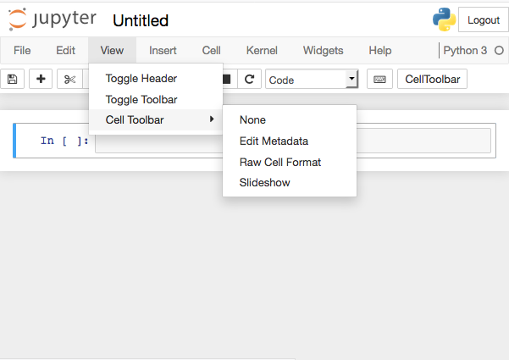
Jupyter Notebooks - attributes
23
menu items

Slide 24
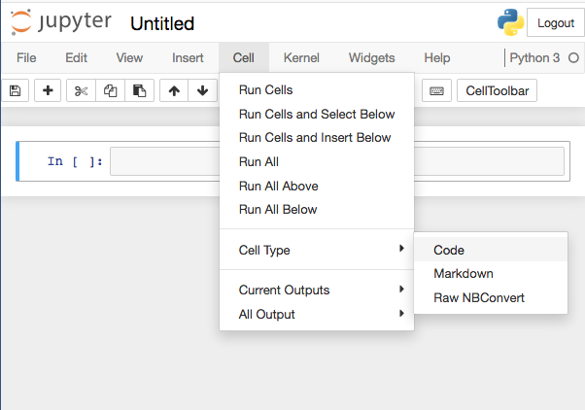
Jupyter Notebooks - attributes
24
menu items

Slide 25
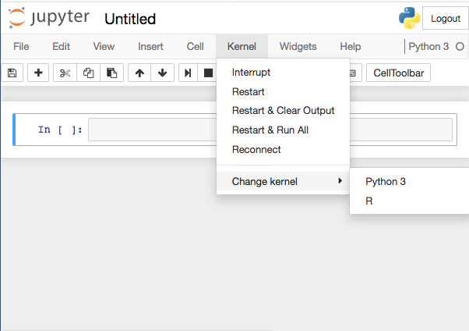
Jupyter Notebooks - attributes
25
menu items

Slide 26
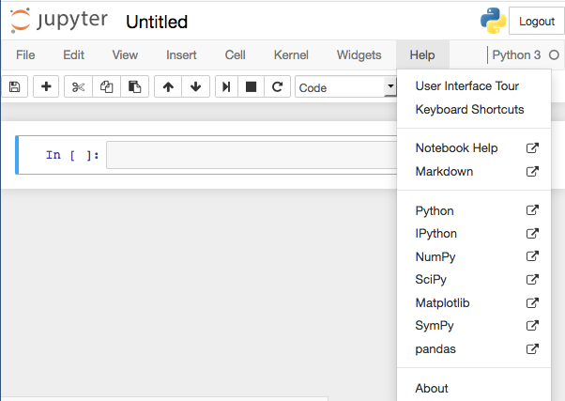
Jupyter Notebooks - attributes
26
menu items

Slide 27
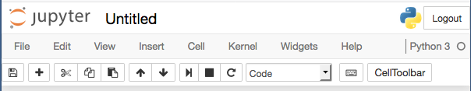
Jupyter Notebooks - attributes
27
menu items
restart the kernel
interrupt kernel
run selected cell
move selected cells down
move selected cells up
paste cells below
copy selected cells
cut selected cells
insert cell below
Save and Checkpoint

Slide 28
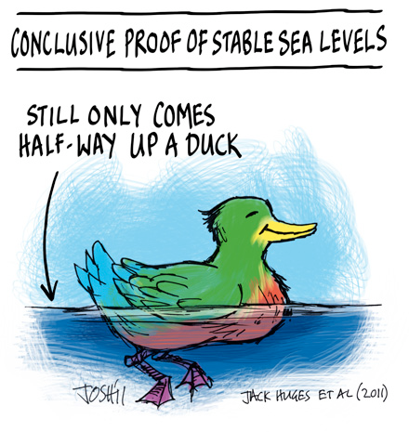
Computer-based Science Instruction – sea level example
28
Focus Question(s)
Does sea level change in Rhode Island ?
- examples ?
- time scales ?
- causes ?

Slide 29

Computer-based Science Instruction – sea level example
29
Focus Activity
- Hands-on sea level change activity

Slide 30
Computer-based Science Instruction – sea level example
30
Focus Activity
- Hands-on sea level change activity
Event or Action (What did you do?) | Water Level Change (up, down, depends) | Region Affected (all-sides, 1-side, middle) | Duration, Timing (maintained, temporary)

Slide 31
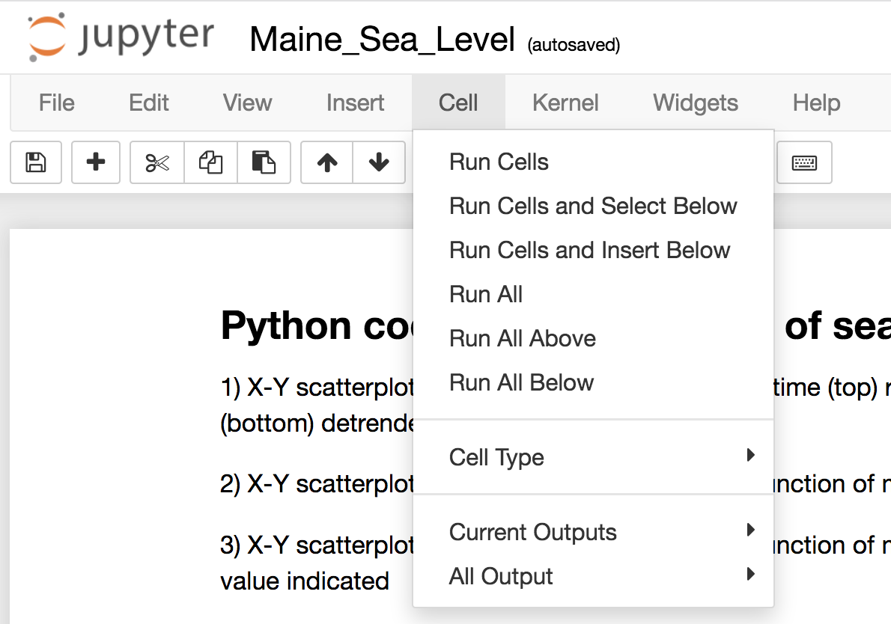
Computer-based Science Instruction – sea level example
31
Computer-based Activity
Go to Jupyter Notebooks
Go to “code” filter
Open “NOAA_Sea_Level.ipynb”
Run code

Slide 32
Computer-based Science Instruction – sea level example
32
Follow-up Questions
Is sea level changing in RI?
rise or fall ?
how much ?
what time scale ?
possible causes ?
How does sea level change throughout the year?
range of change ?
possible causes ?
Is the character of sea level change the same all over RI?
How do sea level changes in RI compare to Juneau, AK?

Slide 33
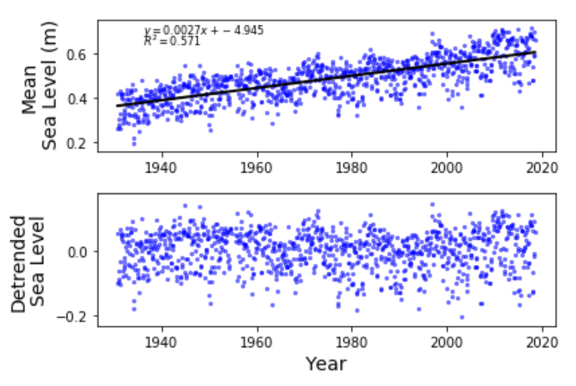
Computer-based Science Instruction – sea level example
33
Follow-up Questions
Is sea level changing in Rhode Island?
rise or fall ?
how much ?
how fast ?
what time scale ?
possible causes ?
Newport, RI

Slide 34
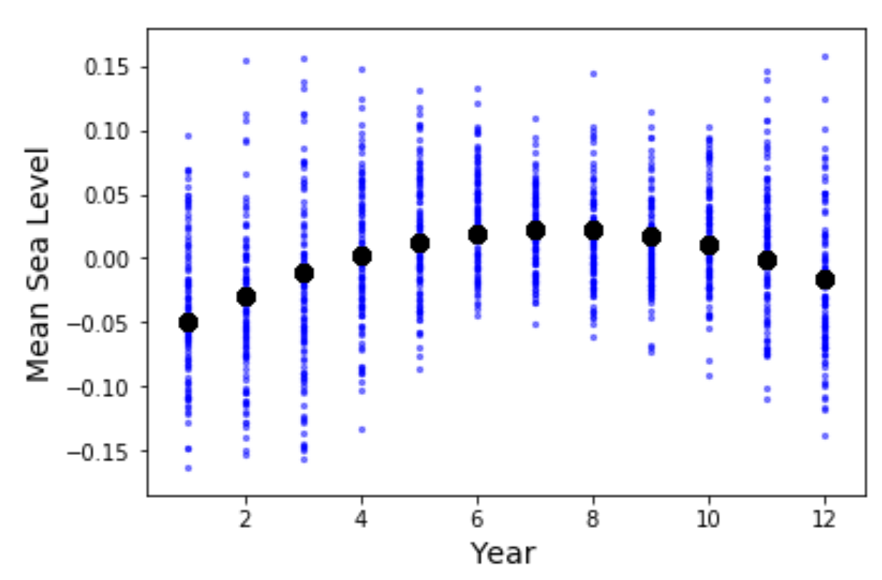
Computer-based Science Instruction – sea level example
34
Follow-up Questions
How does sea level change throughout the year?
range of change ?
possible causes ?

Slide 35
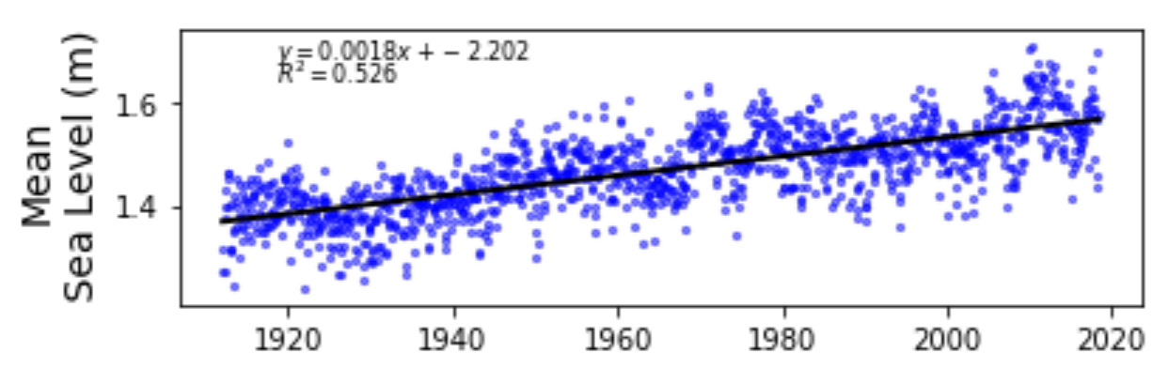
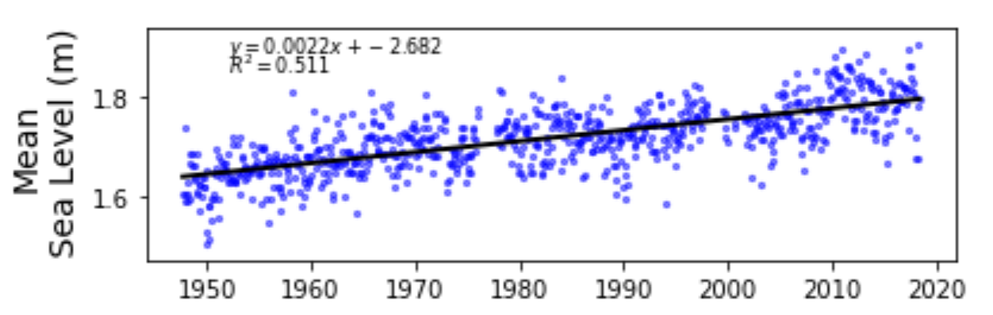
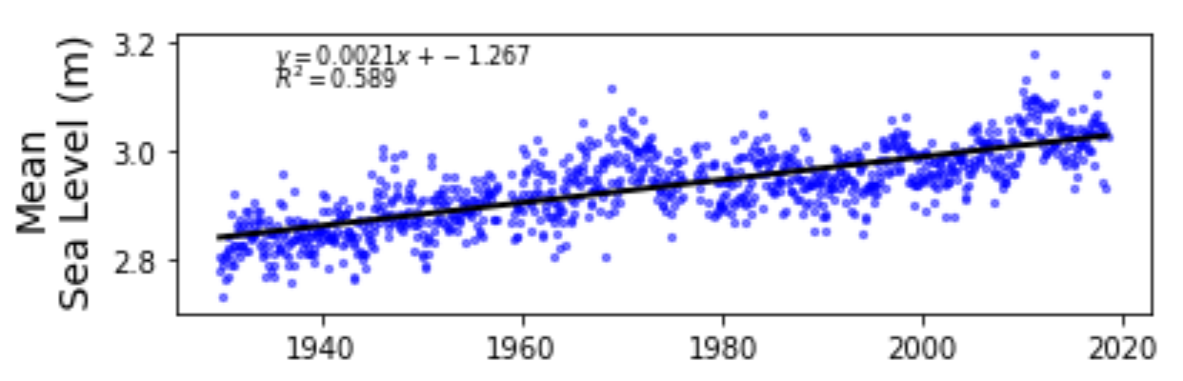
Computer-based Science Instruction – sea level example
35
Follow-up Questions
Is the rate of sea level change the same everywhere?
Portland
1.8 mm/yr
Bar Harbor
2.2 mm/yr
East Port
2.1 mm/yr

Slide 36
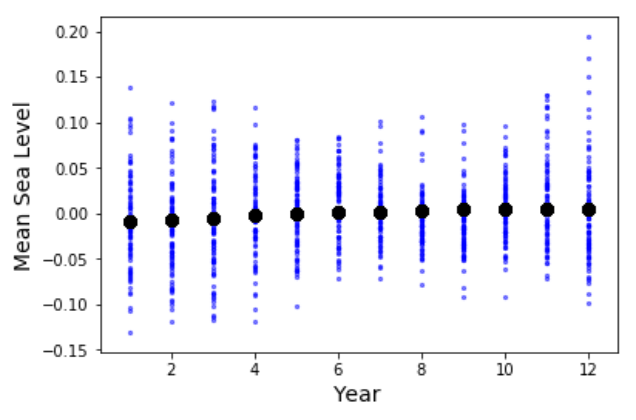
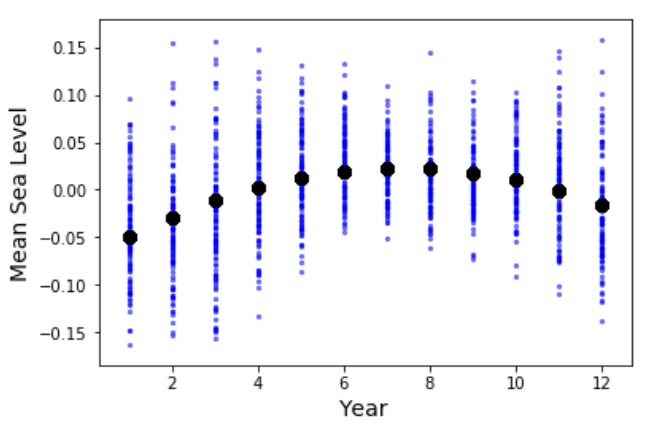
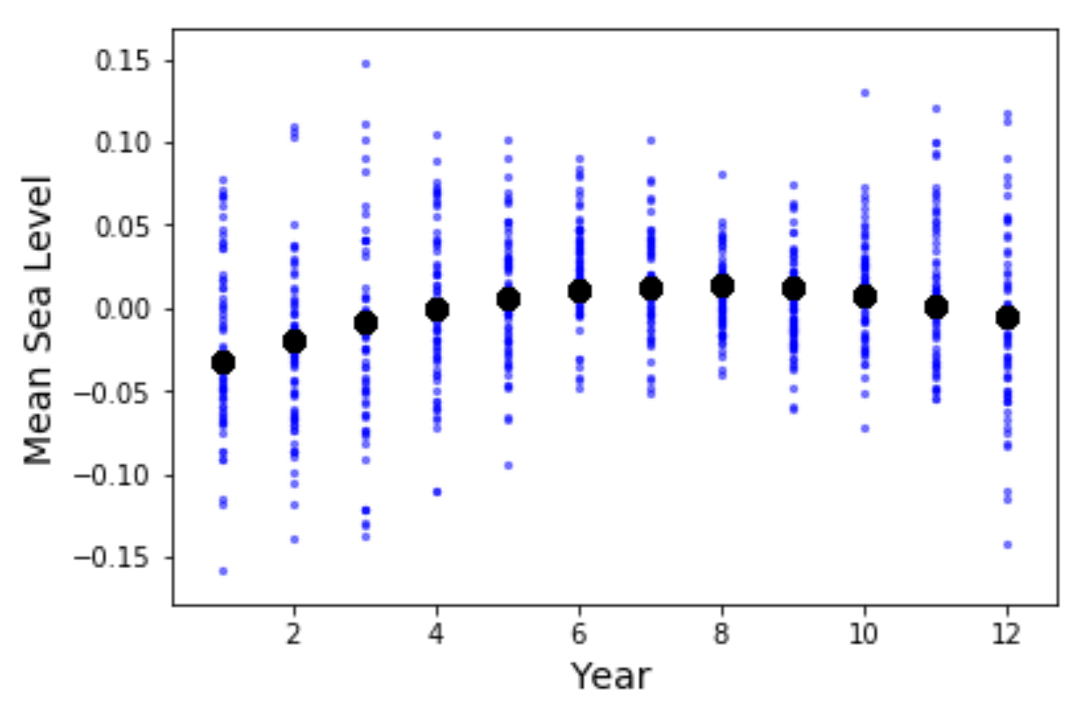
Computer-based Science Instruction – sea level example
36
Follow-up Questions
Is the annual character of sea level change the same all over Maine?
Portland
Bar Harbor
East Port

Slide 37
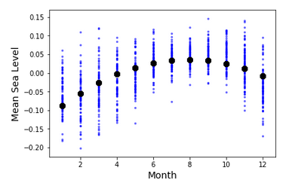
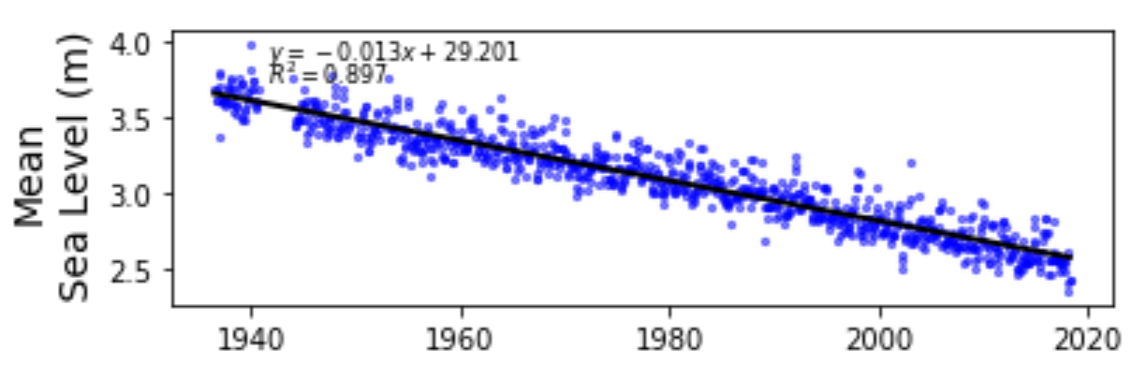
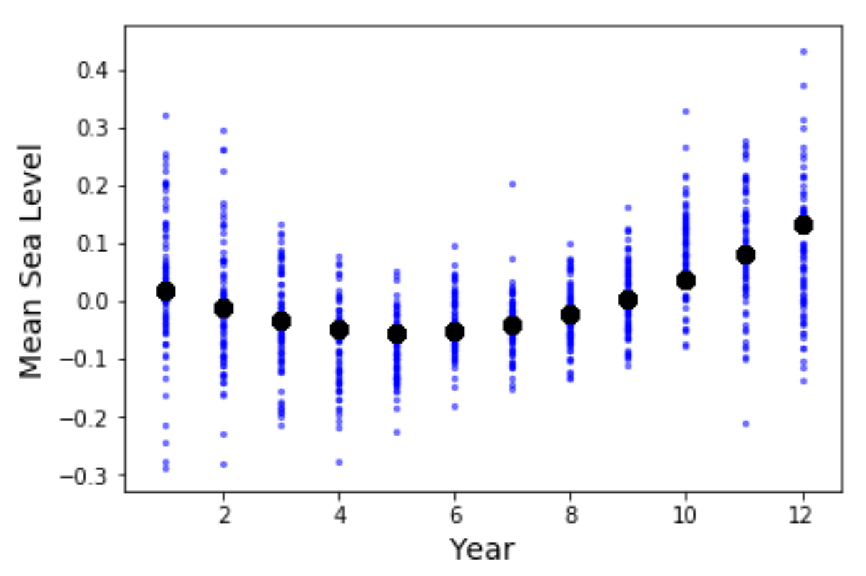
Computer-based Science Instruction – sea level example
37
Follow-up Questions
How do sea level changes in RI compare to Juneau, AK?
2.7 mm/yr
13.0 mm/yr

Slide 38
Computer-based Science Instruction – additional example
38
More Focus Questions
How much does sea level need to change to flood…..
Kingston, RI?
How soon until Kingston is underwater?
What other regions are threatened?

Slide 39
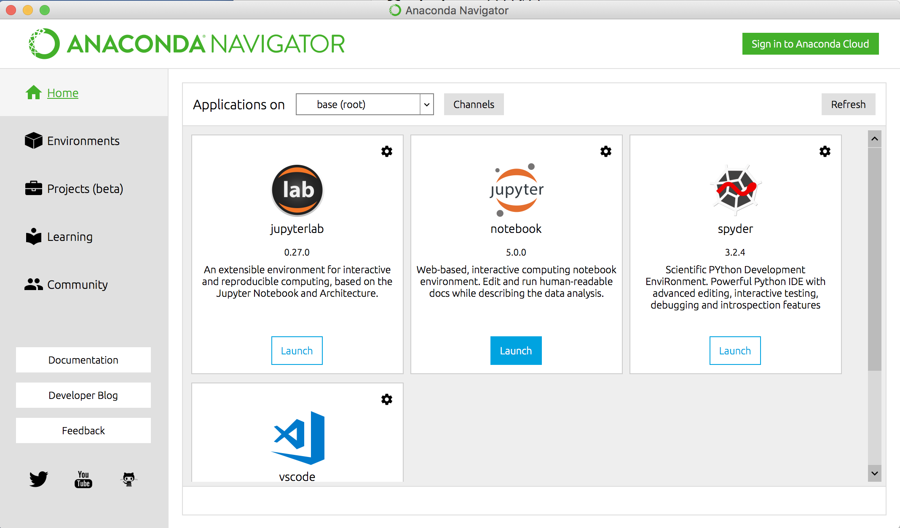
More Advanced Python Scripts
39
Need to Import Additional Libraries
- go to Anaconda Navigator Page
- select environments

Slide 40
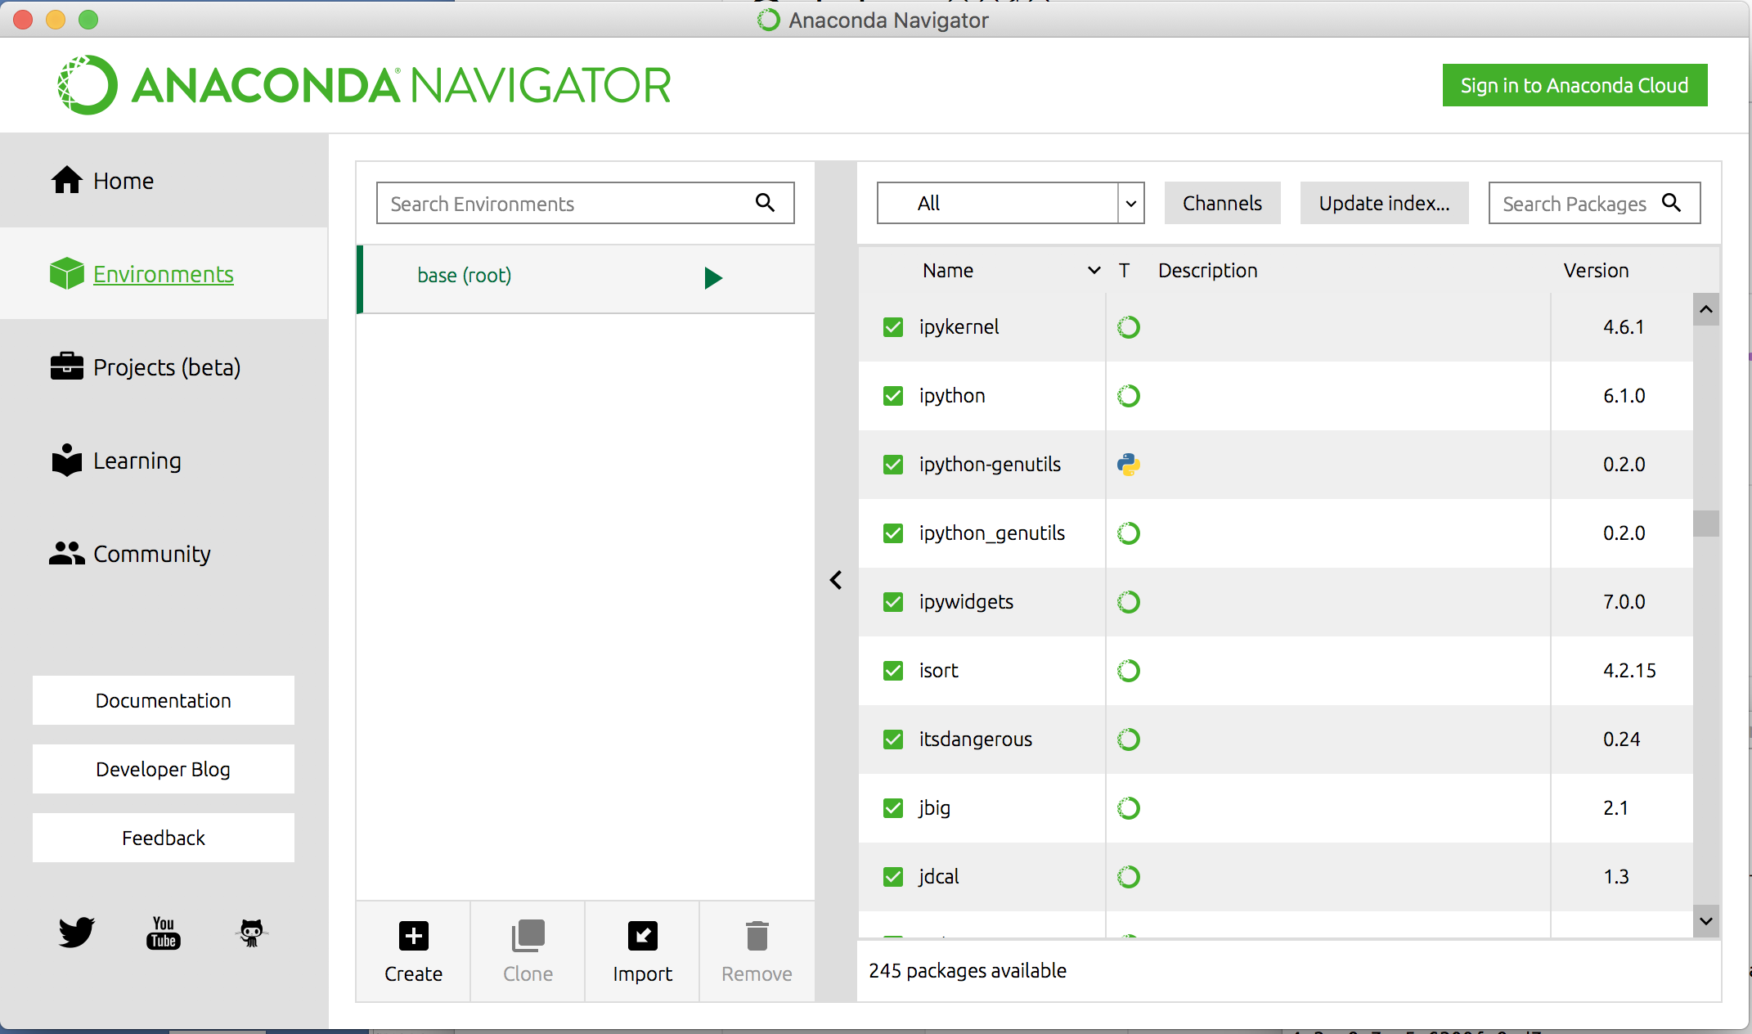
More Advanced Python Scripts
40
Need to Import Additional Libraries
Need to Import Additional Libraries
- search for appropriate libraries (e.g., ipywidgets, netcdf4)
- import
If installation issues….use conda install method in terminal window
conda install -c conda-forge basemap

Slide 41
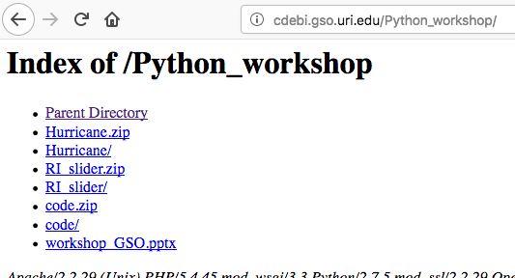
More Advanced Python Scripts
41
Need to Import Additional Libraries

Slide 42
Python Tutorials
42
On-line Tutorials
  https://www.datacamp.com/
  - both Python and R on-line tutorials
  https://docs.python.org/3/tutorial/
  https://www.w3schools.com/python/
Helpful Hints/Post a Question
  https://stackoverflow.com/

Slide 43
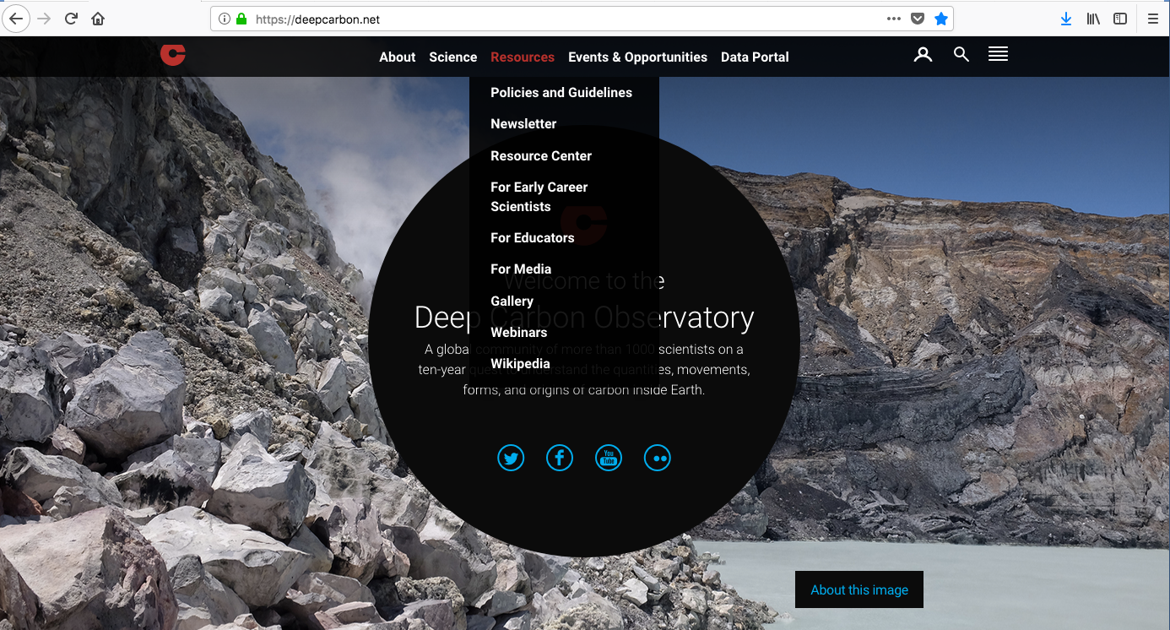
DCO Webinars
43

Slide 44



DCO Webinars
44

