Slide 1
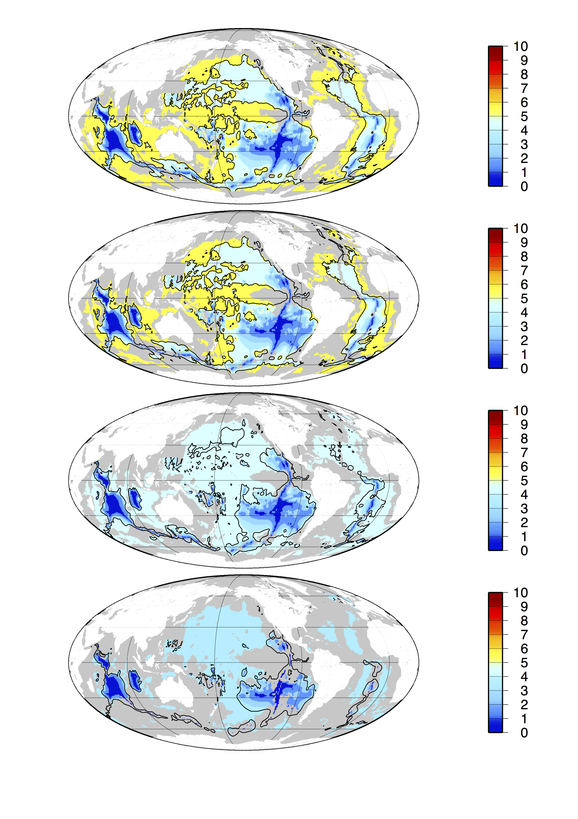
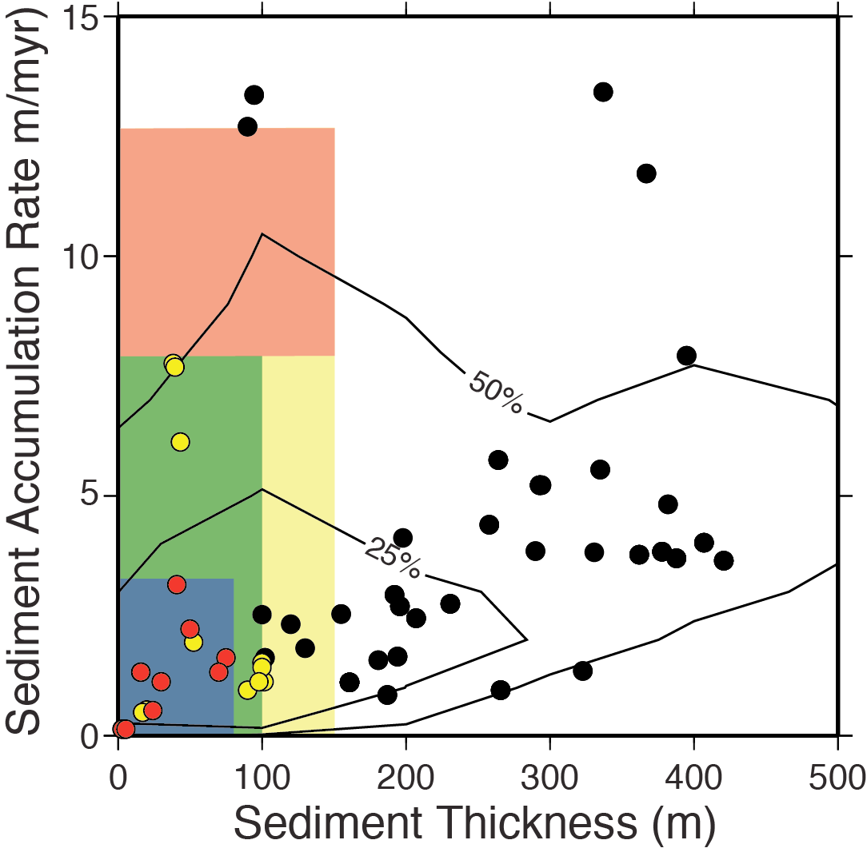
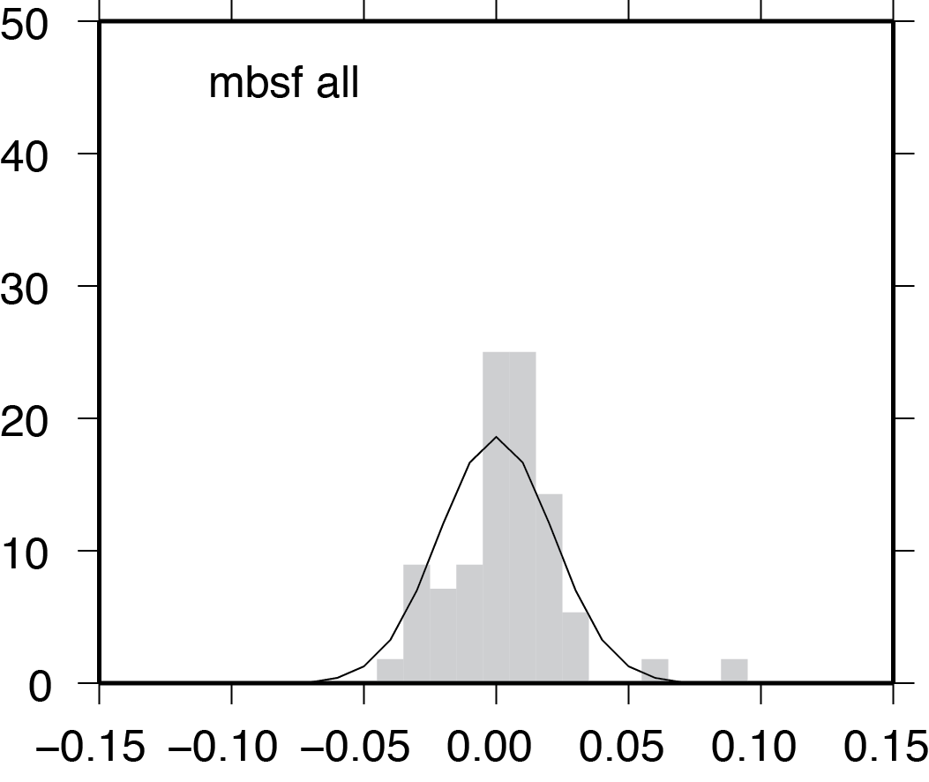
Depth-Integrated for all OC data
Red
Oxic Regions
from D’Hondt et al. 2015
Color labels on map refer to
the parameters for the various regions in the figure
Yellow
Used best-fit power-law equation for integration purposes
Green
Blue
Histogram of residuals with normal distributon curve

Slide 2
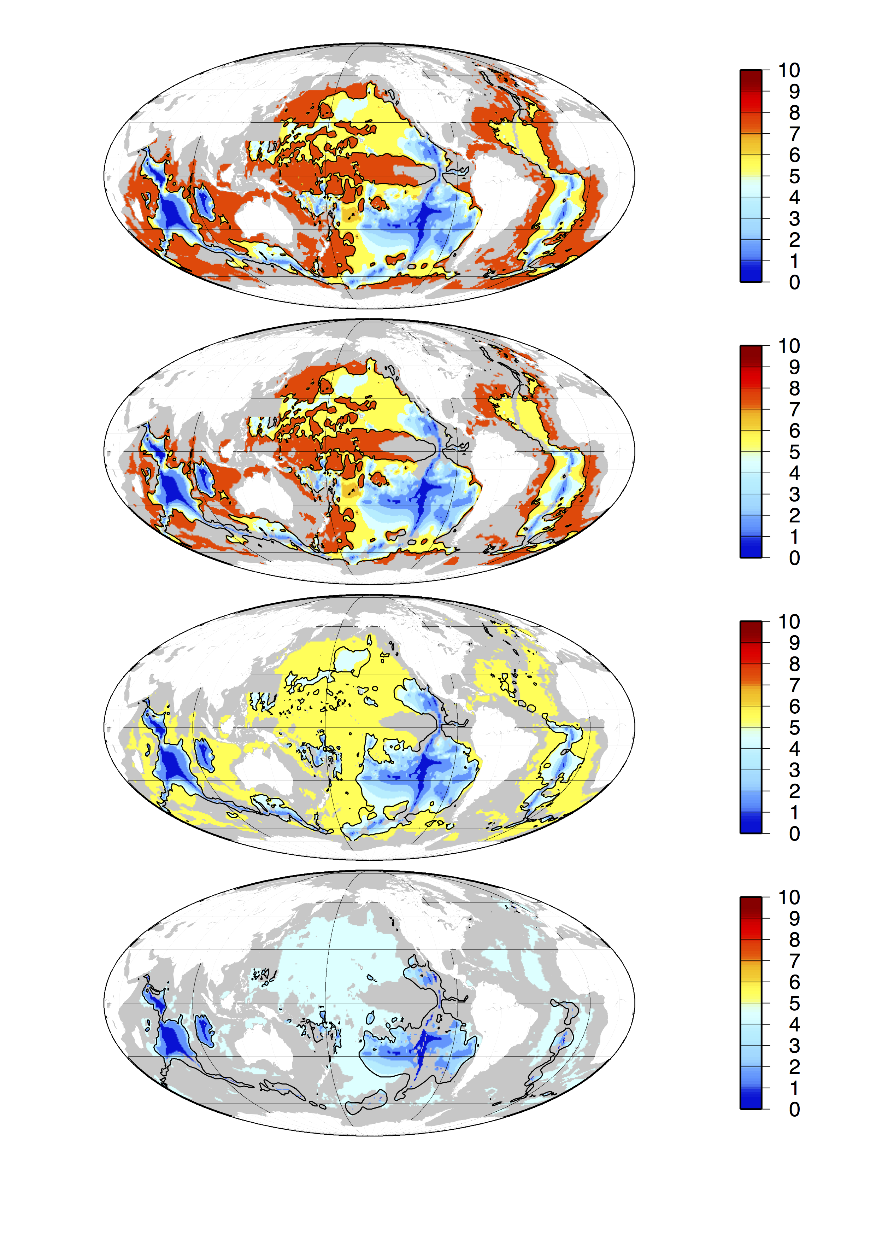
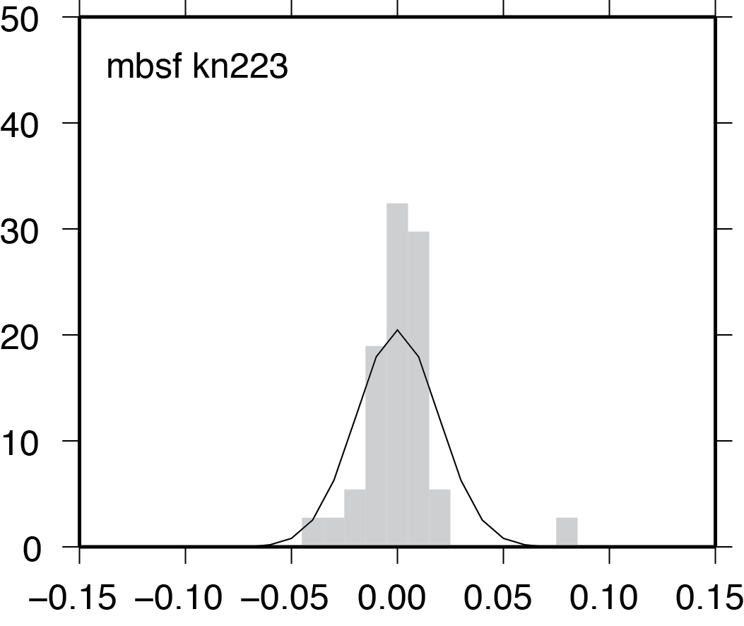
Depth-Integrated for just KN223 OC data
Red
Oxic Regions
from D’Hondt et al. 2015
Color labels on map refer to
the parameters for the various regions in the figure
Yellow
Used best-fit power-law equation for integration purposes
Green
Blue
Histogram of residuals with normal distributon curve

Slide 3
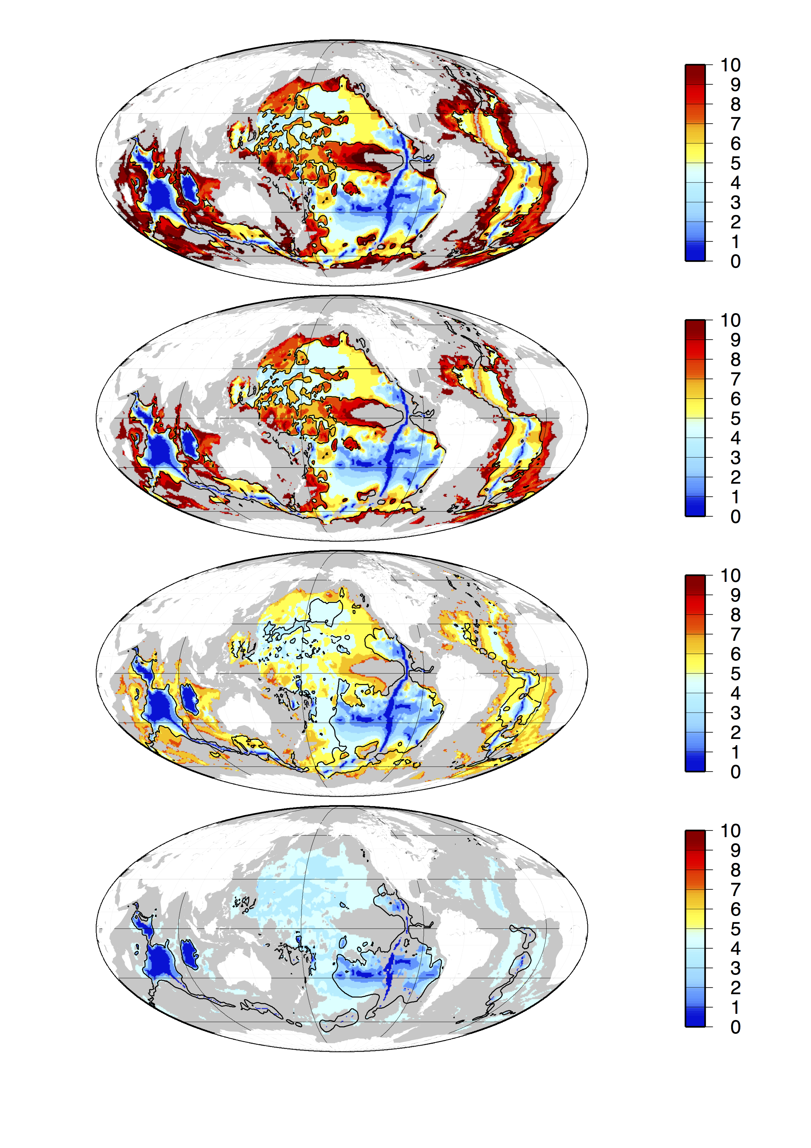
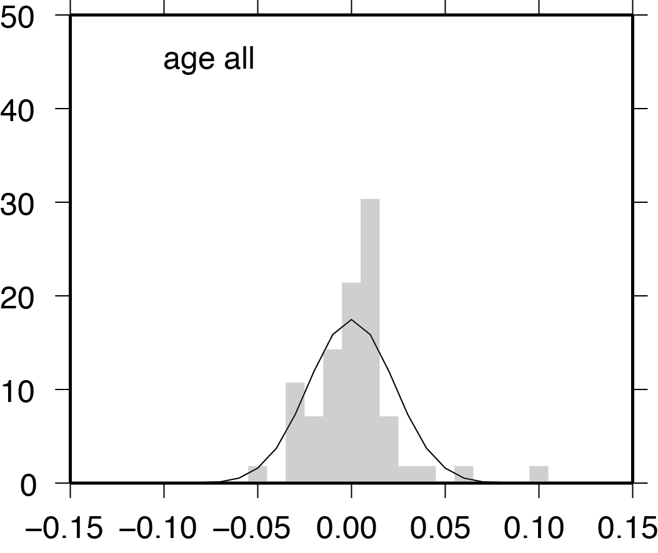
Age-Integrated for all OC data
Red
Oxic Regions
from D’Hondt et al. 2015
Color labels on map refer to
the parameters for the various regions in the figure
Yellow
Used best-fit power-law equation for integration purposes
Green
Blue
Histogram of residuals with normal distributon curve

Slide 4
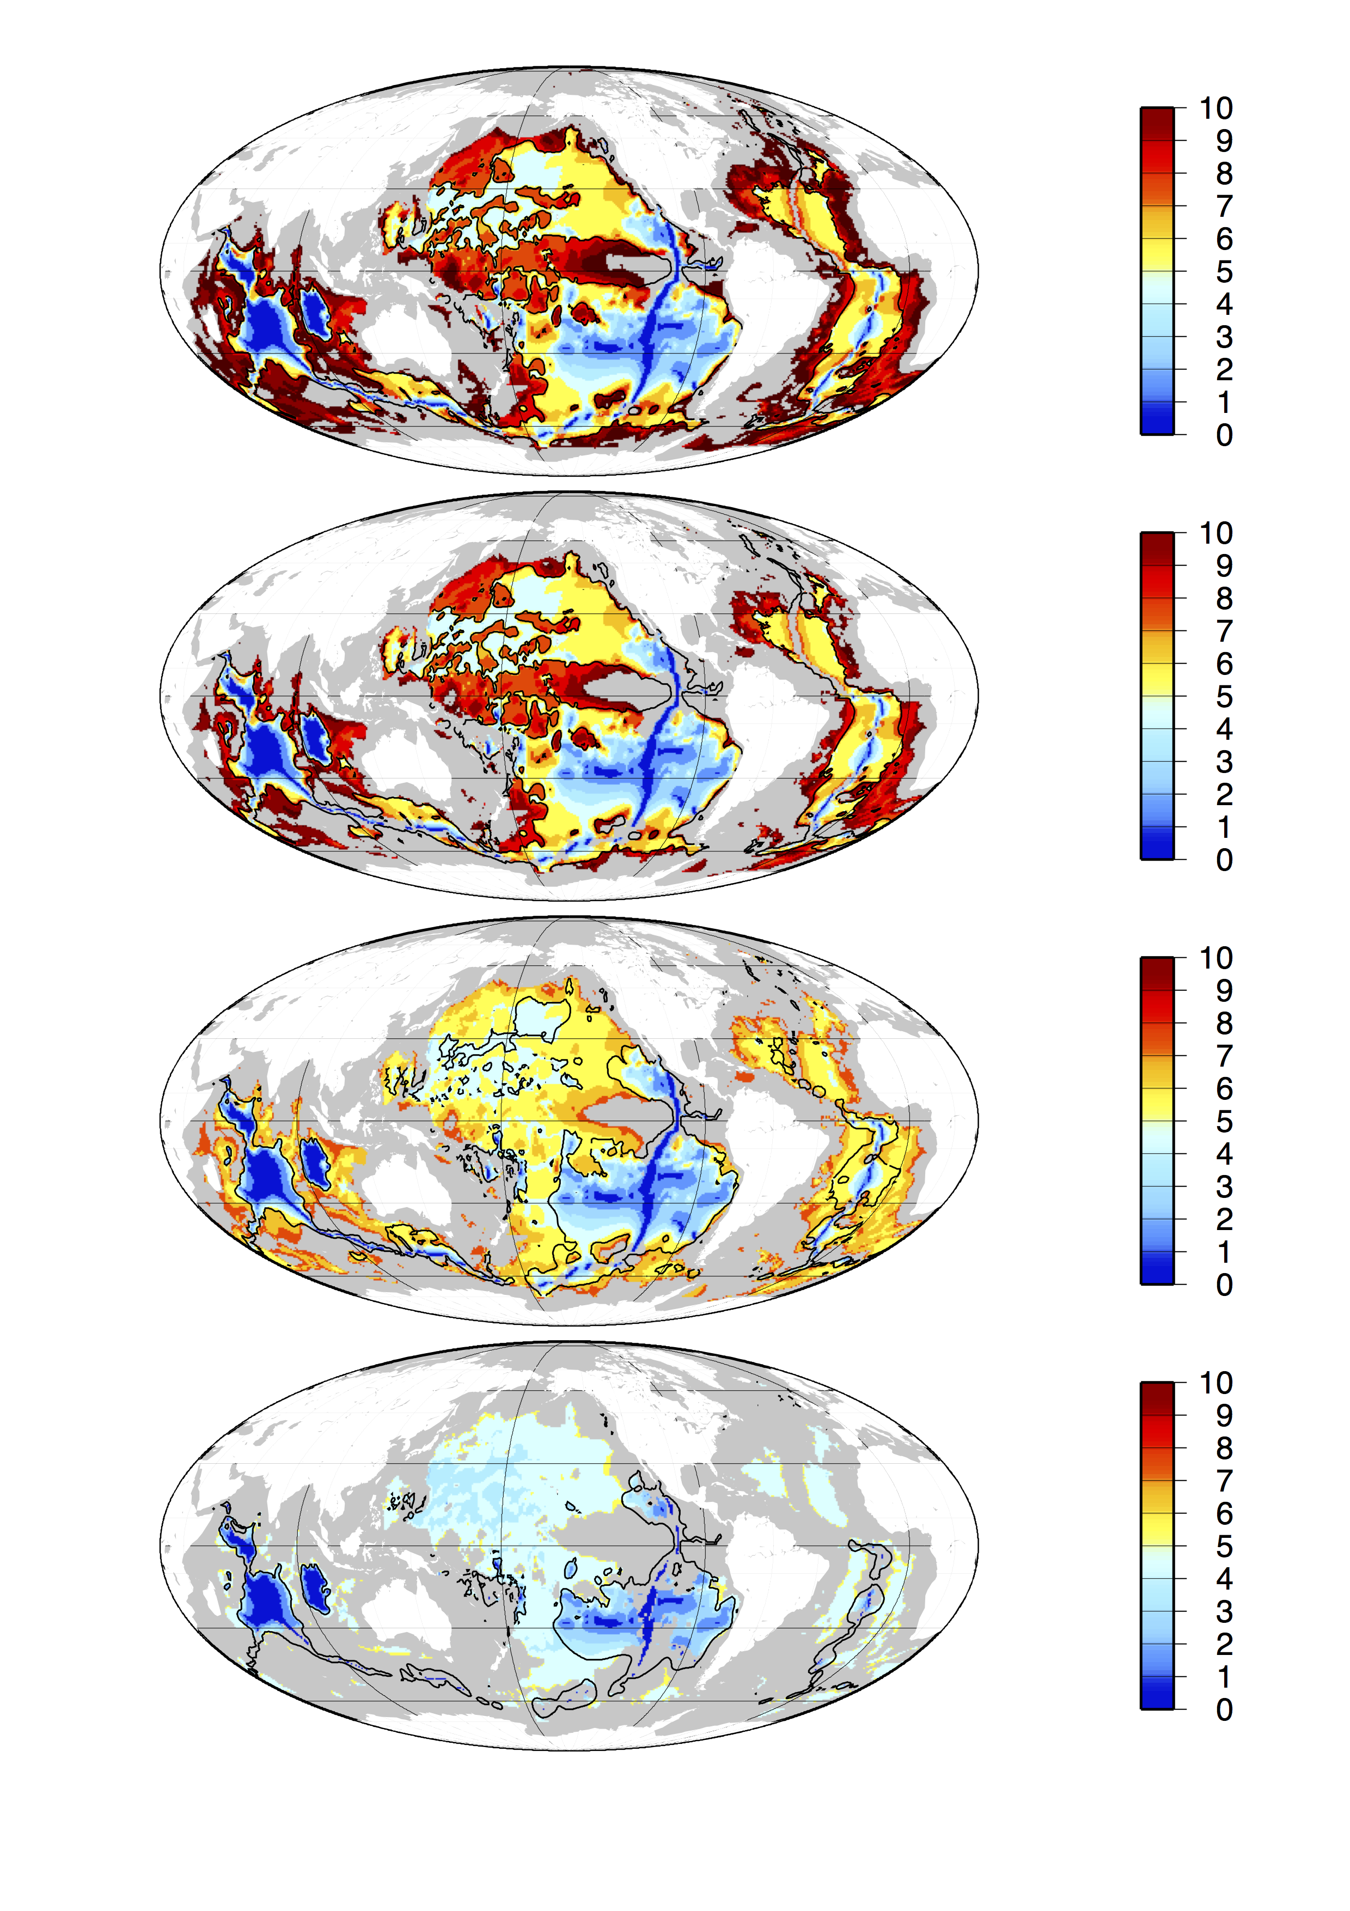
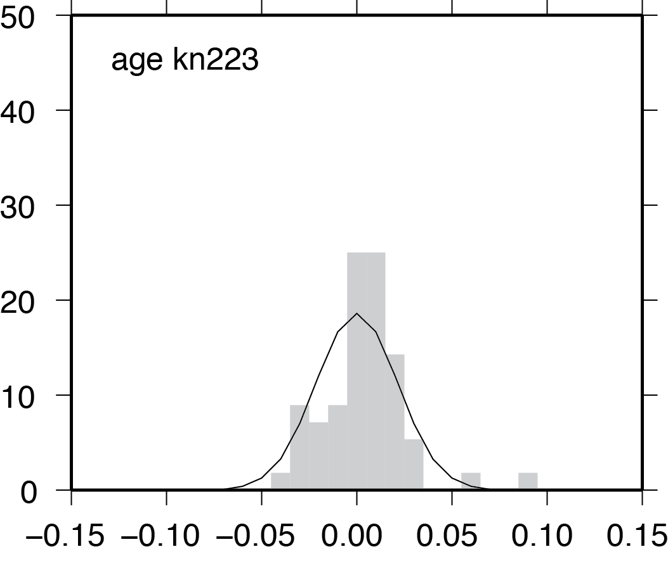
Age-Integrated for just KN223 OC data
Red
Oxic Regions
from D’Hondt et al. 2015
Color labels on map refer to
the parameters for the various regions in the figure
Yellow
Used best-fit power-law equation for integration purposes
Green
Blue
Histogram of residuals with normal distributon curve

Slide 5
We need to discuss what these depth-integrated units are.

