Slide 1


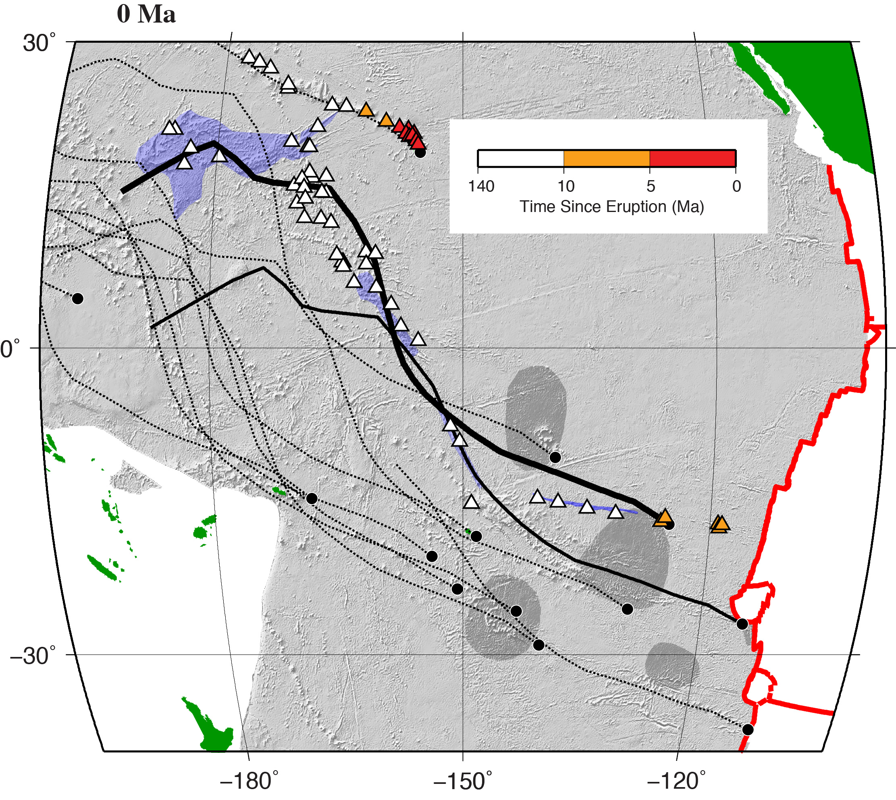
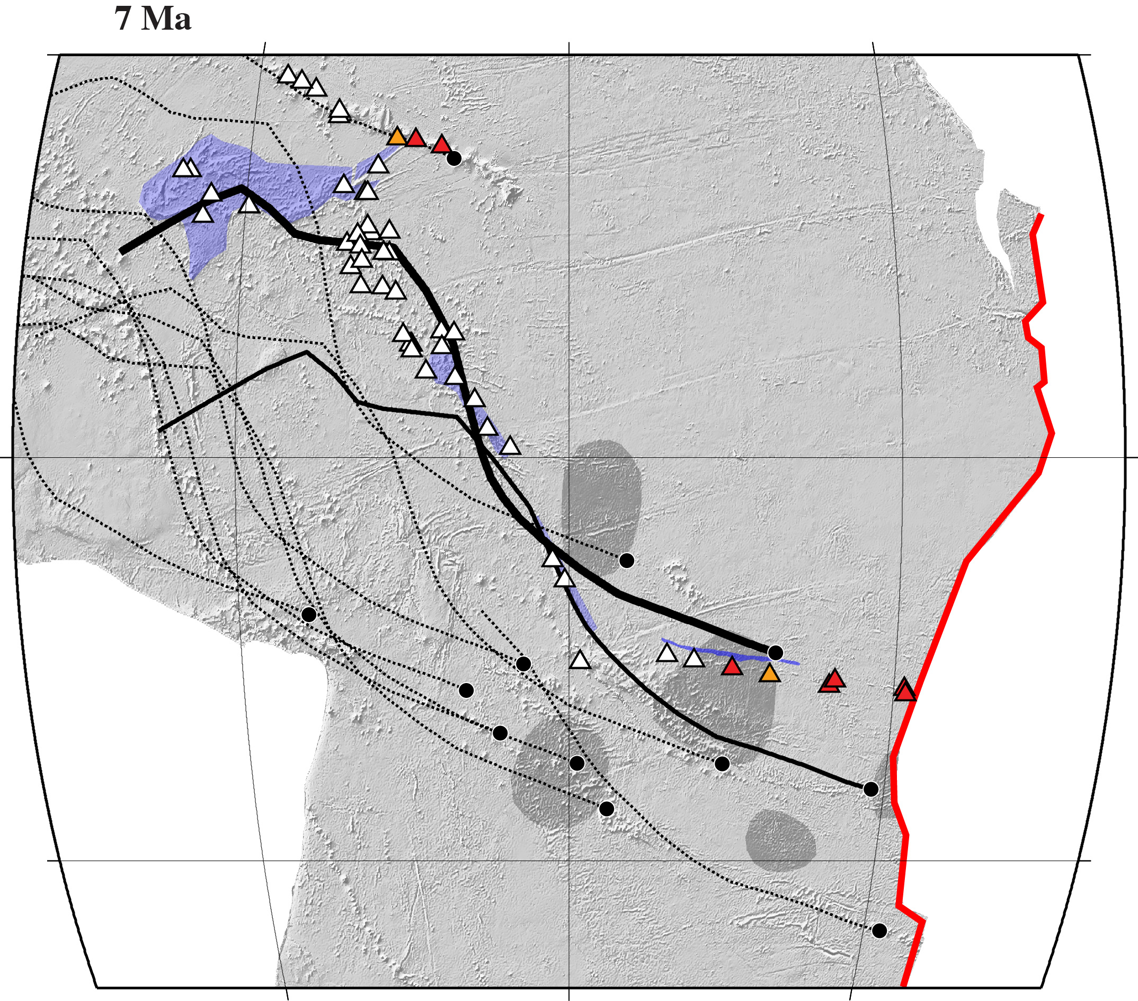
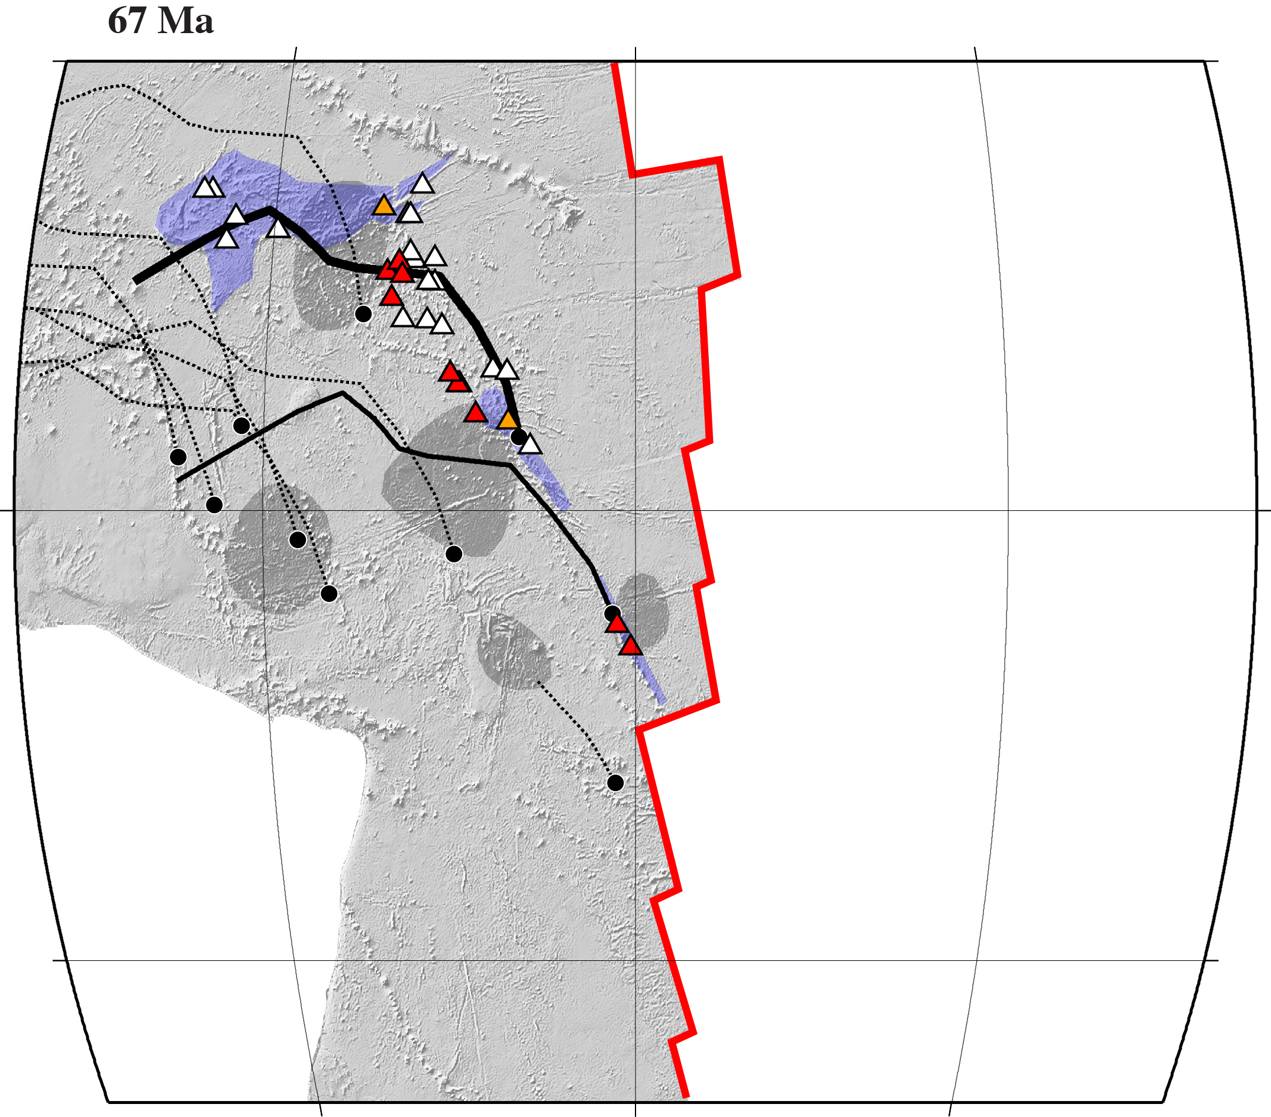
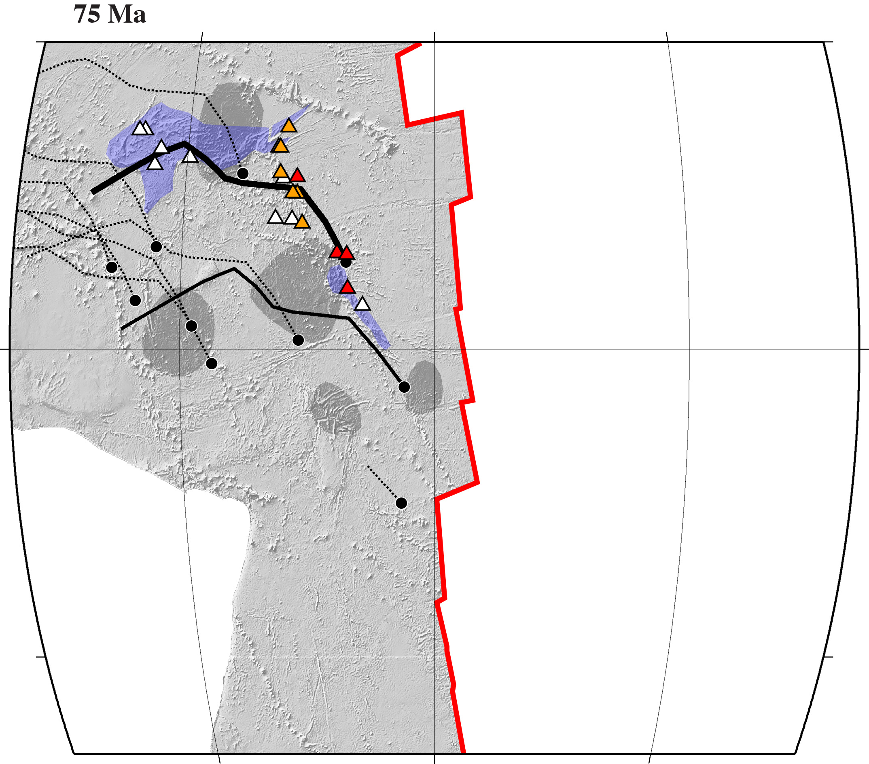
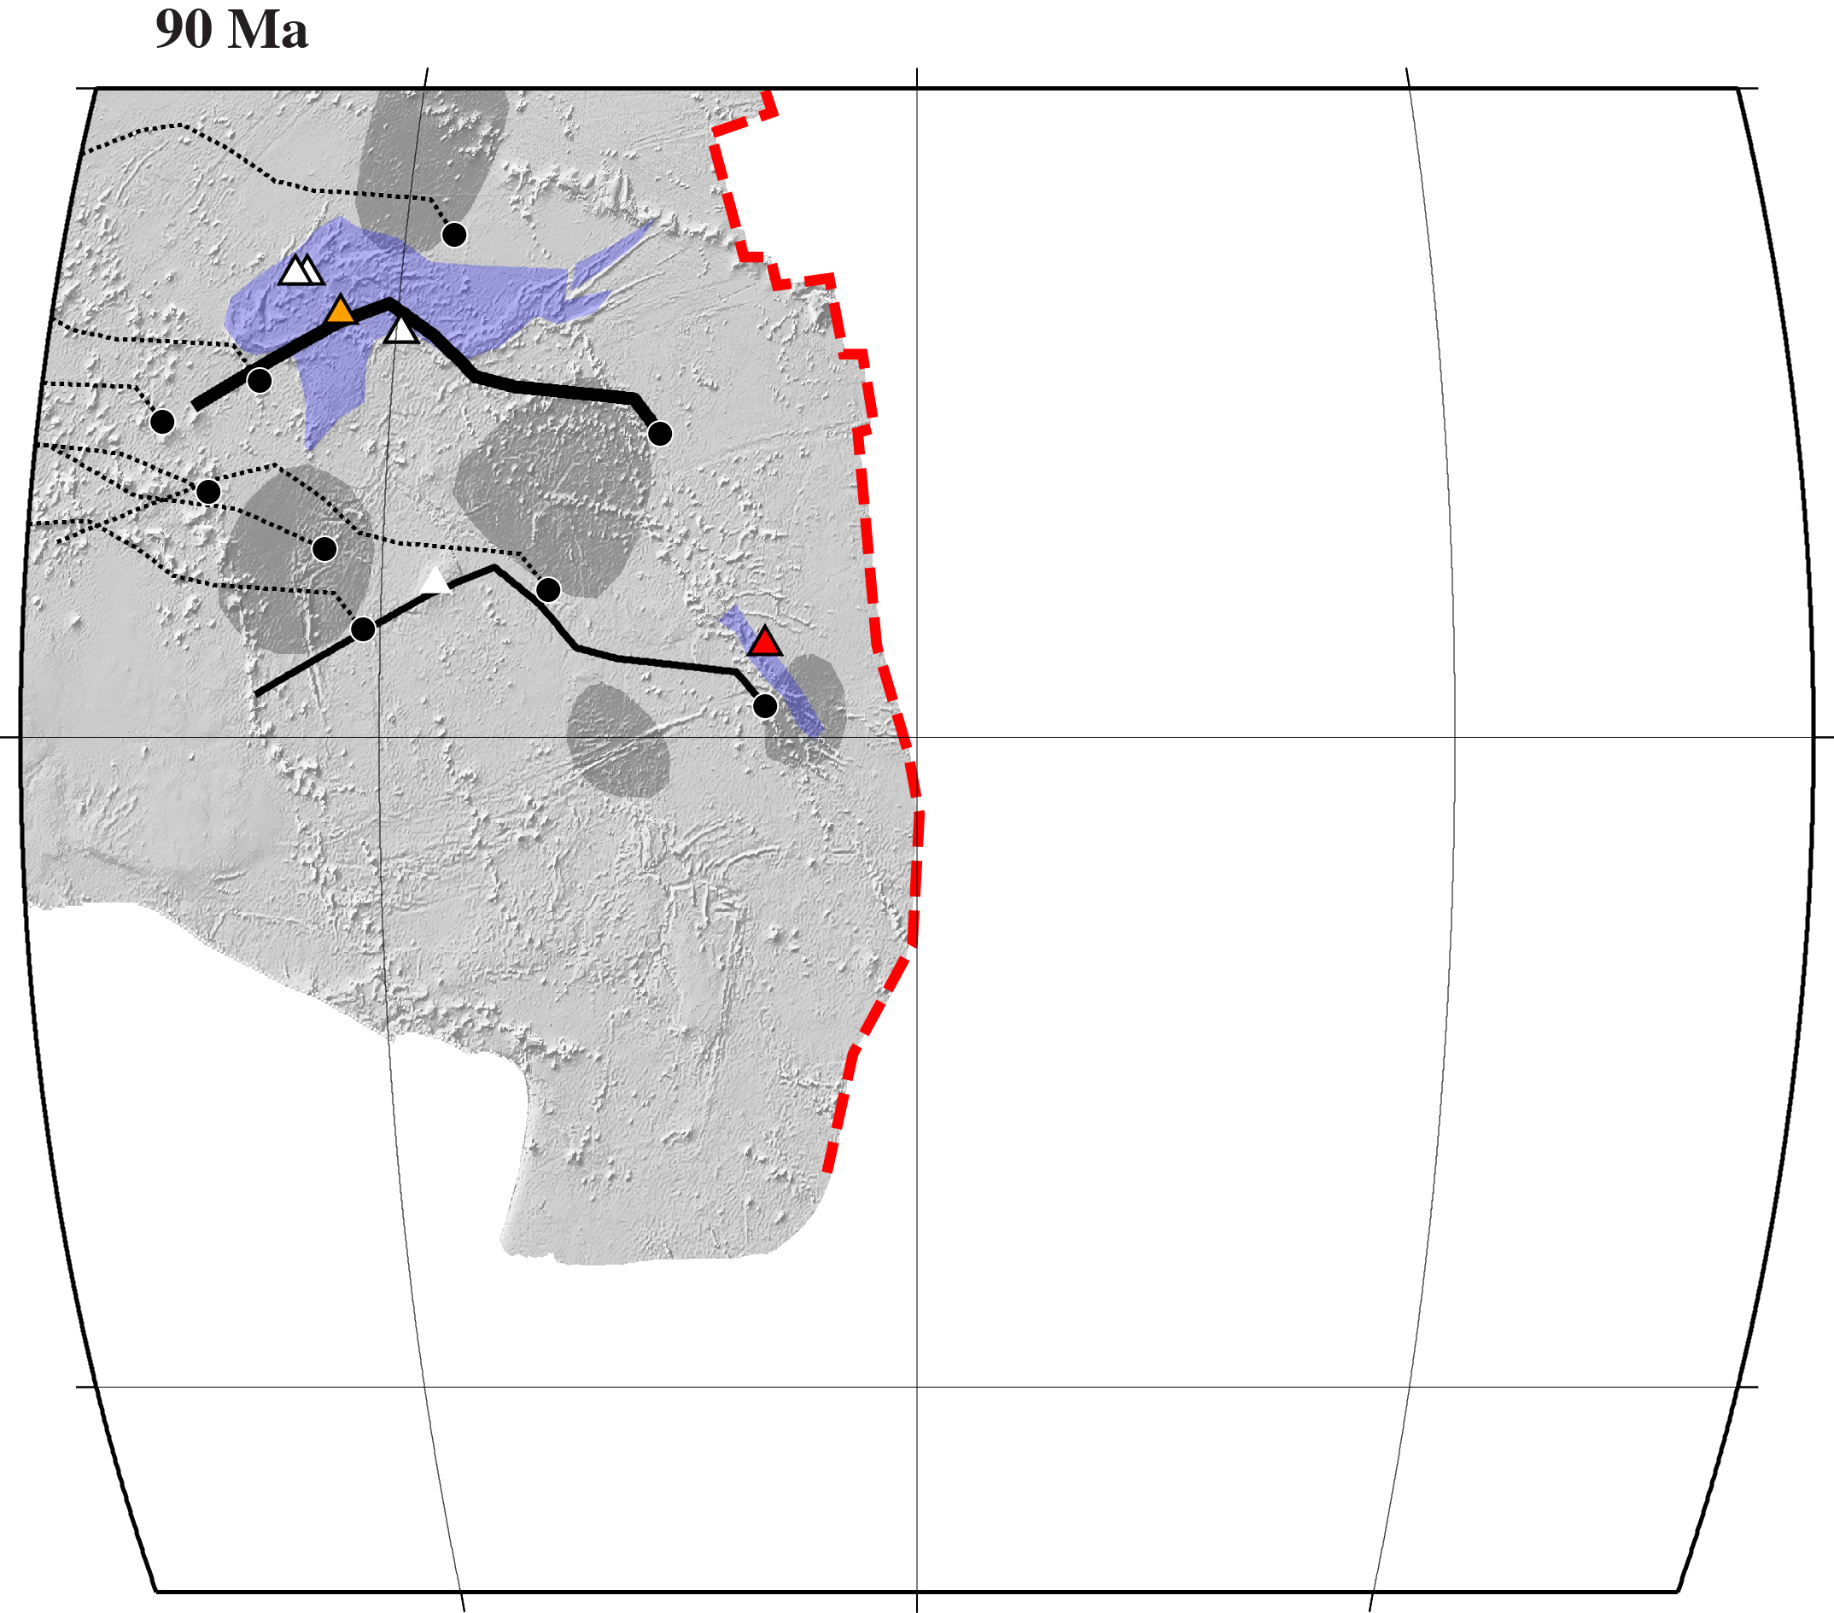
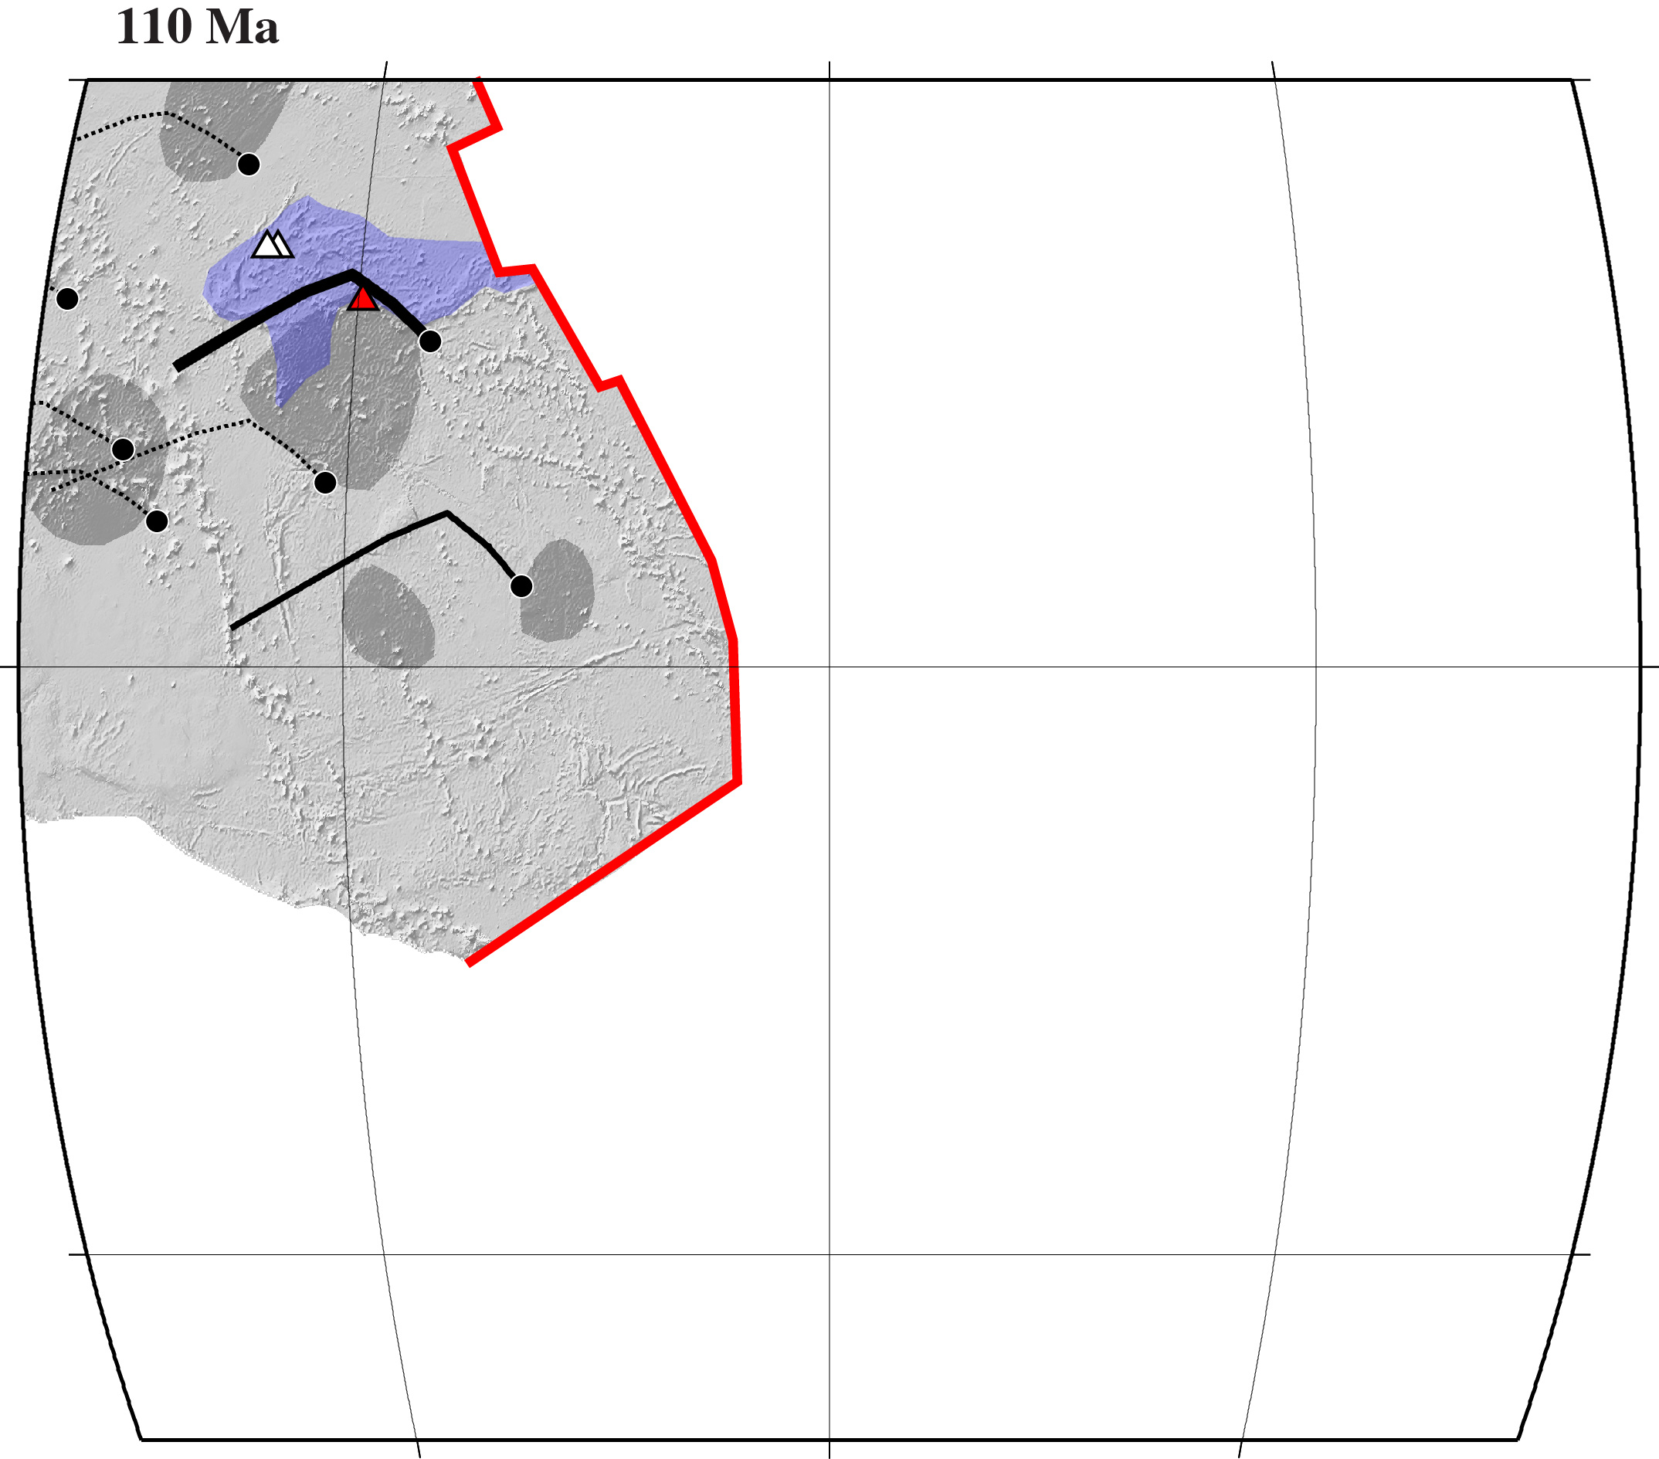
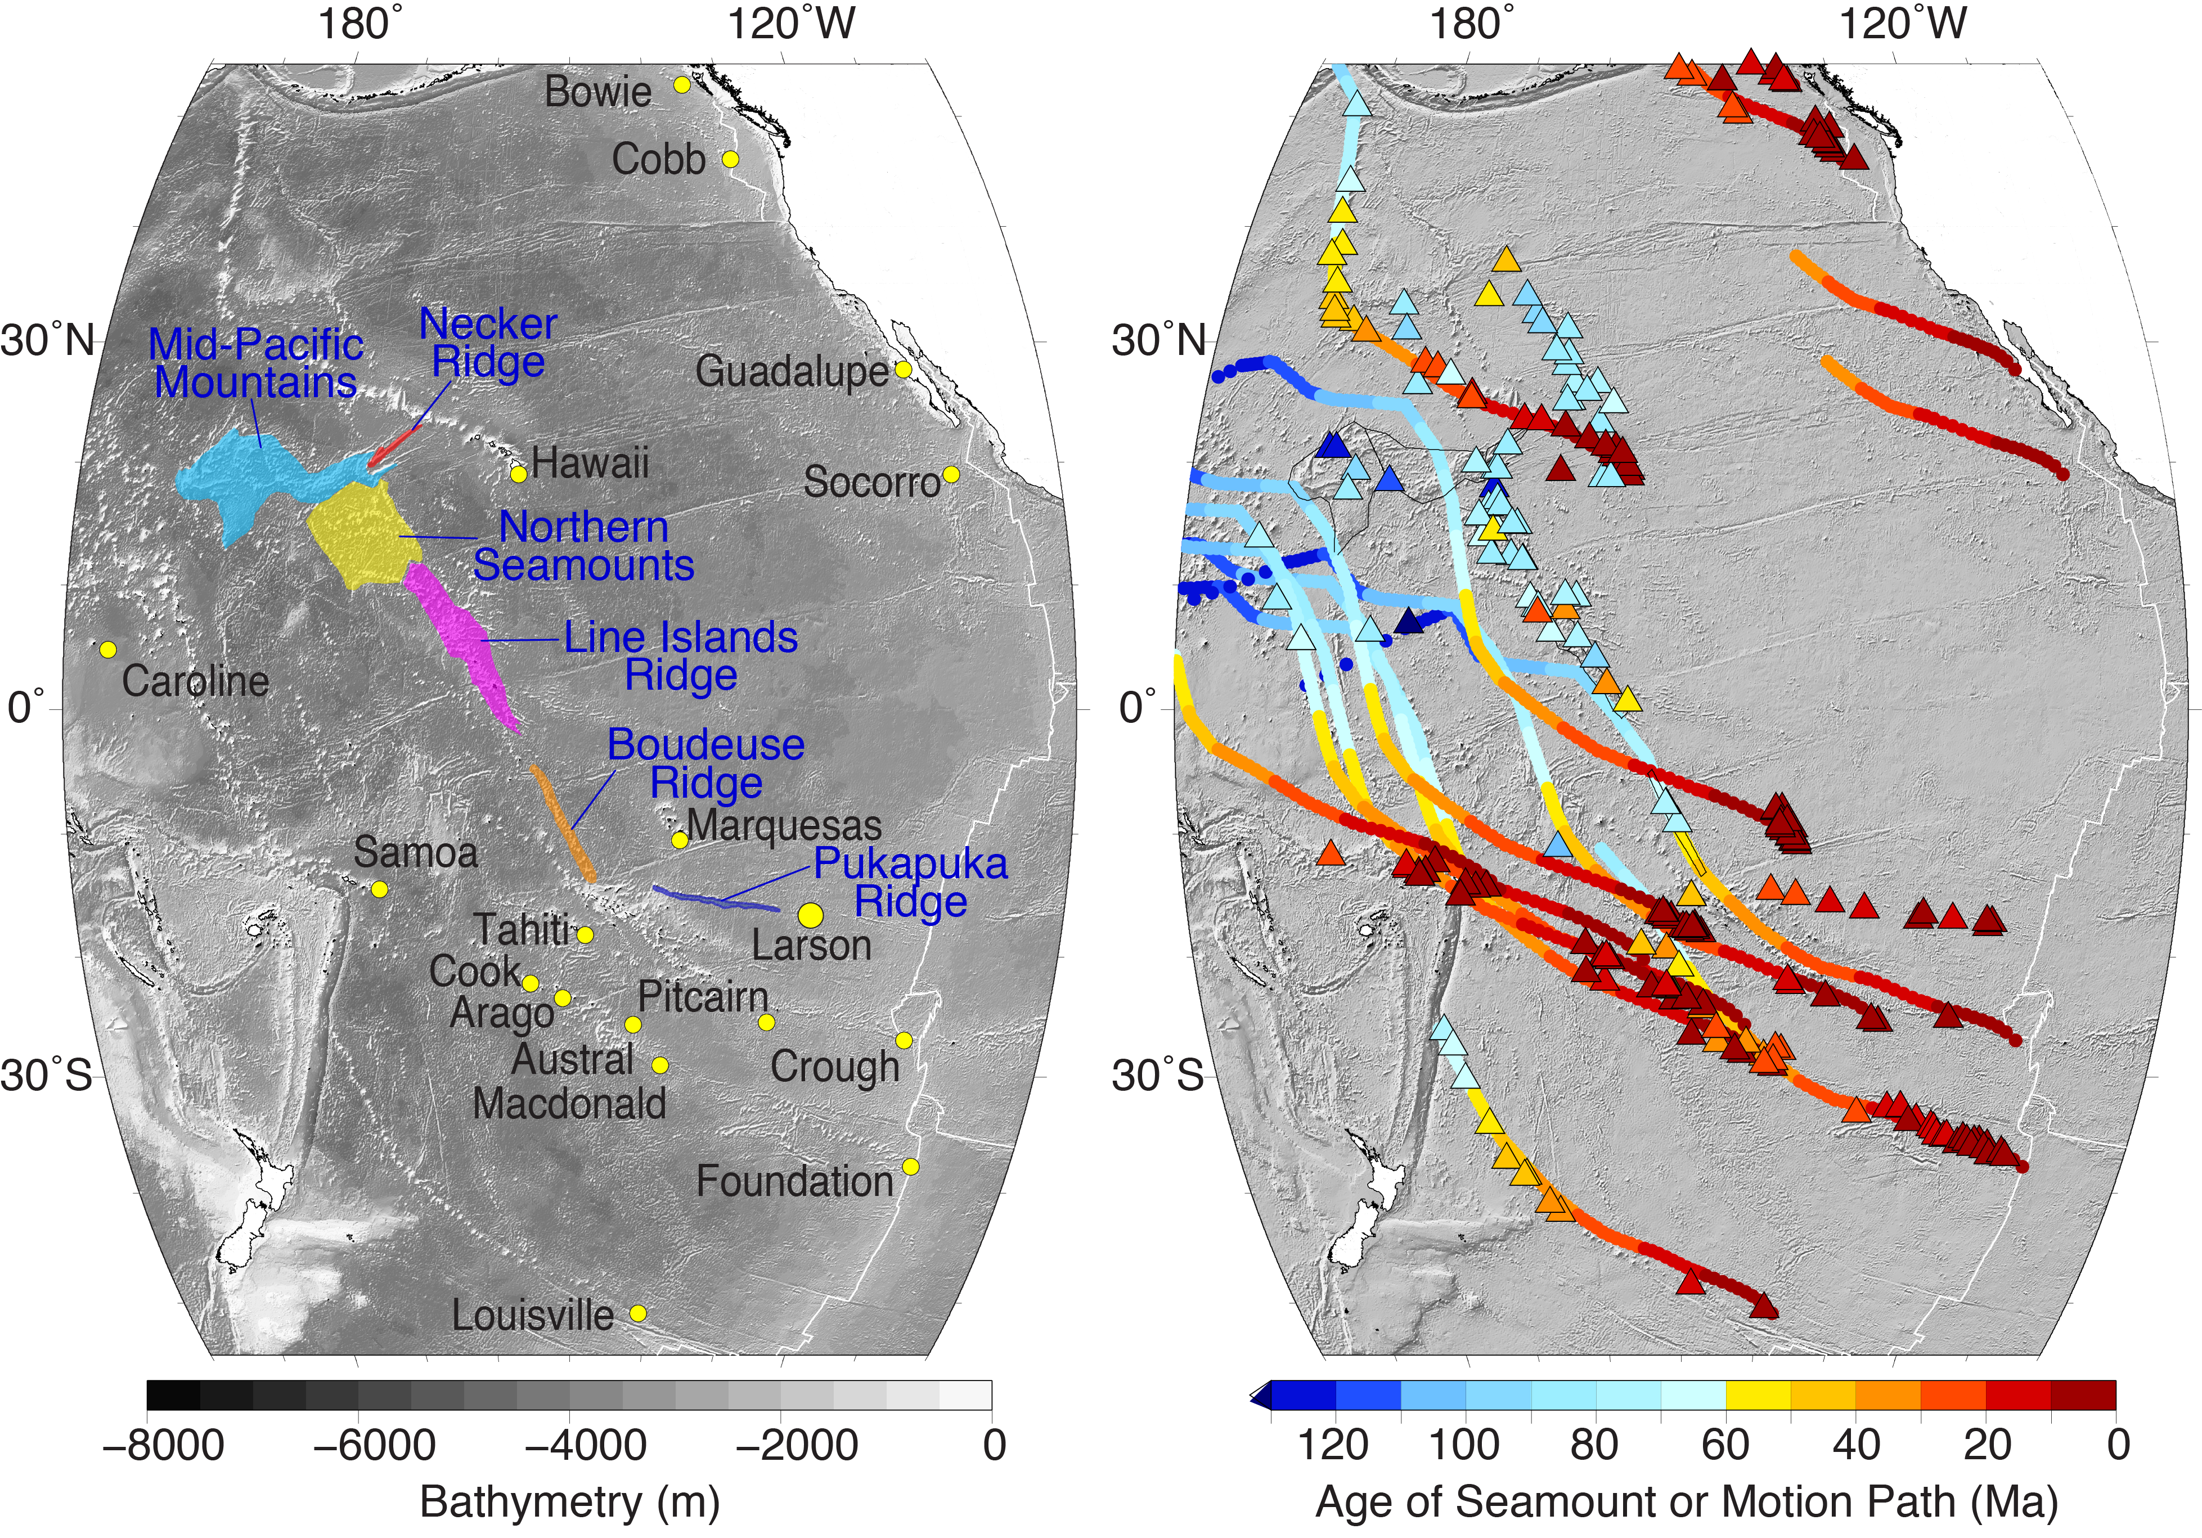
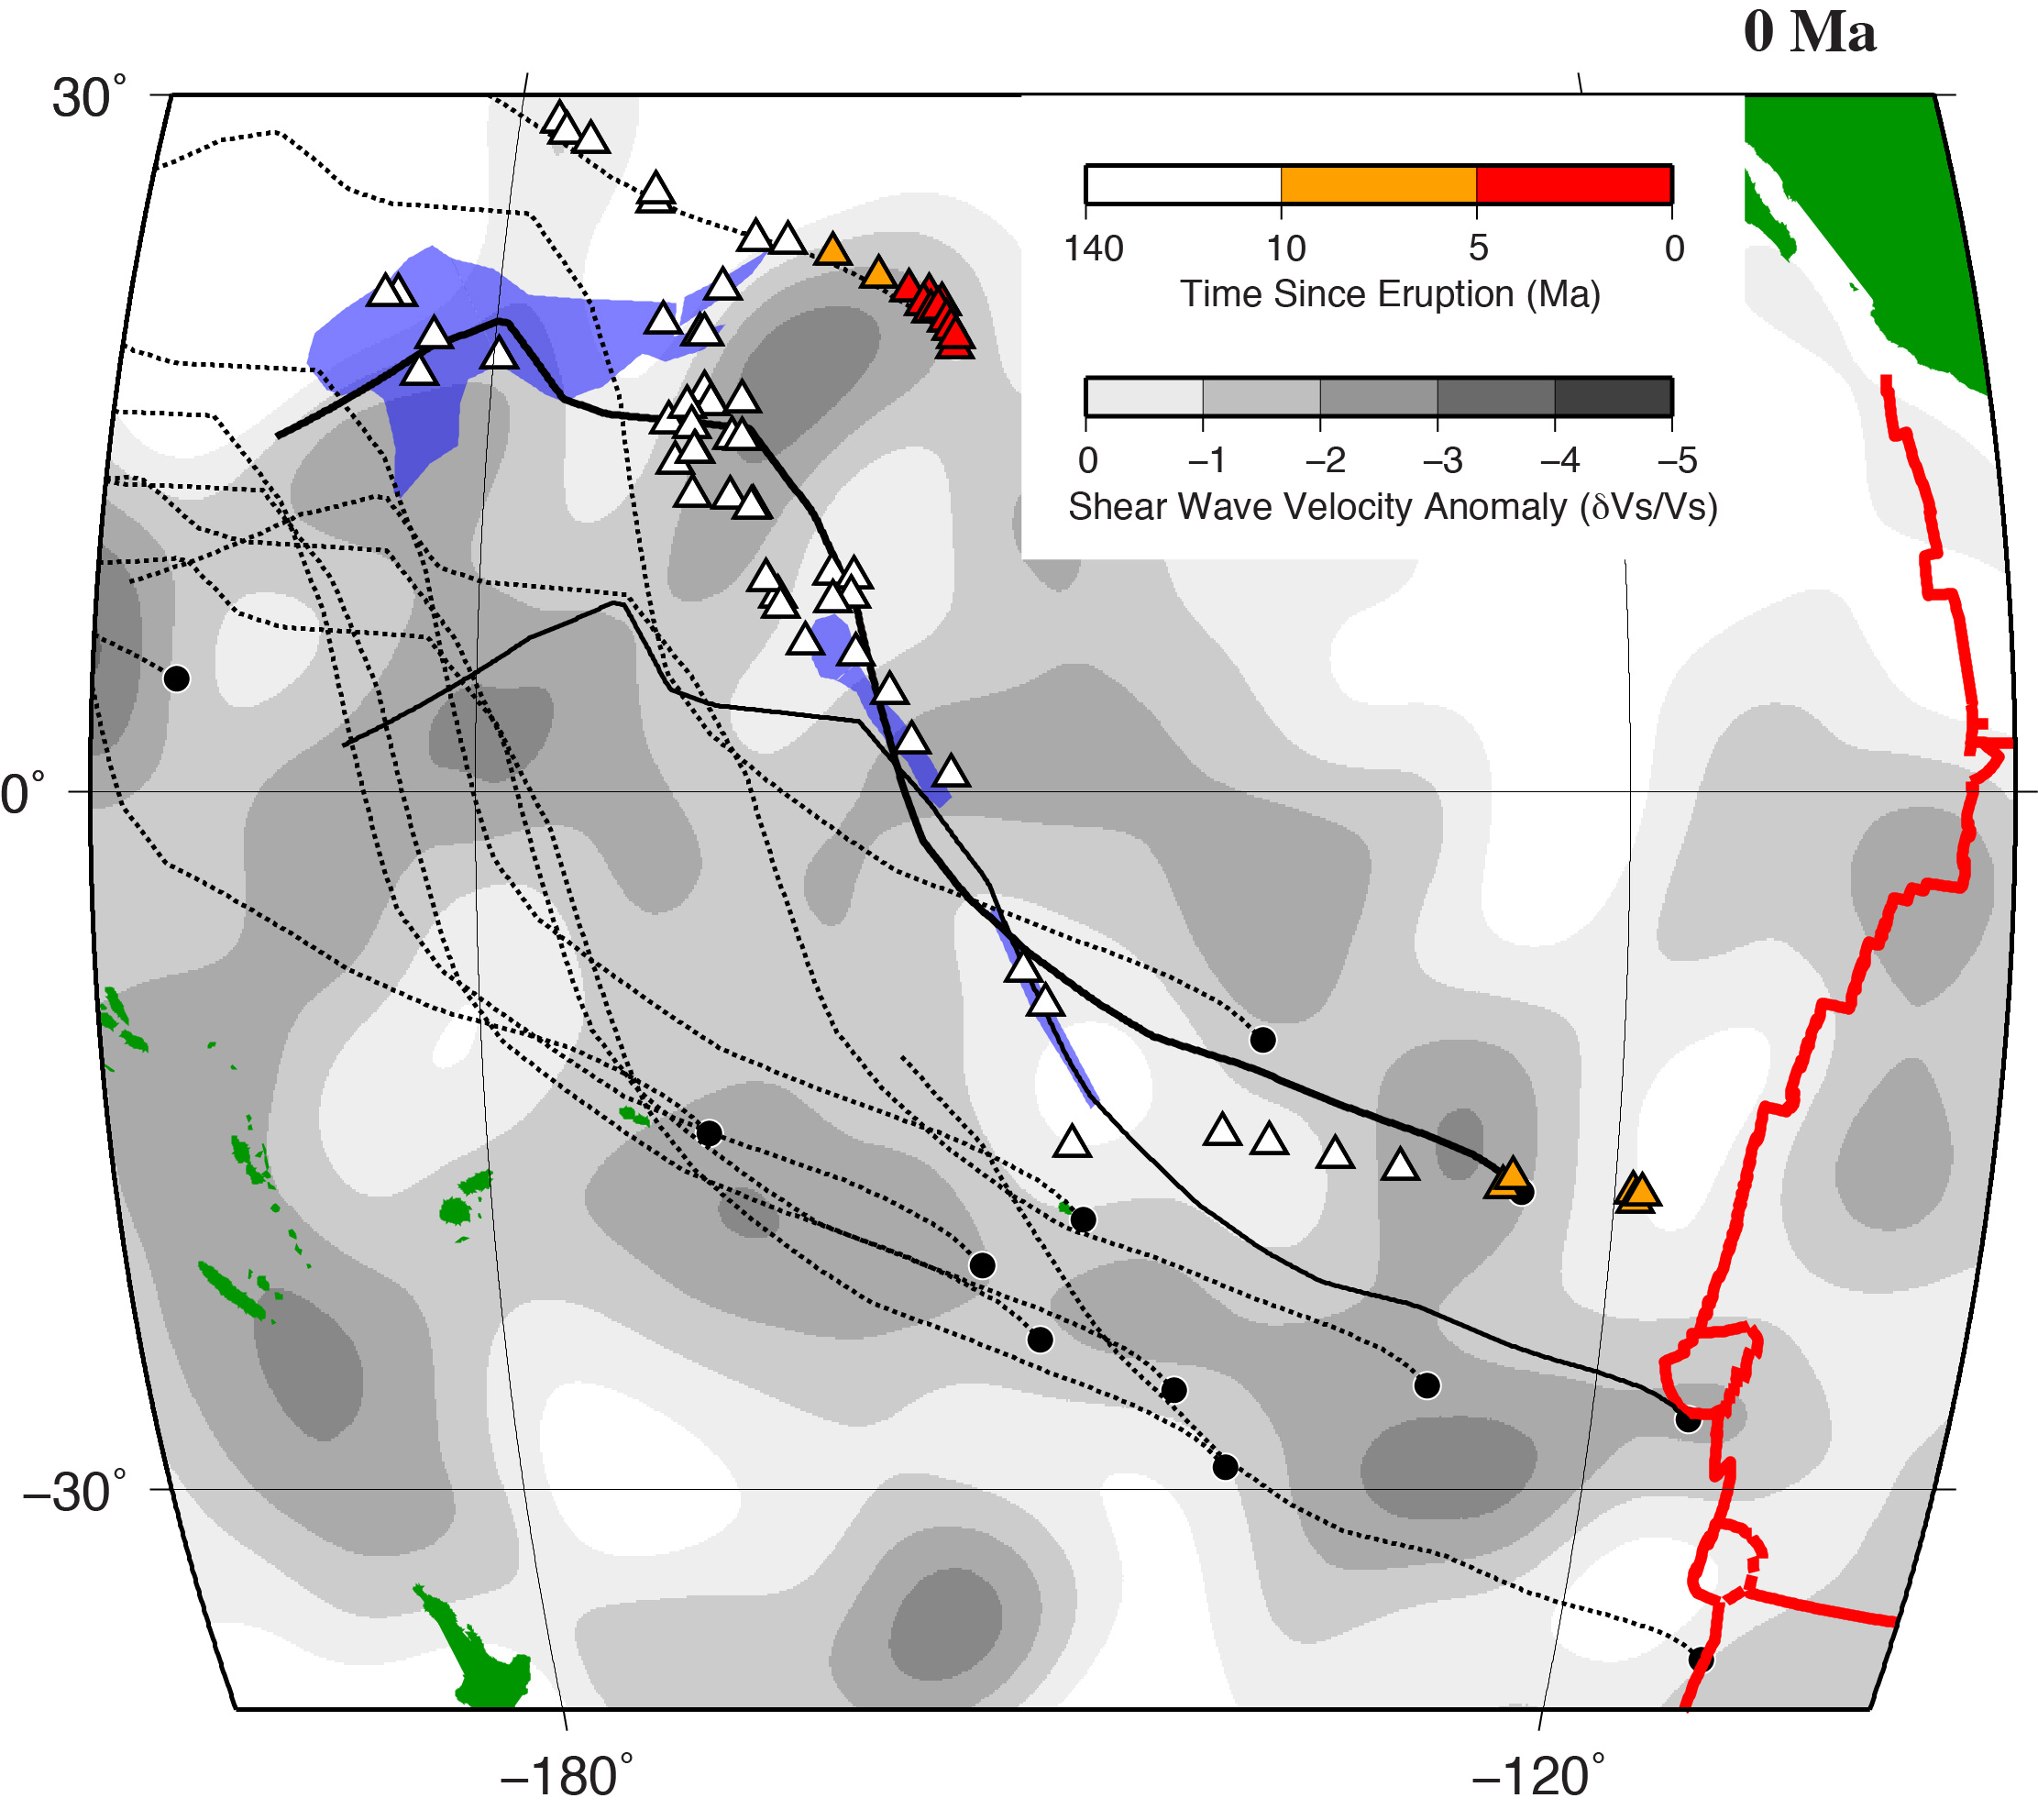
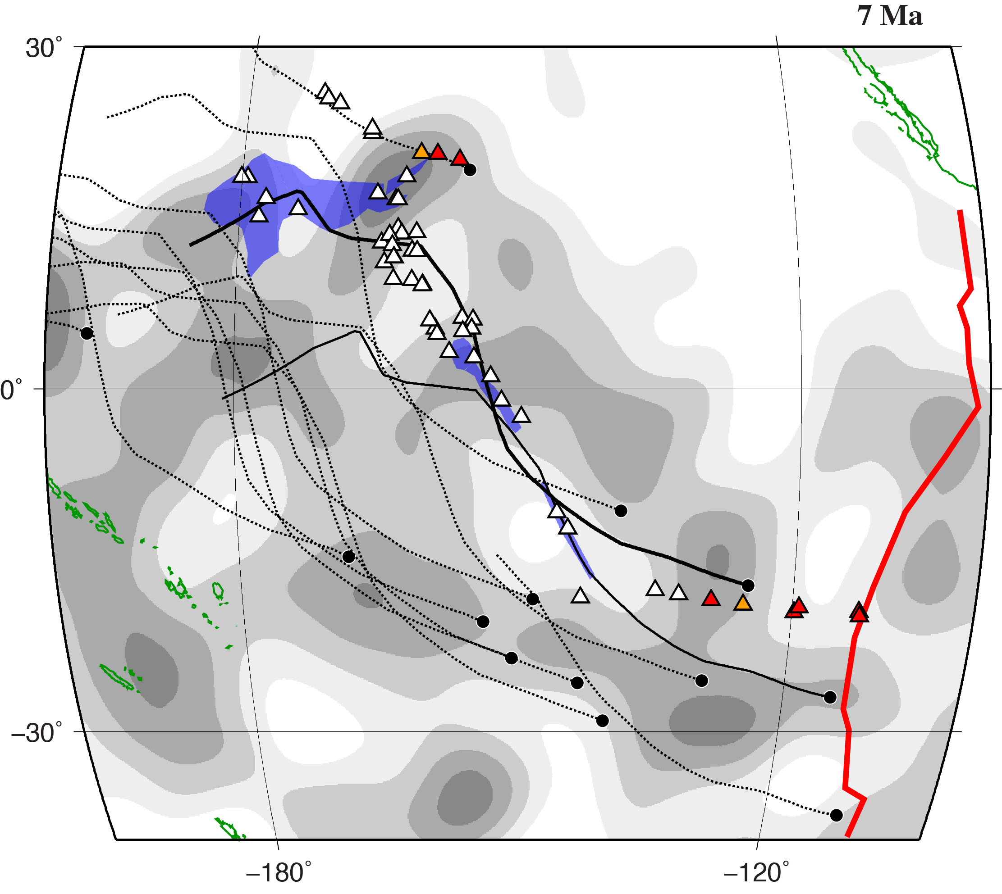
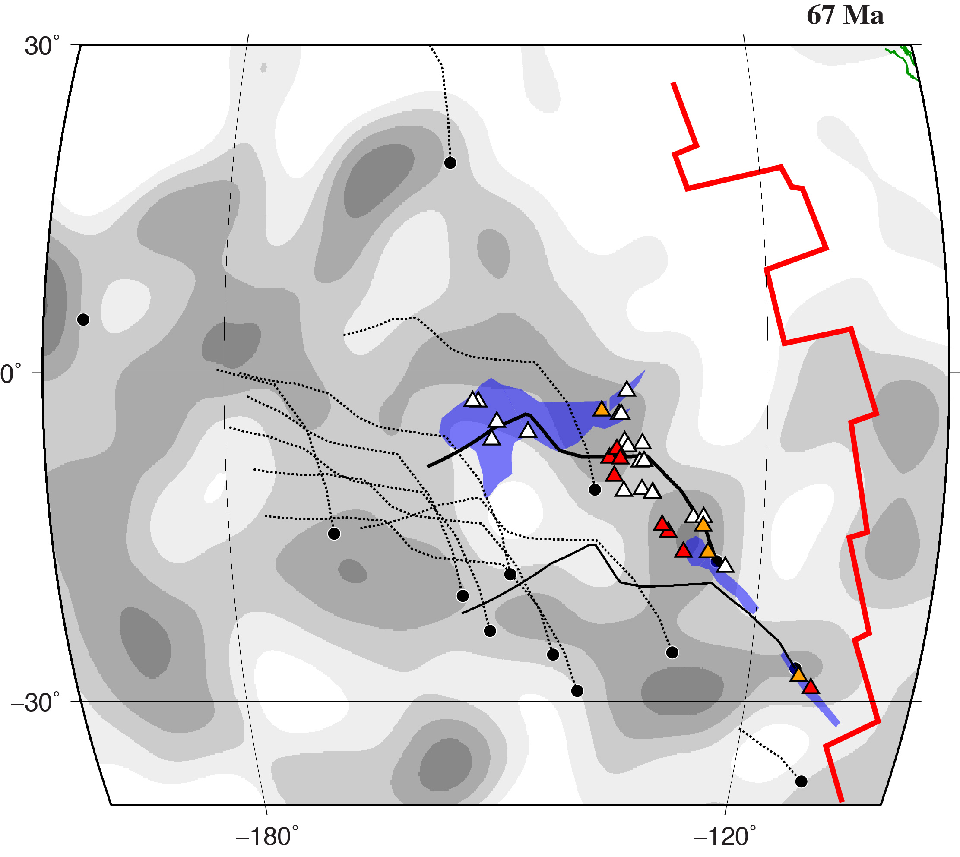
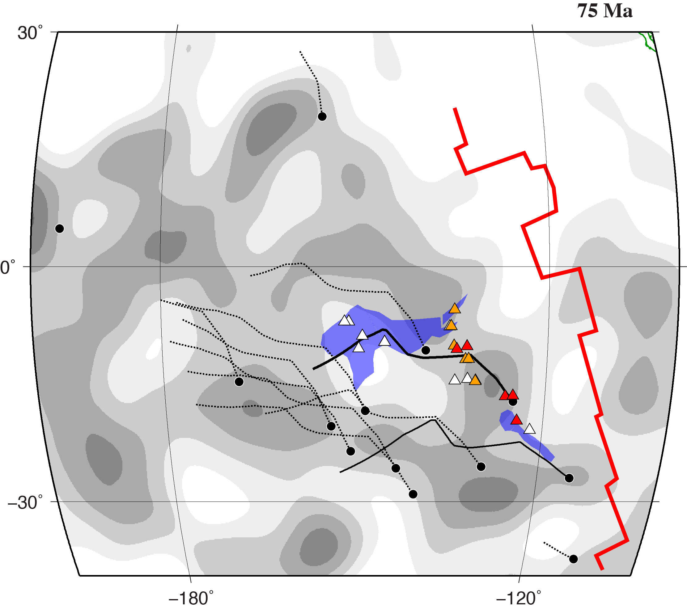
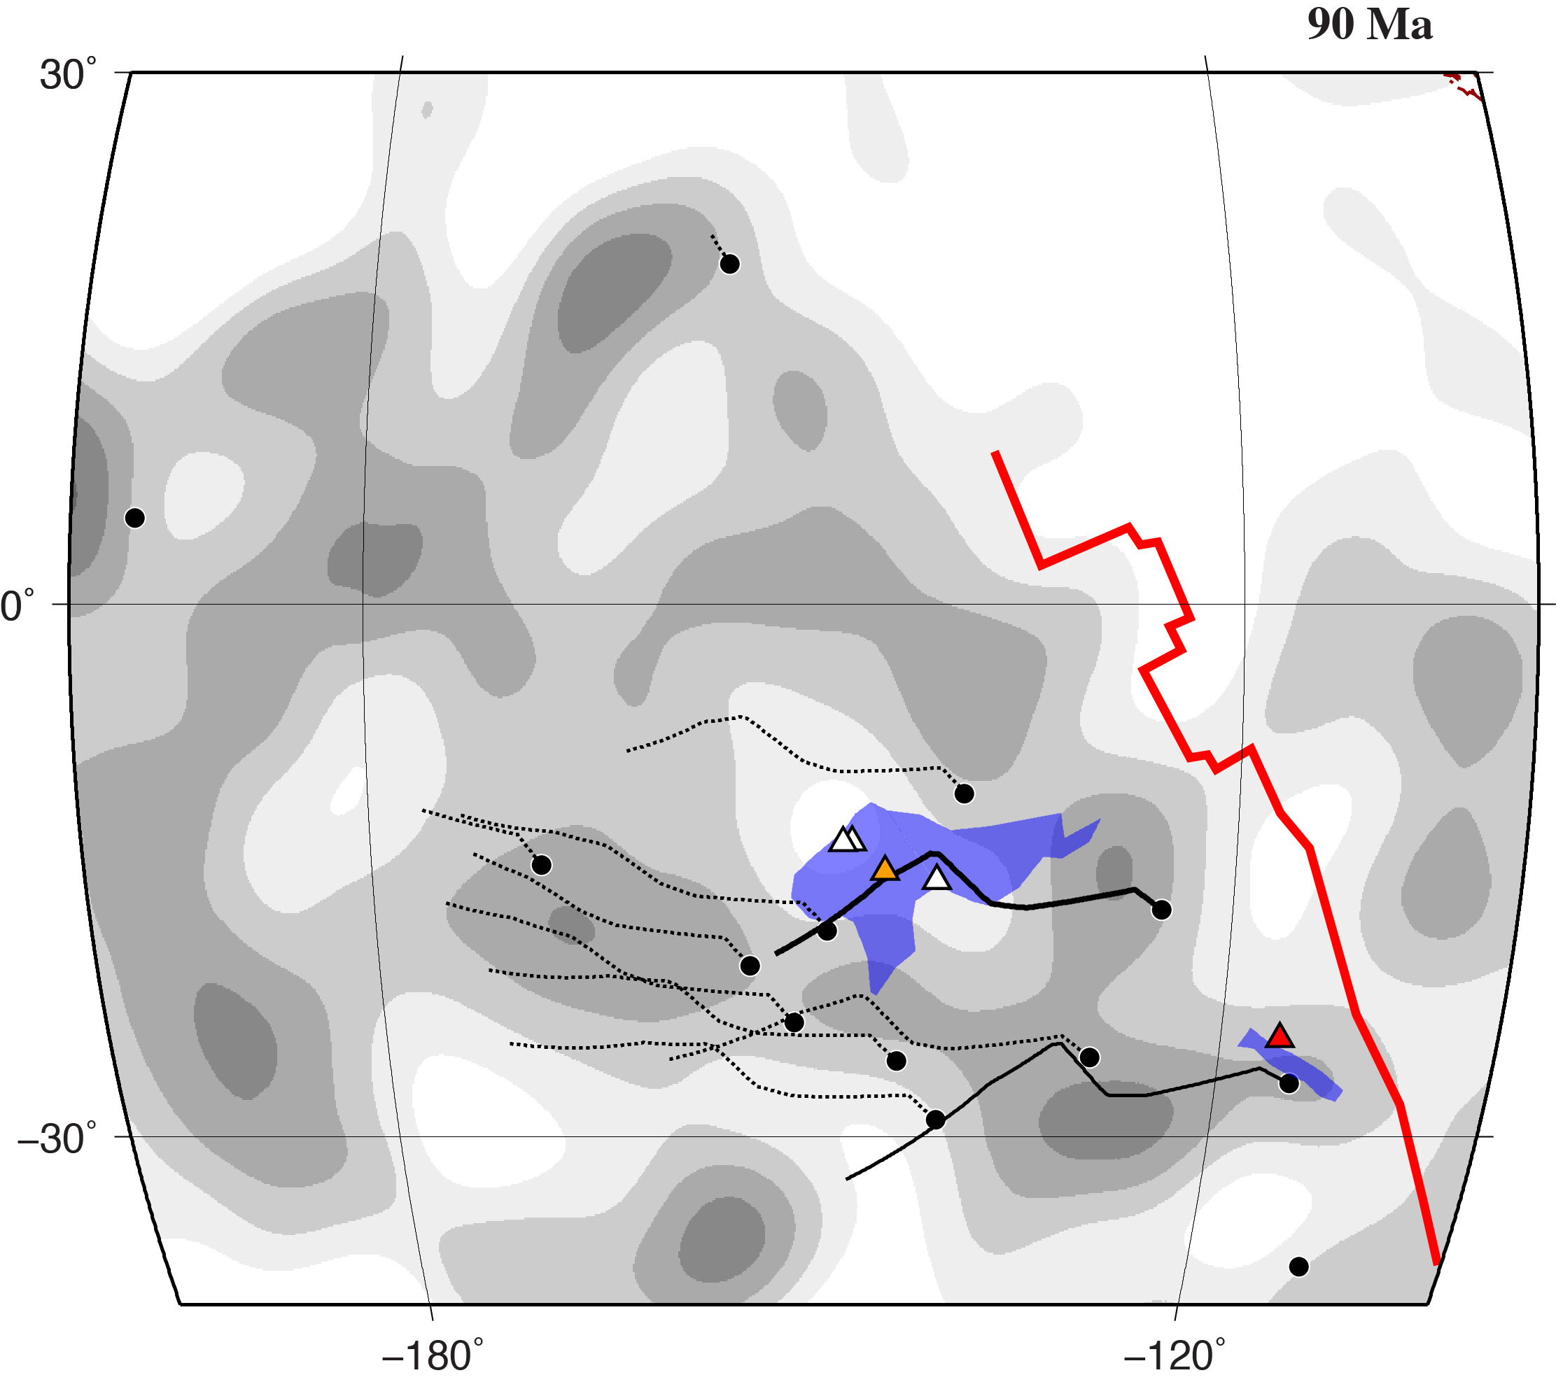
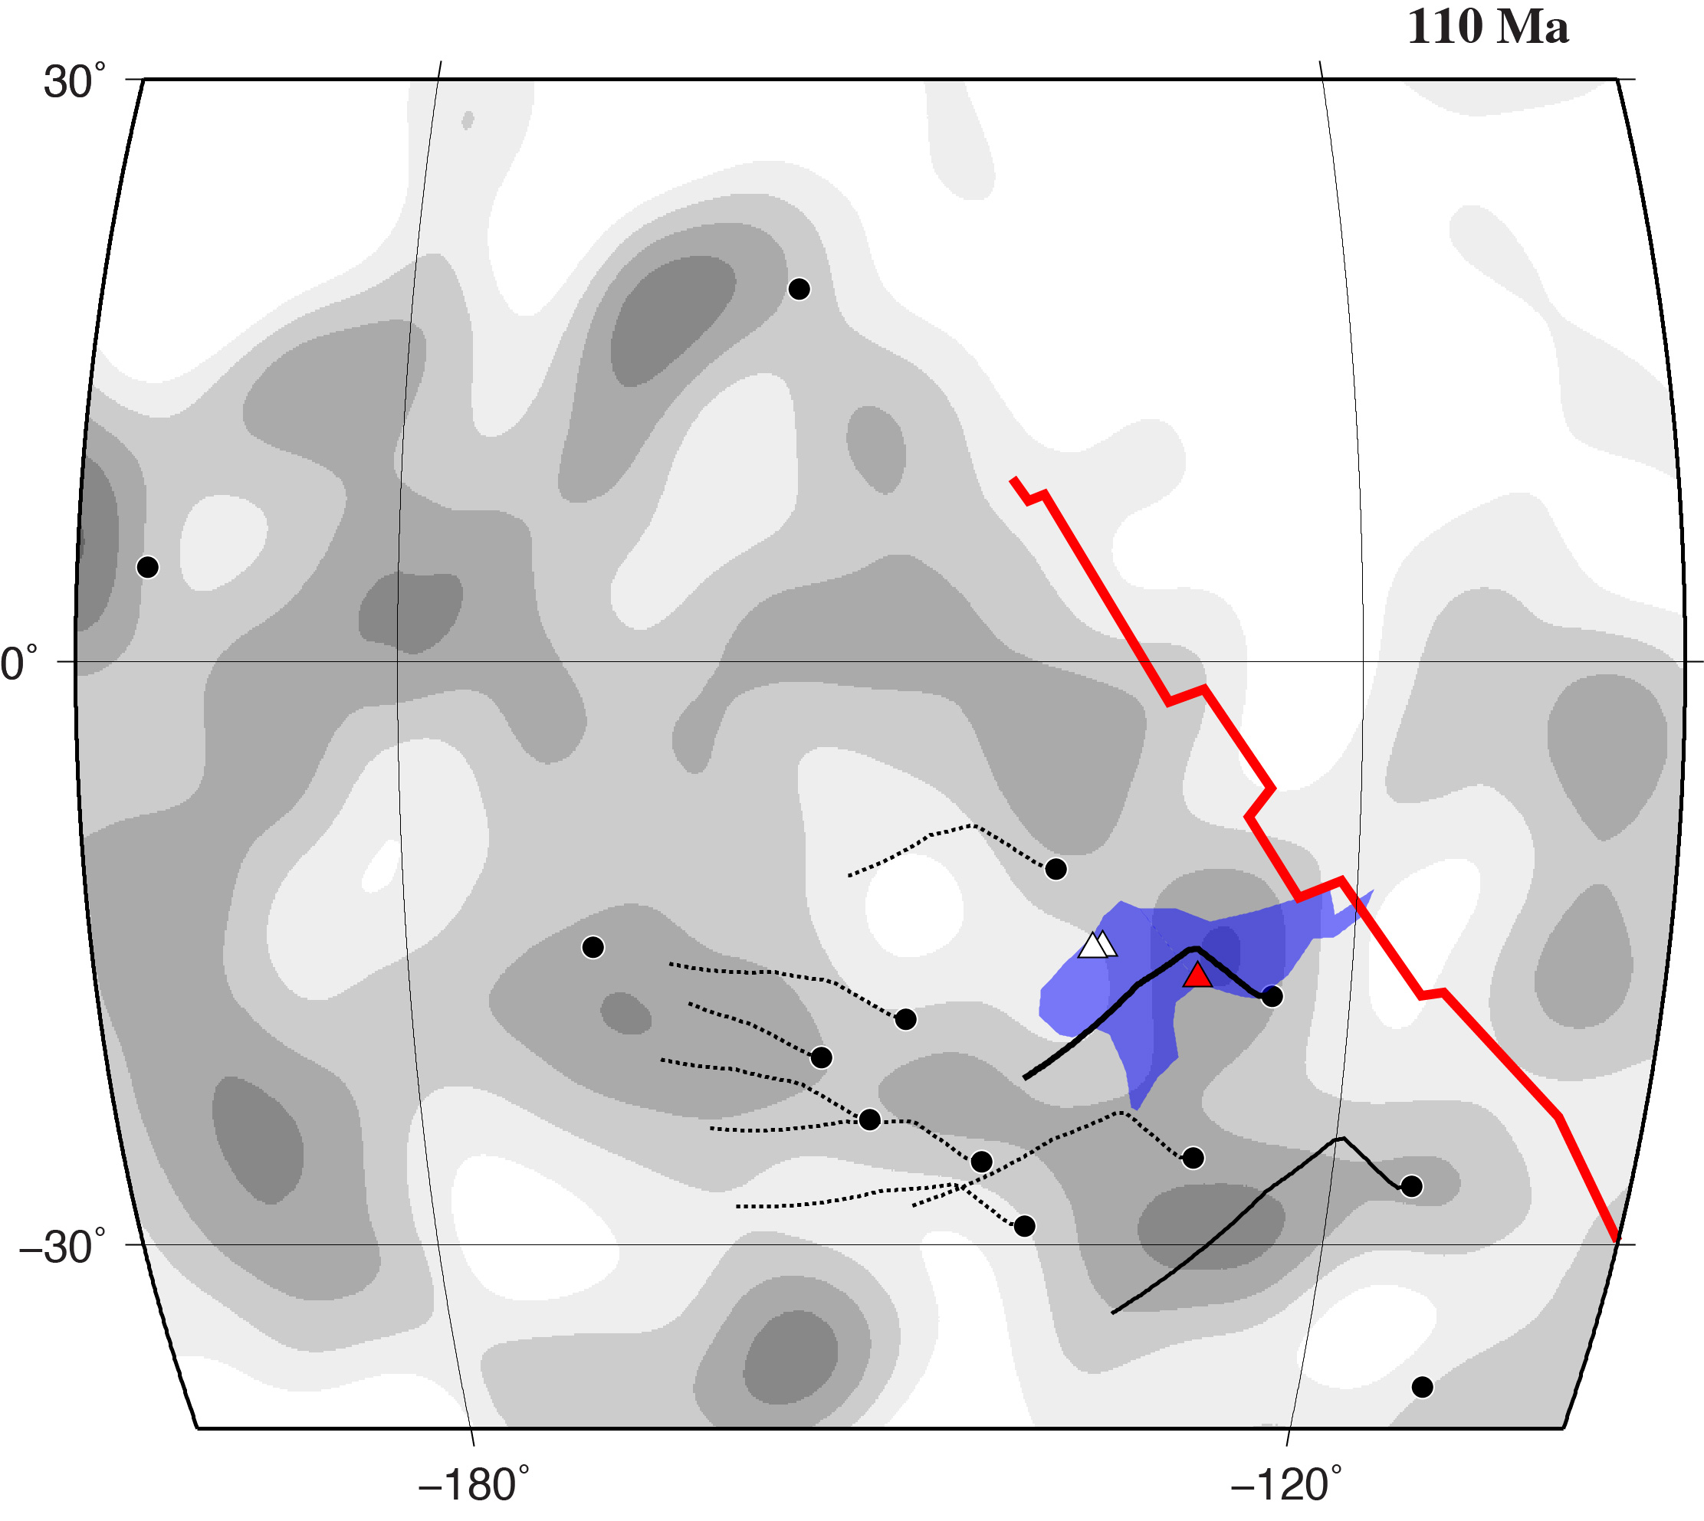
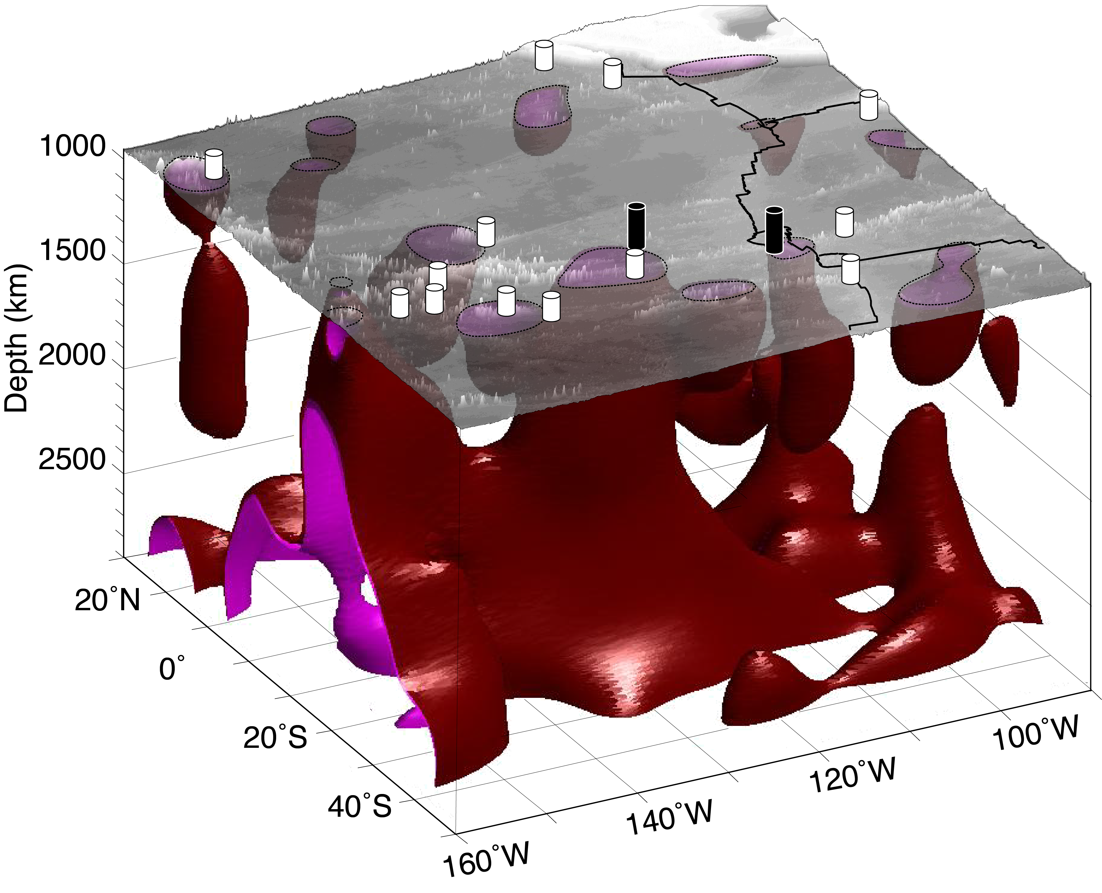
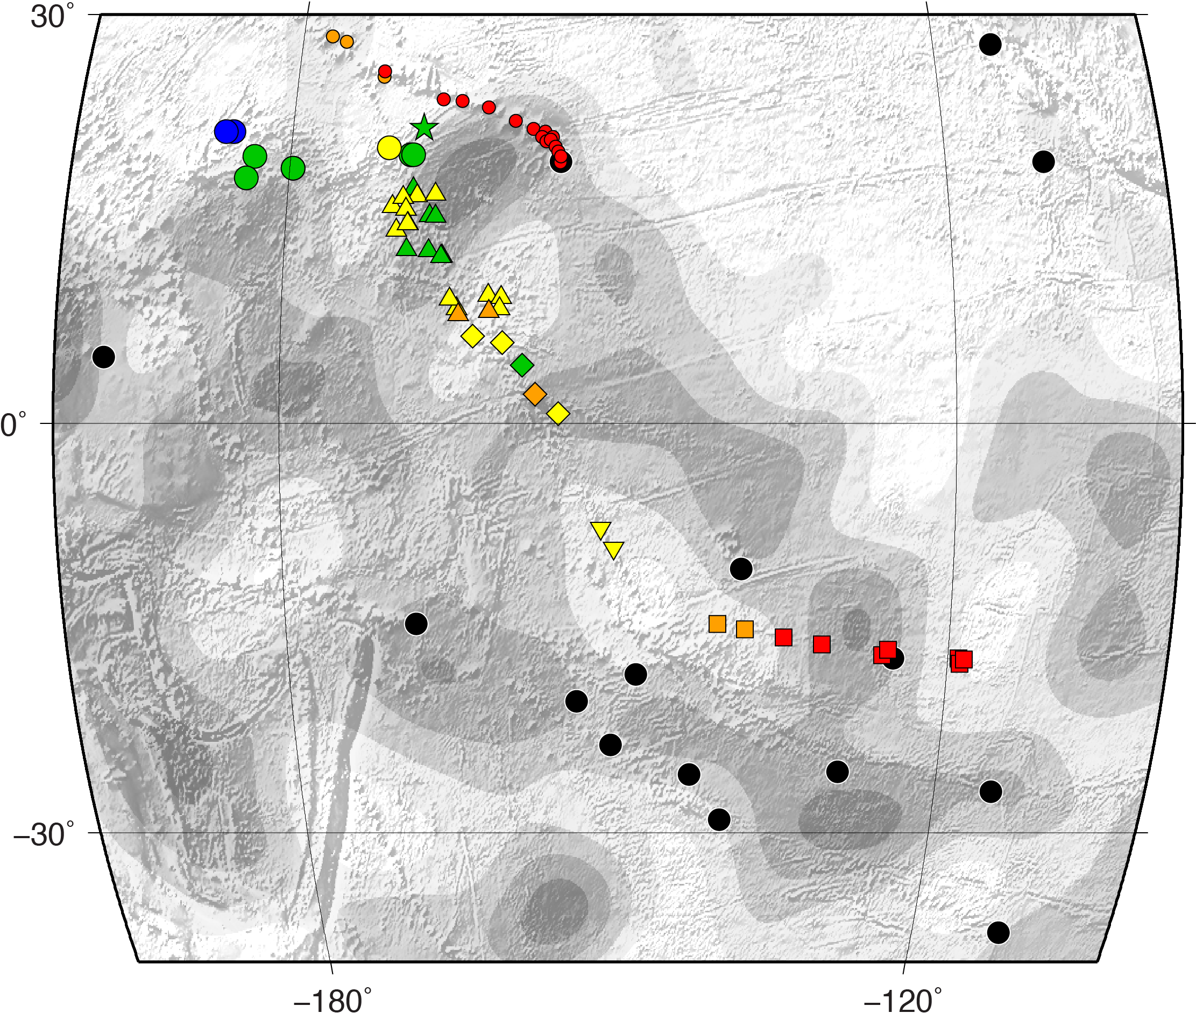
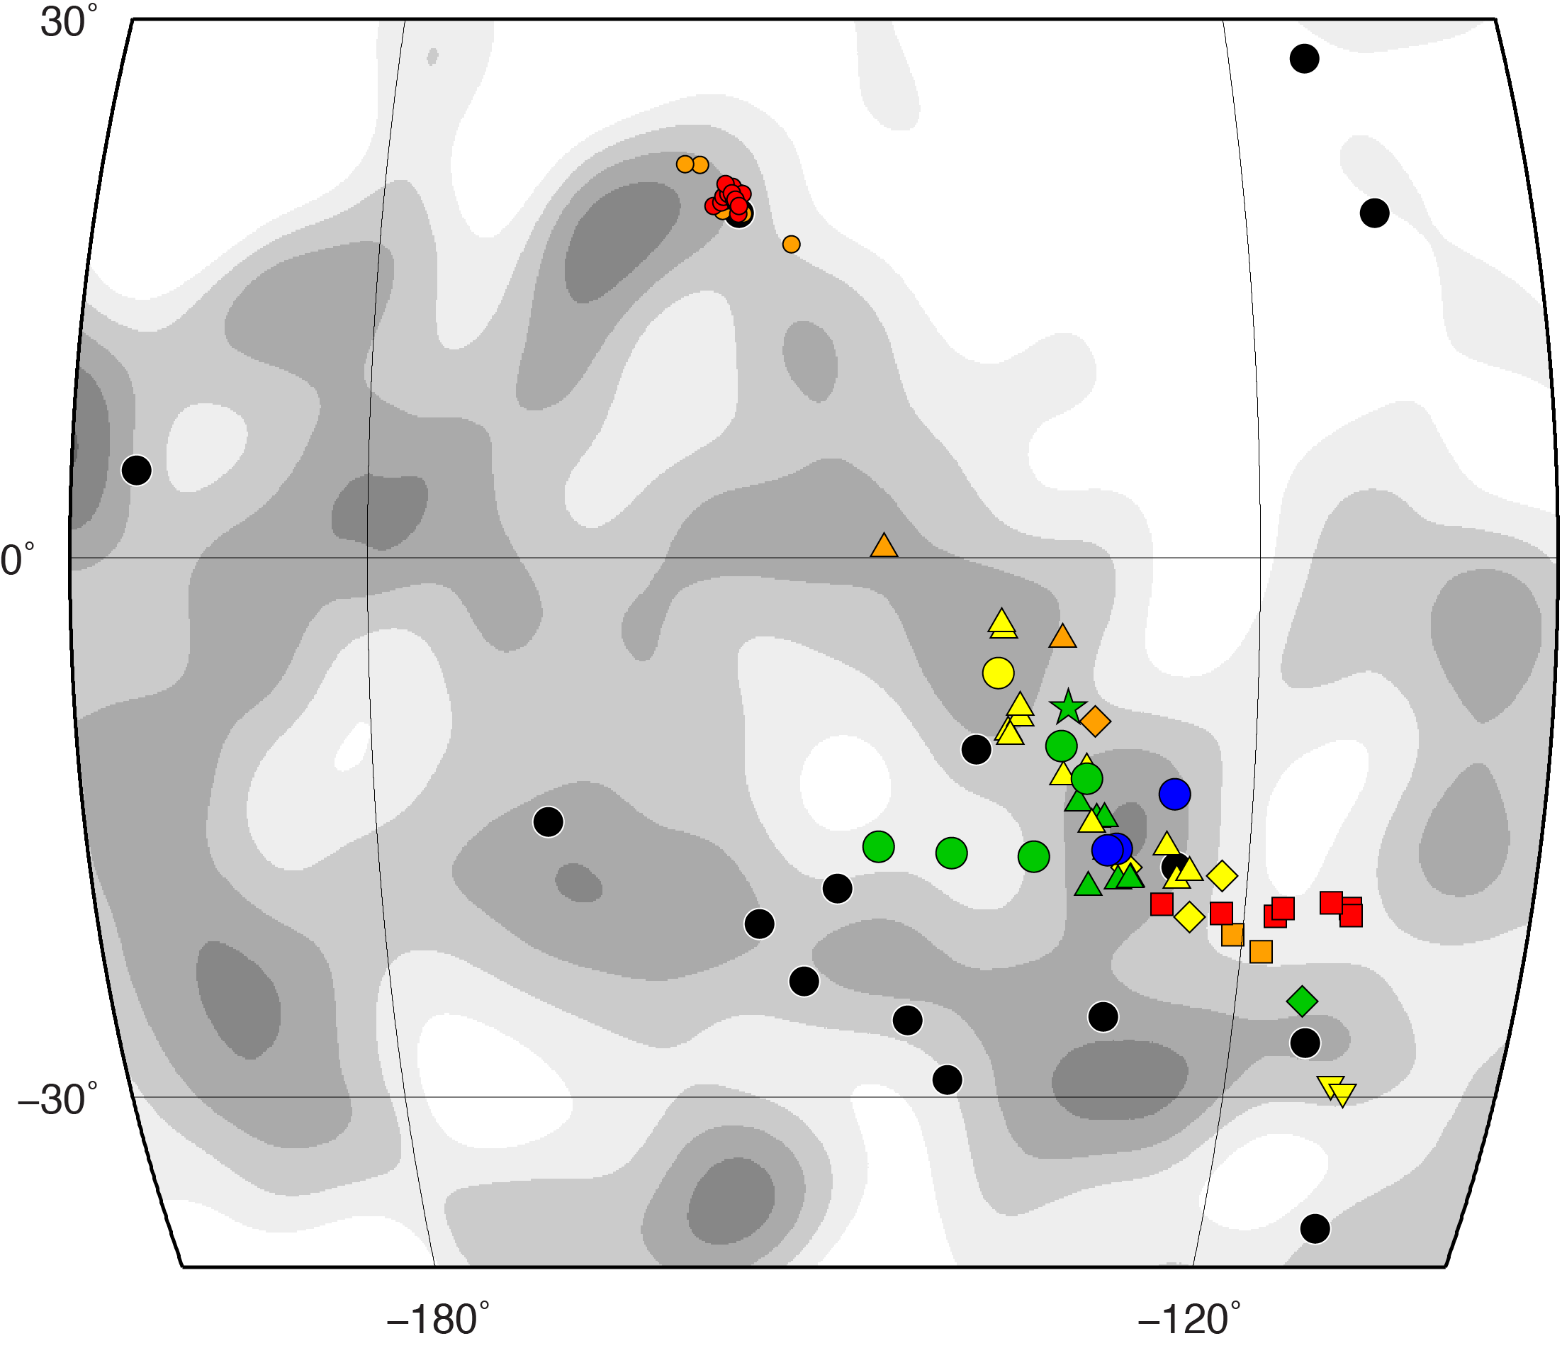
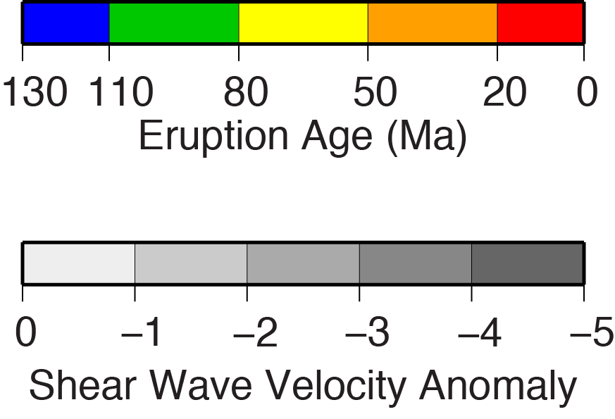
V23B
-3141
A Double Hotspot Model for the Origin of Line Islands Ridge
Robert A. Pockalny Graduate School of Oceanography, U. Rhode Island, Narragansett, RI (robp@gso.uri.edu)
Ginger Barth U.S. Geological Survey, Menlo Park, California
Christina Wertman Graduate School of Oceanography, U. Rhode Island, Narragansett, RI
MOTIVATION
  Explore Origin of Enigmatic Line Islands Ridge
  Path of volcanism follows a general absolute plate motion trend
  Lacks classic age-progressive volcanism pattern along Line Islands Ridge
  Propose a Double Hotspot Model of Line Islands Ridge
    Southern Line Islands Ridge
    Crough Hotspot (80 – 100 Ma)
    Larson Hotspot (50 – 65 Ma)
    Northern Line Islands Ridge
      Larson Hotspot (65 – 85 Ma)
RECONSTRUCTION (Fixed Pacific Plate)
Pukapuka Ridge
- Larson or Crough Hotspot (0 – 30 Ma)
Boudeuse Ridge
- Crough Hotspot (45 – 75 Ma)
Line Islands Ridge (North)
- Larson Hotspot (65 – 80 Ma)
Line Islands Ridge (South)
- Crough Hotspot (80 – 100 Ma)
- Larson Hotspot (50 – 65 Ma
Mid-Pacific Mountains
- Larson Hotspot prior to 110 Ma
LIP and/or
Plume-Ridge
Interaction
Melt Conduit?
Melt Conduit?
Larson
Lithosphere
Extension
Crough
Melt Conduit
RECONSTRUCTION (Fixed Mantle)
Pukapuka Ridge
- Larson or Crough Hotspot (0 – 30 Ma)
Boudeuse Ridge
- Crough Hotspot (45 – 75 Ma)
Line Islands Ridge (North)
- Larson Hotspot (65 – 80 Ma)
Line Islands Ridge (South)
- Crough Hotspot (80 – 100 Ma)
- Larson Hotspot (50 – 65 Ma
Mid-Pacific Mountains
- Larson Hotspot prior to 110 Ma
PREVIOUS WORK
Larson
  Age Progressive Single Hotspot Track
    Morgan [1972]
    Duncan and Clague [1985]
Crough
  Multiple Hotspots
    Crough and Jarrad [1981]
    Henderson and Gordon [1982]
LARSON HOTSPOT JUSTIFICATION
References
Cannon, J., Lau, E. and Müller, R. D. 2014, Solid Earth Discussions, 6, 793-830.
Clouard, V. and Bonneville, A. 2005, GSA Special Papers, 388, 71-90.
Courtillot, V., Davaille, A., Besse, J. and Stock, J. 2003. Earth Planet. Sci. Lett,, 205, 295-308.
  Crough, S. T., and Jarrad, R. D. 1981Journal of Geophysical Research, 86, 11,763–11,771.
  Davis, A. S., Gray, L. B., Clague, D. A. and Hein, J. R. 2002, Geochemistry, Geophysics, Geosystems, 3, 1-28.
Duncan, R. A. and Clague, D. A. 1985, The ocean basins and margins (pp. 89-121). Springer US, doi 10.1007/978-1-4613-2351-8_3.
Earth Reference Data and Models, 2015, Seamount Catalog: http:// http://earthref.org/SC/ (accessed Sept., 2015).
French, S. W. and Romanowicz, B. 2015, Nature, 525, 95-99.
  Henderson, L. J., and Gordon, R. G. 1982. GSA Abstr. Programs, 14, 513, 1982.
  Morgan, W. J., 1972. Am. Assoc. Petrol. Geol. Bull., 56, 203–213.
  Morgan, W. J. and Morgan, J. P. 2007, GSA Special Papers, 430, 65-78.
Sandwell, D. T., Winterer, E. L., Mammerickx, J., Duncan, R. A., Lynch, M. A., Levitt, D. A. and Johnson, C. L. 1995, J. Geophys. Res., 100, 15087-15099.
Seton, M., Müller, R. D., Zahirovic, S., Gaina, C., Torsvik, T., Shephard, G., Talsma, A., Gurnis, M., Turner, M., Maush, S. and Chandler, M. 2012, Earth-Science Reviews, 113, 212-270.
Smith, W. H., and Sandwell, D. T. 1997, Science, 277, 1956-1962.
Winterer, E. L. and Metzler, C. V. 1984, J. Geophys. Res., 89, 9969-9979.
Deep and Mid-Mantle Plume Sources
Present-day
Dated Seamount Locations
  Lithosphere Extension
    Winterer [1976]
    Davis et al. [2002]
Larson
Crough
Reconstructed
Eruption Sites
DATA & METHODS
  Tectonic Reconstruction Software
    GPlates, Cannon et al [2014]
Larson
  Plate Motion Model
    Seton et al. [2012]
Crough
  Seamount Ages
    Earth Reference Data and Models [2015]
    Clouard and Bonneville [2005]
  Hotspot Locations
    Morgan and Morgan [2007]
    Courtillot et al. [2003]
Larson
Shear Wave Velocity Anomaly
Isosurfaces (-0.7 – -0.8)
Crough
Acknowledgments
This research was partially funded by the U.S. Geological Survey (#G13AC00351) and the National Science Foundation (OCE-1158994).
  Mantle Shear Wave Anomalies
    French and Romanowicz [2015]

