Slide 1
GSO Teaching Workshop
Learning Styles
Pedagogy
Instructional Design
Those who can, do; those who can't, teach.
George Bernard Shaw's Man and Superman.
Those who can’t teach, teach teachers.
Carol Lawson, SBU Education Major, 1985.
Rob Pockalny (rpockalny@uri.edu)
Assoc. Marine Research Scientist
Horn Lab 207
Graduate School of Oceanography
University of Rhode Island
Narragansett. RI 02882

Slide 2
What was the most memorable/favorite course you have ever had?
- Why?
What was the least memorable/favorite course you have ever had?
- Why?

Slide 3
Learning Theories
Constructivism
research projects / case studies
problem-based learning
outcomes are not always predictable
construct own knowledge
Cognitivism
Behaviorism
classifying information
analogies
reorganization of experiences vs attaining new insights
drill & rote
repetitive practice
not good for problem solving or creative thinking

Slide 4
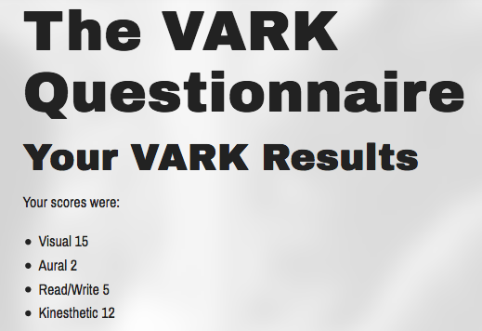
Learning Styles
http://vark-learn.com/the-vark-questionnaire/

Slide 5
Learning Styles
VARK
Visual
- depiction of information in maps, graphs, labeled diagrams
- NOT pictures, videos or powerpoint
Aural
- preference for information that is heard or spoken
- lectures, group discussion, radio, email, speaking
Read/Write
- preference is for information displayed as words
- text-based input and output - manuals, reports, essays
Kinesthetic
- preference for experience and practice (simulated or real).
- demonstrations, simulations, videos and movies of "real" things, as well as case studies, practice and applications

Slide 6
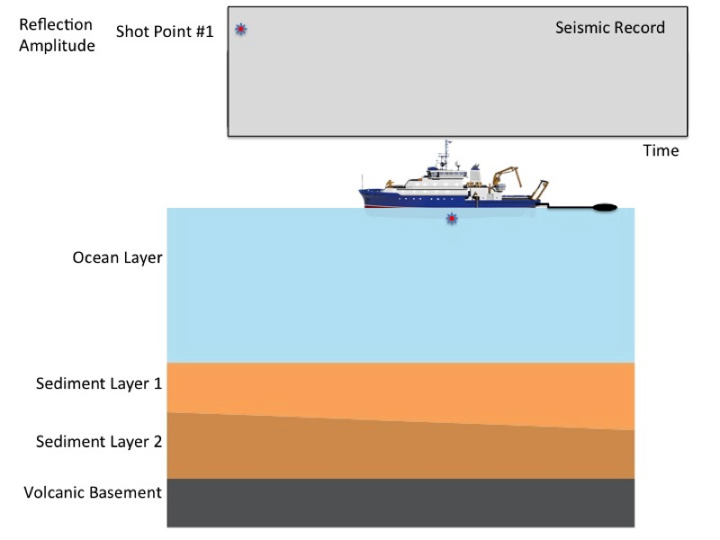
Learning Styles

Slide 7
Pedagogy
Study of how knowledge and skills are exchanged in an educational context, and it considers the interactions that take place during learning
What are the components of pedagogy?
Teacher
Mode of Instruction
- didactic/structured
Knowledge
Skills
Learner

Slide 8
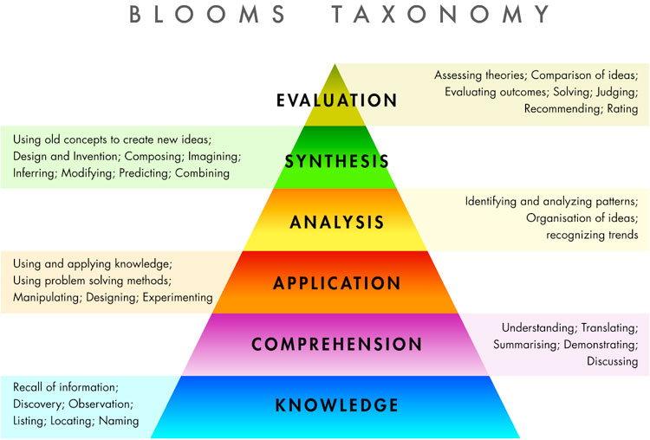
Pedagogy
Levels of Understanding

Slide 9

Pedagogy
1) Which seafloor features exhibit active volcanism?
2) Where do you think the seafloor is oldest?
3) ID 5 features on Seafloor
4) How can you explain pattern of the Hawaii chain?
5) Is there a trend you observe in the Hawaii chain?
6) Is there corroborating evidence of your Hawaii chain explanation?
What is the order of increasing knowledge
according to Blooms Taxonomy?

Slide 10
Pedagogy
6) Is there corroborating evidence of your Hawaii chain explanation?
4) How can you explain pattern of the Hawaii chain?
5) Is there a trend you observe in the Hawaii chain?
2) Where do you think the seafloor is oldest?
1) Which seafloor features exhibit active volcanism?
3) ID 5 features on Seafloor
What is the order of increasing knowledge?

Slide 11
Pedagogy
Levels of Understanding
Review of
Proposals/Manuscripts
Thesis/Dissertation
College
High School
Middle School
Grade School

Slide 12
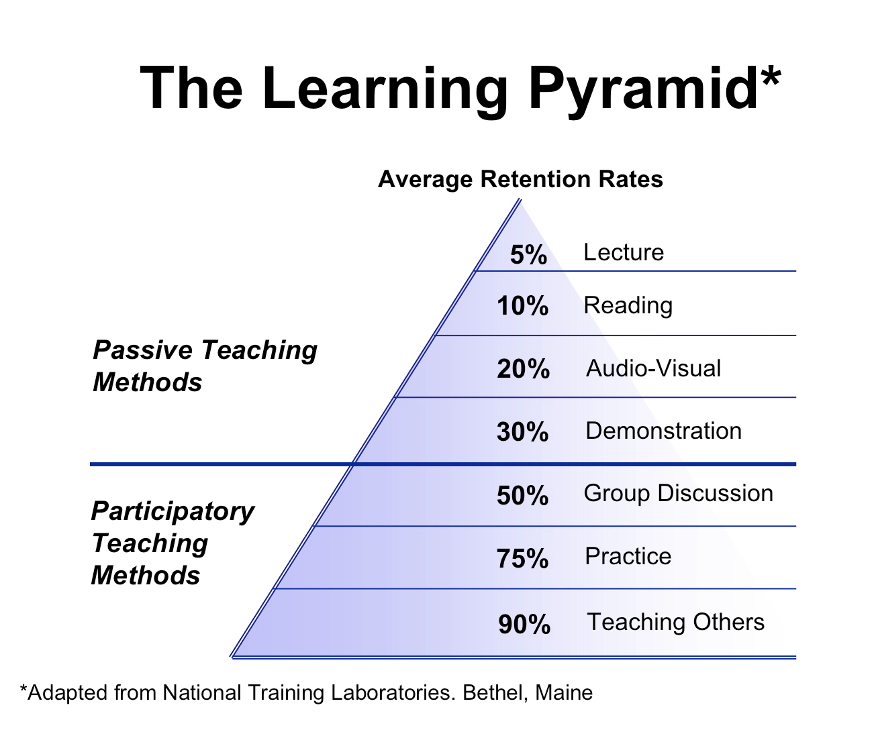
Pedagogy
Which methods are most predominant
in your graduate education?
classes
research
Passive
Learning Methods
Active
Learning Methods

Slide 13
Pedagogy
Levels of Inquiry Activity
Get into 4 groups
Follow “directions” on the sheets (do not write on sheets)
After 5 minutes, exchange sheets with the next adjacent group
Use on-line resources as needed.

Slide 14
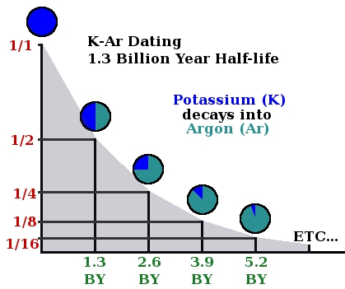
Pedagogy
What is the age of the rock below?
Count the number of Parent Isotopes (⁴⁰K)
Count the number of Daughter Isotopes (⁴⁰Ar)
Calculate ratio of Parent to Daughter isotopes (⁴⁰K/⁴⁰Ar)
Use ratio and graph to estimate age of rock.
Rock Chemistry
⁴⁰ K
⁴⁰ K
⁴⁰ Ar
⁴⁰ Ar
⁴⁰ K
⁴⁰ K
⁴⁰ Ar
⁴⁰ Ar
⁴⁰ Ar
⁴⁰ Ar
⁴⁰ K
⁴⁰ Ar
⁴⁰ K
⁴⁰ Ar
⁴⁰ K
⁴⁰ Ar
⁴⁰ K
⁴⁰ K
⁴⁰ Ar
⁴⁰ K
⁴⁰ Ar
⁴⁰ K
⁴⁰ Ar
⁴⁰ Ar
⁴⁰ K
⁴⁰ Ar
⁴⁰ K
⁴⁰ Ar
⁴⁰ K
⁴⁰ K
⁴⁰ Ar
⁴⁰ Ar
⁴⁰ Ar
⁴⁰ Ar
⁴⁰ K
⁴⁰ Ar
⁴⁰ Ar
⁴⁰ Ar
⁴⁰ K
⁴⁰ K
⁴⁰ Ar
⁴⁰ Ar
⁴⁰ Ar
⁴⁰ Ar
⁴⁰ Ar
⁴⁰ Ar
⁴⁰ Ar
⁴⁰ Ar
⁴⁰ Ar
⁴⁰ Ar
⁴⁰ K
⁴⁰ Ar
⁴⁰ Ar
⁴⁰ Ar
⁴⁰ Ar
⁴⁰ Ar
⁴⁰ Ar
⁴⁰ Ar
⁴⁰ Ar
⁴⁰ Ar
⁴⁰ Ar
⁴⁰ Ar
⁴⁰ Ar
⁴⁰ Ar

Slide 15
Pedagogy
What is the age of the rock below?
Use the Parent (⁴⁰K) and Daughter (⁴⁰Ar) isotope ratios and the graph to estimate age of rock sample.
Rock Chemistry
⁴⁰ K
⁴⁰ K
⁴⁰ Ar
⁴⁰ Ar
⁴⁰ K
⁴⁰ K
⁴⁰ Ar
⁴⁰ Ar
⁴⁰ Ar
⁴⁰ Ar
⁴⁰ K
⁴⁰ Ar
⁴⁰ K
⁴⁰ Ar
⁴⁰ K
⁴⁰ Ar
⁴⁰ K
⁴⁰ K
⁴⁰ Ar
⁴⁰ K
⁴⁰ Ar
⁴⁰ K
⁴⁰ Ar
⁴⁰ Ar
⁴⁰ K
⁴⁰ Ar
⁴⁰ K
⁴⁰ Ar
⁴⁰ K
⁴⁰ K
⁴⁰ Ar
⁴⁰ Ar
⁴⁰ Ar
⁴⁰ Ar
⁴⁰ K
⁴⁰ Ar
⁴⁰ Ar
⁴⁰ Ar
⁴⁰ K
⁴⁰ K
⁴⁰ Ar
⁴⁰ Ar
⁴⁰ Ar
⁴⁰ Ar
⁴⁰ Ar
⁴⁰ Ar
⁴⁰ Ar
⁴⁰ Ar
⁴⁰ Ar
⁴⁰ Ar
⁴⁰ K
⁴⁰ Ar
⁴⁰ Ar
⁴⁰ Ar
⁴⁰ Ar
⁴⁰ Ar
⁴⁰ Ar
⁴⁰ Ar
⁴⁰ Ar
⁴⁰ Ar
⁴⁰ Ar
⁴⁰ Ar
⁴⁰ Ar
⁴⁰ Ar

Slide 16
Pedagogy
What is the age of the rock below?
What is the approximate age of the rock below?
Rock Chemistry
⁴⁰ K
⁴⁰ K
⁴⁰ Ar
⁴⁰ Ar
⁴⁰ K
⁴⁰ K
⁴⁰ Ar
⁴⁰ Ar
⁴⁰ Ar
⁴⁰ Ar
⁴⁰ K
⁴⁰ Ar
⁴⁰ K
⁴⁰ Ar
⁴⁰ K
⁴⁰ Ar
⁴⁰ K
⁴⁰ K
⁴⁰ Ar
⁴⁰ K
⁴⁰ Ar
⁴⁰ K
⁴⁰ Ar
⁴⁰ Ar
⁴⁰ K
⁴⁰ Ar
⁴⁰ K
⁴⁰ Ar
⁴⁰ K
⁴⁰ K
⁴⁰ Ar
⁴⁰ Ar
⁴⁰ Ar
⁴⁰ Ar
⁴⁰ K
⁴⁰ Ar
⁴⁰ Ar
⁴⁰ Ar
⁴⁰ K
⁴⁰ K
⁴⁰ Ar
⁴⁰ Ar
⁴⁰ Ar
⁴⁰ Ar
⁴⁰ Ar
⁴⁰ Ar
⁴⁰ Ar
⁴⁰ Ar
⁴⁰ Ar
⁴⁰ Ar
⁴⁰ K
⁴⁰ Ar
⁴⁰ Ar
⁴⁰ Ar
⁴⁰ Ar
⁴⁰ Ar
⁴⁰ Ar
⁴⁰ Ar
⁴⁰ Ar
⁴⁰ Ar
⁴⁰ Ar
⁴⁰ Ar
⁴⁰ Ar
⁴⁰ Ar

Slide 17
Pedagogy
Rock Chemistry
⁴⁰ K
⁴⁰ K
⁴⁰ Ar
⁴⁰ Ar
⁴⁰ K
⁴⁰ K
⁴⁰ Ar
⁴⁰ Ar
⁴⁰ Ar
⁴⁰ Ar
⁴⁰ K
⁴⁰ Ar
⁴⁰ K
⁴⁰ Ar
⁴⁰ K
⁴⁰ Ar
⁴⁰ K
⁴⁰ K
⁴⁰ Ar
⁴⁰ K
⁴⁰ Ar
⁴⁰ K
⁴⁰ Ar
⁴⁰ Ar
⁴⁰ K
⁴⁰ Ar
⁴⁰ K
⁴⁰ Ar
⁴⁰ K
⁴⁰ K
⁴⁰ Ar
⁴⁰ Ar
⁴⁰ Ar
⁴⁰ Ar
⁴⁰ K
⁴⁰ Ar
⁴⁰ Ar
⁴⁰ Ar
⁴⁰ K
⁴⁰ K
⁴⁰ Ar
⁴⁰ Ar
⁴⁰ Ar
⁴⁰ Ar
⁴⁰ Ar
⁴⁰ Ar
⁴⁰ Ar
⁴⁰ Ar
⁴⁰ Ar
⁴⁰ Ar
⁴⁰ K
⁴⁰ Ar
⁴⁰ Ar
⁴⁰ Ar
⁴⁰ Ar
⁴⁰ Ar
⁴⁰ Ar
⁴⁰ Ar
⁴⁰ Ar
⁴⁰ Ar
⁴⁰ Ar
⁴⁰ Ar
⁴⁰ Ar
⁴⁰ Ar

Slide 18
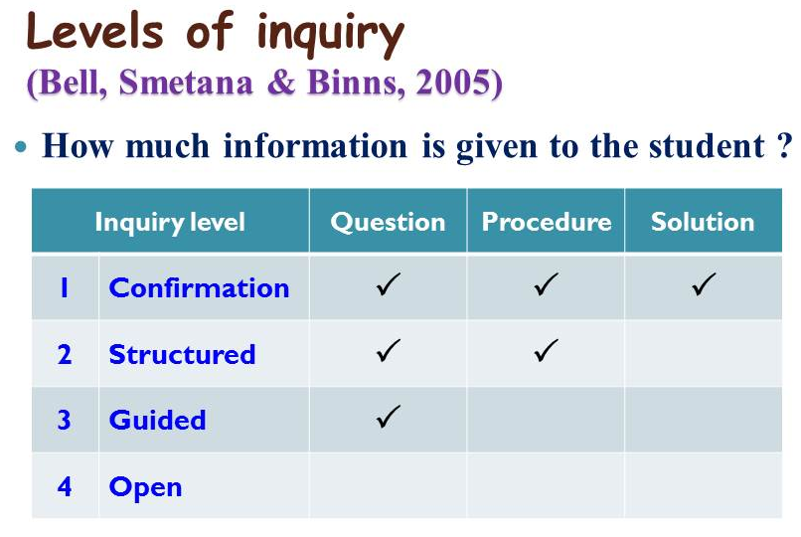
Pedagogy
College Labs
MS Thesis
PhD Chapt. 2?
PhD Chapt. 3?
Post-Doc.
Which activity did you find most instructive?
Which activity do you think would have the most lasting impact?
Does the order of the activities matter?
How would your age estimate change if ⁴⁰K “leaked” into the sample?

Slide 19
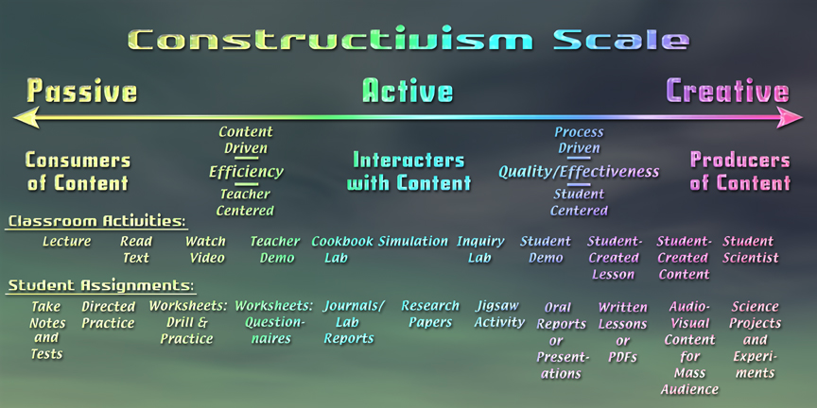
Pedagogy

Slide 20
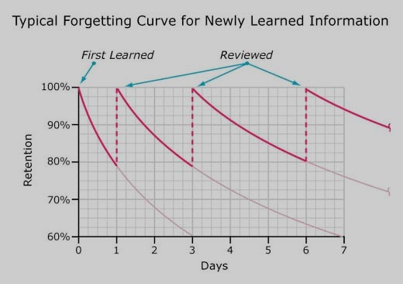
Pedagogy

Slide 21
Pedagogy
andragogy
What are the components of pedagogy?
What are the components of pedagogy?
Teacher
Mode of Instruction
- didactic/structured
Mode of Instruction
- experiential learning
Knowledge
Skills
Learner

Slide 22
Pedagogy
andragogy
What are the components of pedagogy?
 | PEDAGOGY | ANDRAGOGY
Learner | The learner is dependent on the instructor Teacher is responsible for how/what is taught Teacher evaluates the learning | Learner self-directed/ independent Learner responsible for the learning Self-evaluation is seen
Learner's experience | Method is didactic | Method used is problem solving, discussion, service-learning
Readiness to learn | Standardized curriculum based on societal needs | Curriculum is more application based and it revolves around life
Orientation to learning | Process of acquiring subject matter | Performing tasks and solving problems
Motivation | Motivated by external pressure - competition for grades | Driven by internal motivation - self-fulfillment, self-confidence

Slide 23
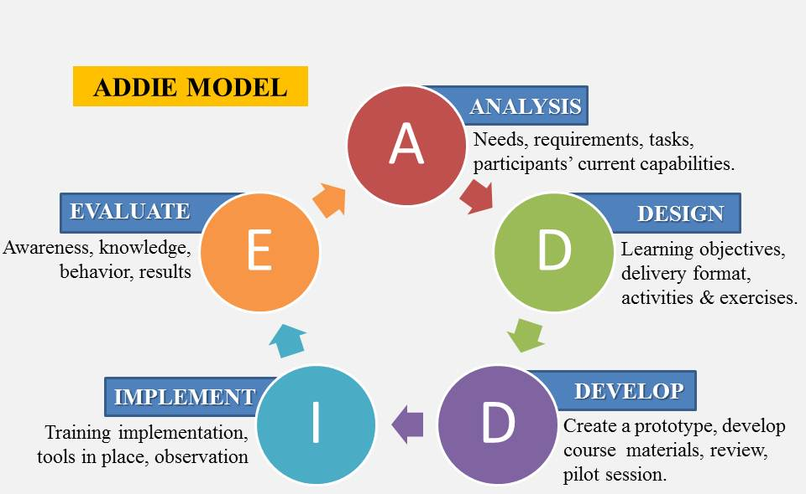
Instructional Design
To Build a Course…..

Slide 24
Instructional Design
To Build a Course…..
Concept Mapping……create a sandwich
What are the parts of a sandwich?
Meat
Bread
Cheese
Filling
Wrapper
Spreads
Wraps
Rolls
Pickle
Condiments
Relish
Butter
Mayo
Mustard

Slide 25
Instructional Design
To Build a Course…..
Concept Mapping……create a sandwich
What are the parts of a sandwich?
How are they related?
Meat
Bread
Cheese
Filling
Wrapper
Spreads
Wraps
Rolls
Pickle
Condiments
Relish
Butter
Mayo
Mustard

Slide 26
Instructional Design
To Build a Course…..
Concept Mapping……create a sandwich
What are the parts of a sandwich?
How are they related?
What is the relative importance (essential, useful, luxury)?
Meat
Bread
Cheese
Filling
Wrapper
Spreads
Wraps
Rolls
Pickle
Condiments
Relish
Butter
Mayo
Mustard

Slide 27
Instructional Design
To Build a Course…..
Concept Mapping……create a sandwich
What are the parts of a sandwich?
How are they related?
What is the relative importance (essential, useful, luxury)?
What can you assume as prior knowledge?
Meat
Bread
Cheese
Filling
Wrapper
Spreads
Wraps
Rolls
Pickle
Condiments
Relish
Butter
Mayo
Mustard

Slide 28
Instructional Design
To Build a Course…..
Concept Mapping……A GSO Core Course
What are the key concepts/skills?
How are they related?
What is the relative importance (essential, useful, luxury)?
What can you assume as prior knowledge?
Physical Oceanography
Geological Oceanography
Chemical Oceanography
Biological Oceanography
Get into your subdisciplinary group
Create a Concept Map of what is or what you feel should be
in your respective Core Course.
ID relative importance and assumed prior knowledge

Slide 29
Instructional Design
To Build a Course…..

Slide 30
Instructional Design
To Build a Course…..
Strategies
Learning Cycles
Just-in-Time
Flipped Classrooms

Slide 31
Instructional Design
To Build a Course…..
Learning Cycle Models
Focus
initial engagement
motivation to study topic
goals
FERA
Focus
Explore
Reflect
Apply
Explore
lectures
activities/labs
discussions
5e
Engage
Explore
Explain
Elaborate Evaluate
Reflect
summarize key points
make meaning of Explore
Apply
apply to new situation (What if?)
implications
do the students get it?

Slide 32
Instructional Design
To Build a Course…..
Learning Cycle Models - scalability
For a Concept
Focus: Radioactive Dating
Explore: Parent/Daughter Exploration
Reflect: What did you learn
Apply: What if stuff “leaks” in
For a Class
Focus: Biogenic Sediment Distributions
Explore: Ocean Circulation (upwellings)
Explore: Primary Productivity (nutrients)
Explore: Ocean Chemistry (CCD)
Reflect: What patterns do we see?
Apply: Future or past considerations
For a Course
Focus: Can Narrow River can support aquaculture?
Explore: Collect & analyze relevant data
Reflect: Review data and site selection criteria
Apply: What if storm or dredging occurs.

Slide 33
Instructional Design
To Build a Course…..
Just-in-Time Model
Pre-Class
Students complete reading or other preparatory work & assignments
Teacher reviews pre-class assignments, and adjusts lecture
During Class
Teacher references pre-class assignments during class
Students engage in discussion of the material with the teacher and students
Post Class
- Teacher creates/adjusts next pre-class assignment to best meet students' needs in light of progress made during class.

Slide 34
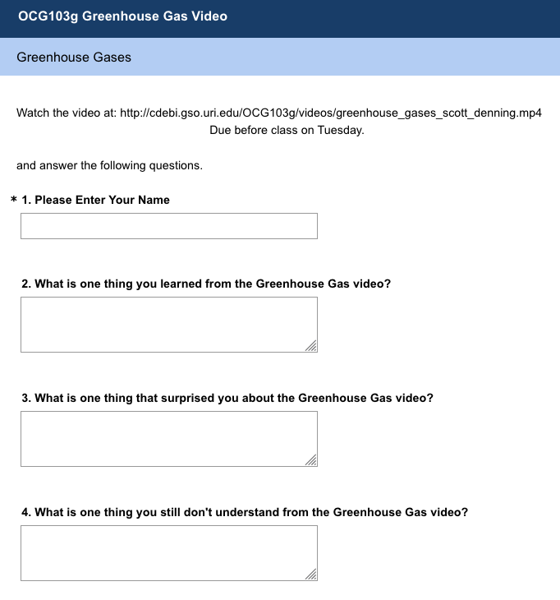
Instructional Design
To Build a Course…..
Just-in-Time Model

Slide 35
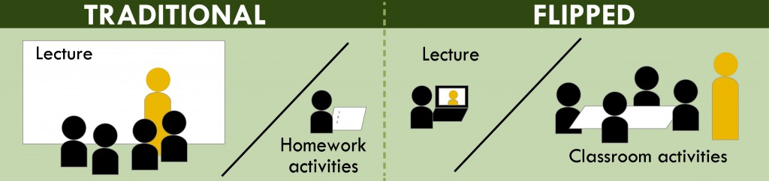
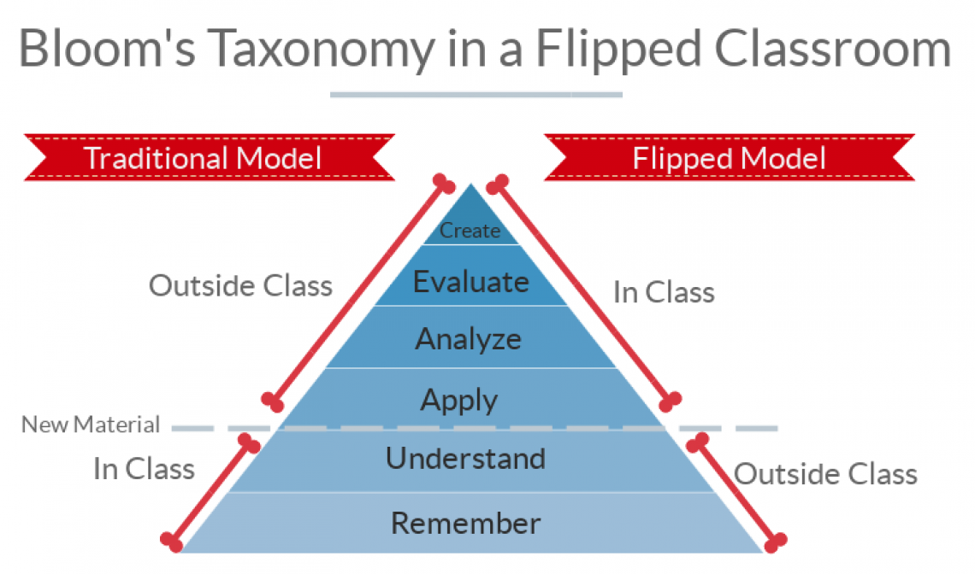
Instructional Design
To Build a Course…..
Flipped Classroom
Pro’s & Con’s

Slide 36
Instructional Design
To Build a Course…..
Learning Cycle Models – scalability
Hybrid Models
Course
Focus
Explore
Reflect
Apply
F
E
R
A
F
E
R
A
J
i
T
T
F
E
R
A
F
E
R
A
J
i
T
T
F
E
R
A
F
L
I
P
F
E
R
A
F
E
R
A
F
L
I
P
F
E
R
A
F
E
R
A
F
L
I
P
F
E
R
A
F
E
R
A
Class
F
E
R
A
F
E
R
A
F
E
R
A
F
E
R
A
F
E
R
A
F
E
R
A
F
E
R
A
F
E
R
A

Slide 37
Instructional Design
To Build a Course…..

Slide 38

http://cdebi.gso.uri.edu/workshops/March_2019.pptx

